Slide 1
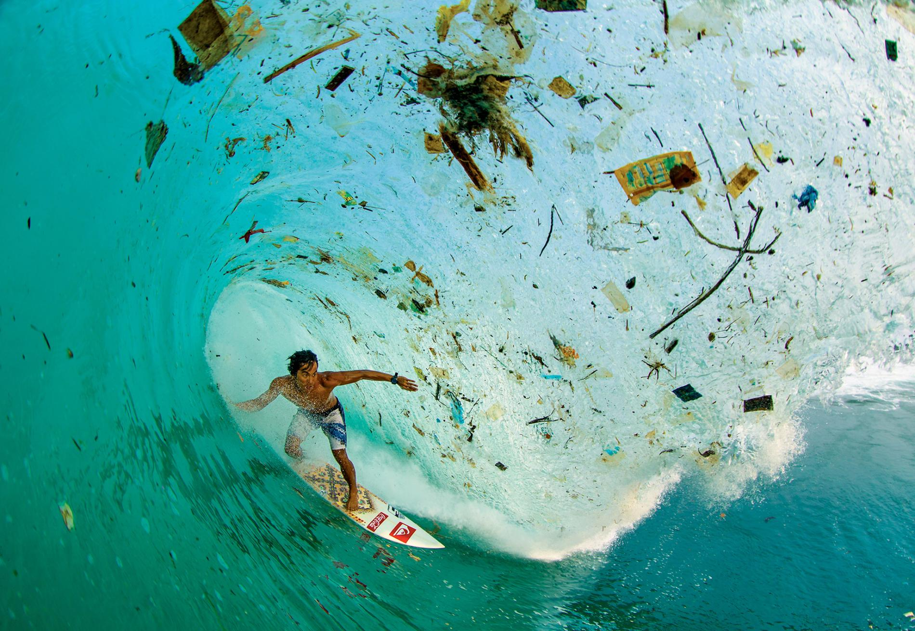
Ocean Pollution Management

Slide 2

Who is Boyan Slat?
What did he do at your age?

Slide 3
Syllabus Link
Strengths and weaknesses of initiatives to manage ocean pollution, including local and global strategies for radioactive materials, oil and plastic waste

Slide 4
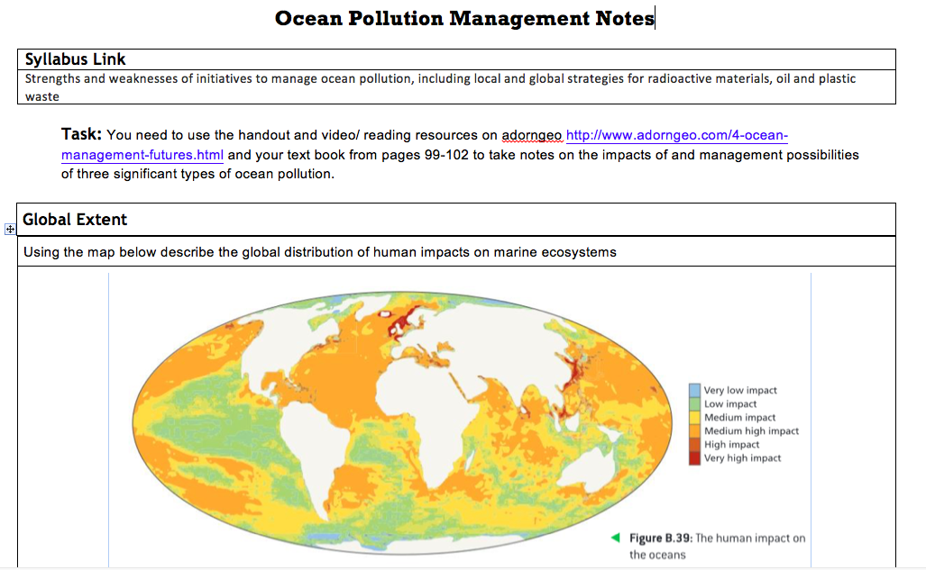

Slide 5
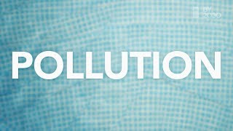

Slide 6
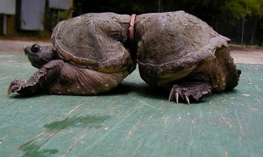
Starter: Look at the following images and identify the type of waste, the cause and consequence.

Slide 7
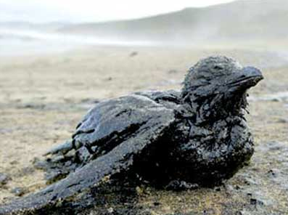
Starter: Look at the following images and identify the type of waste, the cause and consequence.

Slide 8
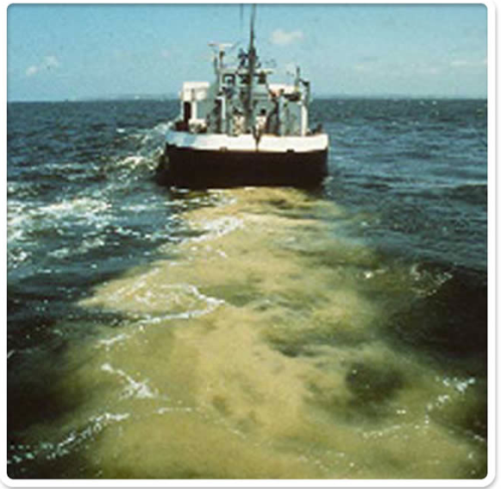
Starter: Look at the following images and identify the type of waste, the cause and consequence.

Slide 9
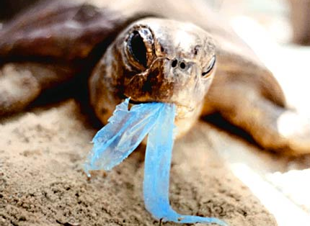
Starter: Look at the following images and identify the type of waste, the cause and consequence.

Slide 10
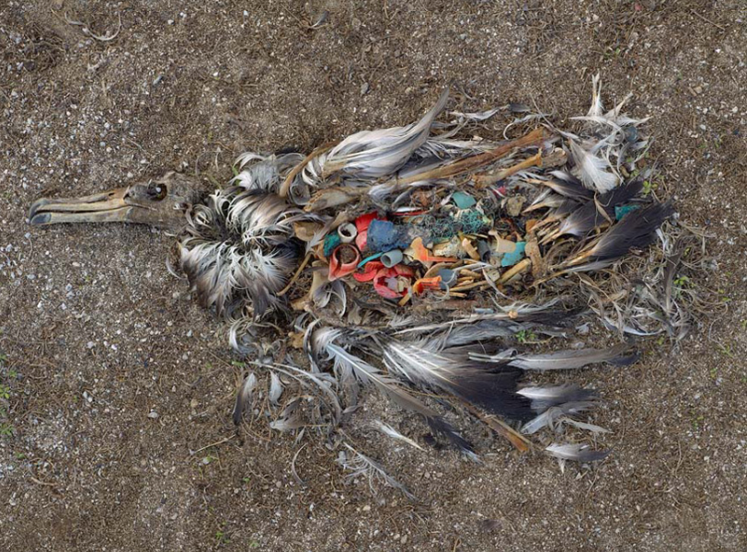
Starter: Look at the following images and identify the type of waste, the cause and consequence.

Slide 11
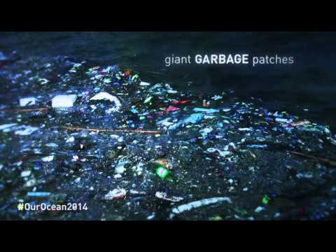

Slide 12
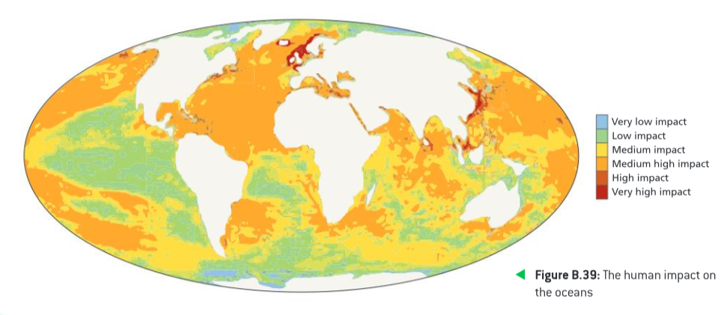
Human impacts on marine ecosystems
(Source: National Centre for Ecological Analysis and Synthesis)

Slide 13
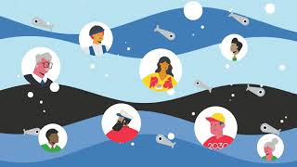
Understand & Beat Marine Pollution

Slide 14
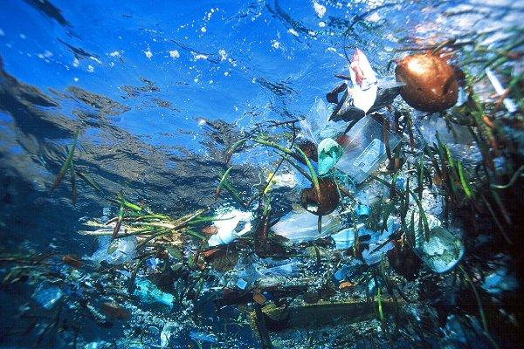
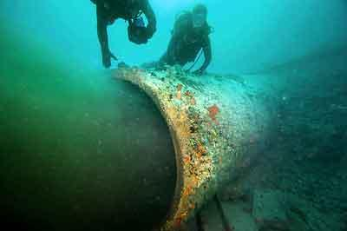
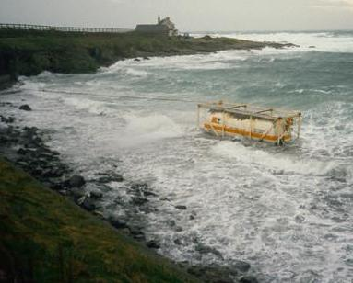
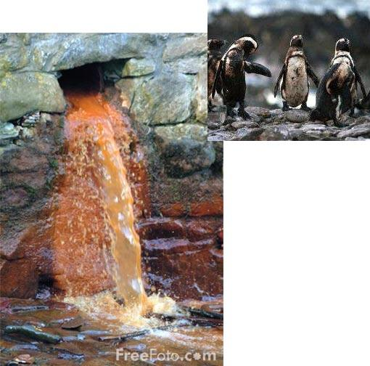
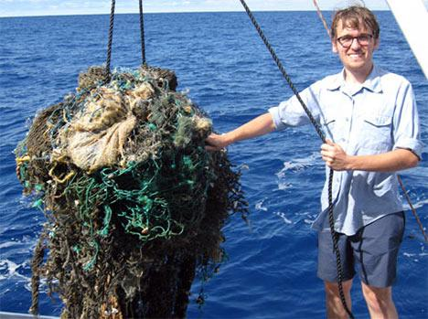
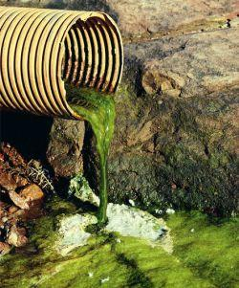
Where does the waste in the oceans come from?

Slide 15
Where does the waste in the oceans come from?
Inorganic waste,
e.g. Radioactive or chemical waste
Oil and gas industries
Fishing industries
Shipping industries
Flooding and overflowing storm drains
Human waste, e.g. Household garbage, factory wastes, sewage, waste water from bathing, plastics etc.
Toxic waste dumping (poisonous materials dumped into the oceans)
Agricultural waste, e.g. Chemicals, pesticides, fertilisers

Slide 16
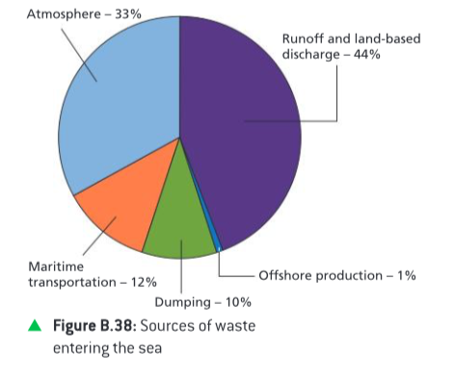
Sources of pollutants from human activities entering the sea (Source: UNEP)
Approximately 80% of all ocean pollution comes from land based activities.

Slide 17
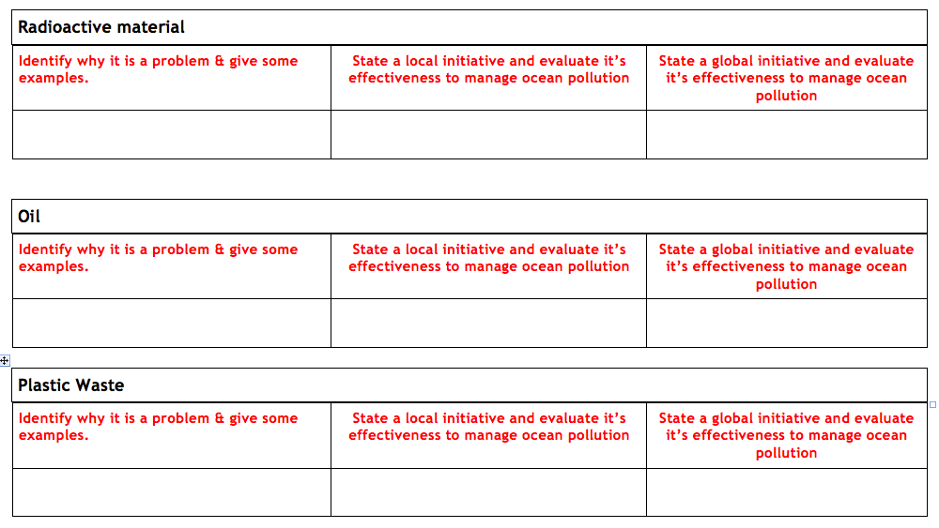

Slide 18
Managing Radioactive Waste
Initially walls of frozen soil were used to contain the contaminated water at the Fukushima nuclear power plant in Japan when it exploded in 2011.
Advantages | Disadvantages
Cheap | Temporary
Quick | Water eventually goes into the groundwater supply and could contaminate more areas.
Effective in short term

Slide 19
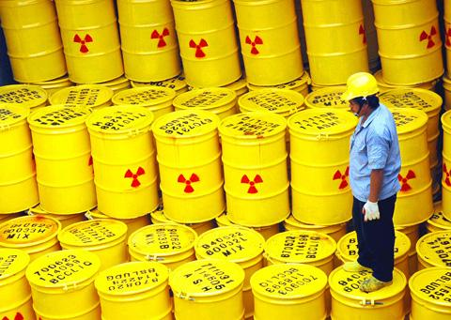

Slide 20
2. Filtering out the radioactive material from the water. This can be done through several methods:
Activated carbon filter-contains gaseous radioactive material which comes out of water vapour.
Ion exchange filter-removes ionizing radioactive elements.
Reverse osmosis- using a semi-permeable membrane and application of pressure.
Advantages | Disadvantages
Effective at removing most of the radioactive material. | Cannot remove all radioactive material.
https://youtu.be/r7NsDZRNhOM | Radioactive sludge is left behind on the filters which then is stored in big containers which are quickly filling up with no plan of where to put them.
Advances science and research. | All clothing that is worn by workers is disposed of at the end of their shift. These also have to be stored.
Notes:
http://all-about-water-filters.com/filtering-radioactivity-from-water-future-for-fukushima/
https://www.nytimes.com/2017/03/11/world/asia/struggling-with-japans-nuclear-waste-six-years-after-disaster.html

Slide 21
Managing Plastic Waste
4Oceans-small businesses working towards cleaning up plastic. https://www.youtube.com/watch?v=U0P6P2_iVOM
Advantages | Disadvantages
Raises awareness on social media and amongst the younger generation to think about their plastic usage. | Small scale. Unlikely to have a huge impact.
Local communities can get involved in clean ups. | Branding shows that they are more about making a profit than cleaning up the oceans.
Expanding globally but mostly working on a local scale so far.

Slide 22
2. Floating barrier: Ocean Clean Up
Advantages | Disadvantages
Very successful and effective method at cleaning up large areas. | Cannot clean up micro-plastics (less than 4mm).
Doesn’t affect wildlife. | Ships are needed to go and collect the plastic-increases CO2 emissions.
Uses clean energy (solar and tidal) to operate. | Hasn’t quite got all the funding required yet.
https://www.youtube.com/
Sea bins

Slide 23
3. Ban on micro-plastics: UK Government
http://www.independent.co.uk/environment/microbeads-ban-bill-uk-cosmetic-products-government-outlaws-microplastics-a7852346.html
Advantages | Disadvantages
Forces companies to rethink their products. | Only in the UK so far. Might not have a large impact.
Makes other countries consider following in the same path.
Stops billions of microbeads entering our seas annually.

Slide 24
Exam Question
Explain three consequences of oil pollution in oceans. (2+2+2)

Slide 25
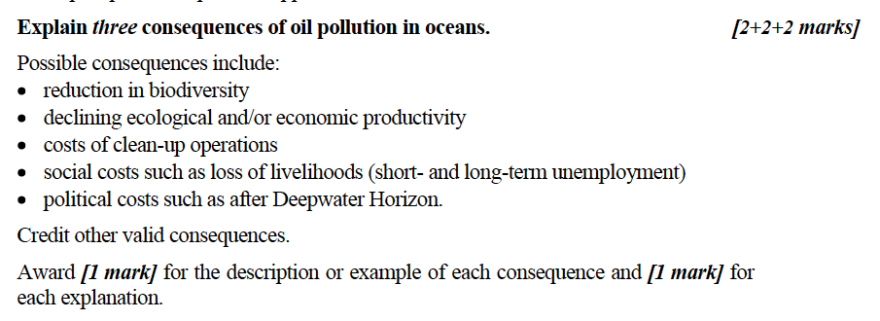
Mark Scheme

