Slide 1
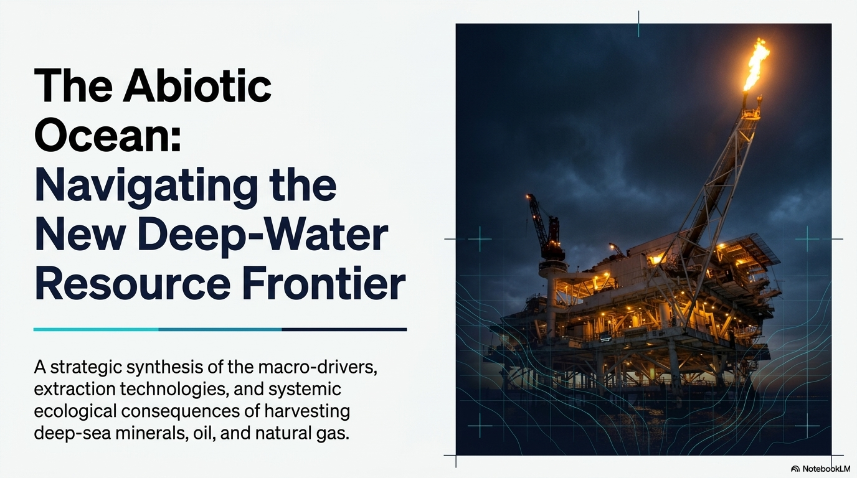

Slide 2
Syllabus Link
Causes and consequences of increasing demand for the abiotic resources of oceans, including minerals, oil and gas

Slide 3
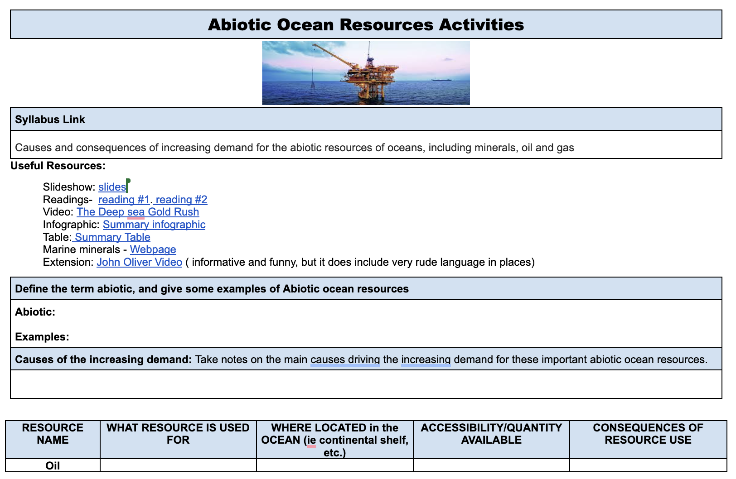
Activities
Use the resources provided to complete the activities on this work/ note sheet.

Slide 4
Introduction
Together, abiotic and biotic factors make up an ecosystem.
Abiotic factors are the non-living parts of an environment.
Biotic factors are the living parts of an environment, such as plants, animals and microorganisms.

Slide 5
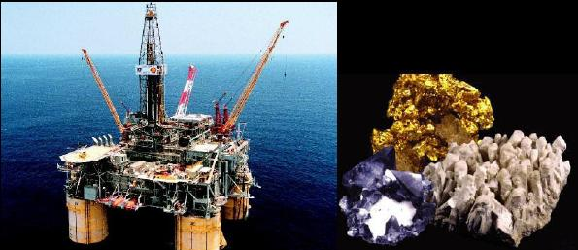
Examples of Ocean Abiotic Resources
Energy:
Oil and Natural Gas
Wave/Tidal Energy
Minerals: Gold, Copper, Diamond, Magnesium
Other:
Geothermal,
Methane Hydrates
Polymetallic nodules
Salt, water (desalinization)
Sand

Slide 6
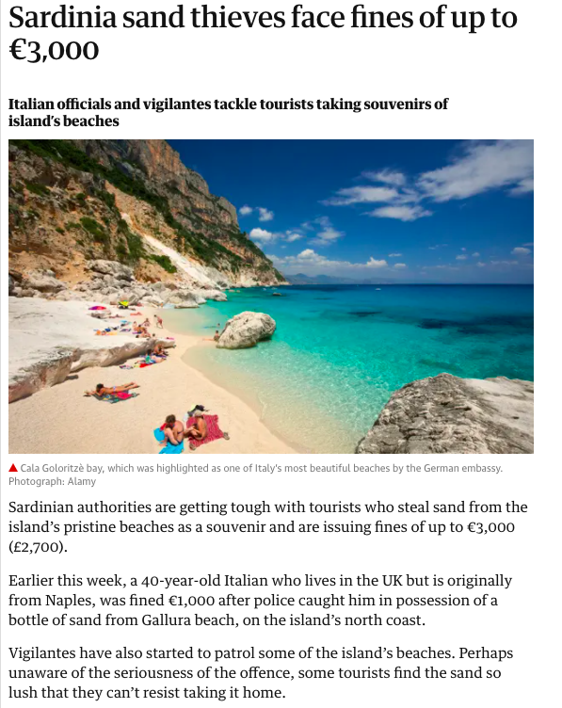
Tourism Tie In

Slide 7
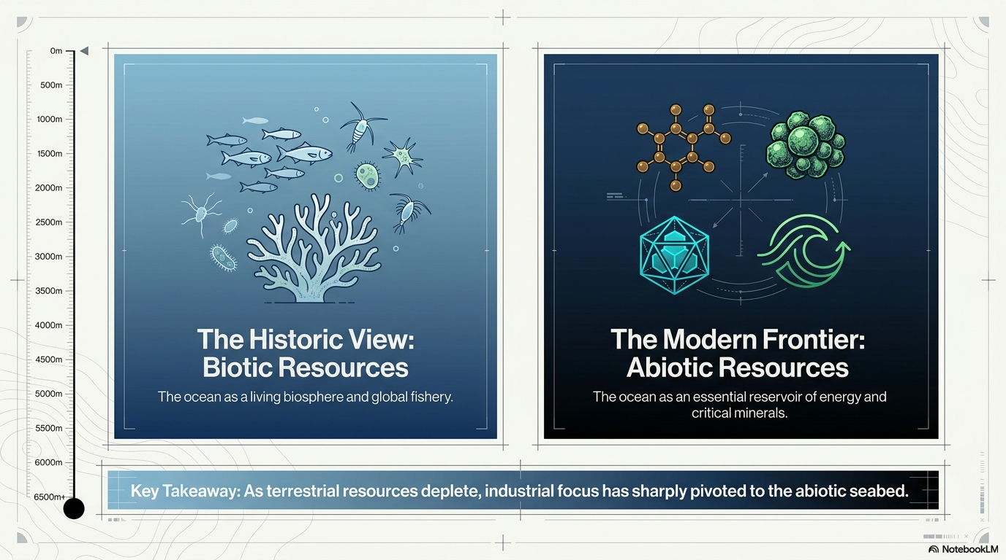

Slide 8
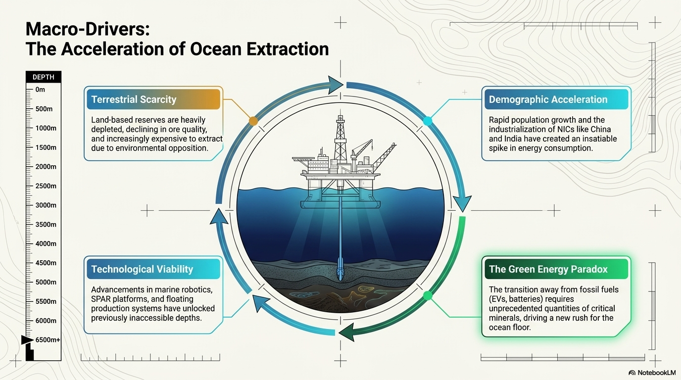

Slide 9
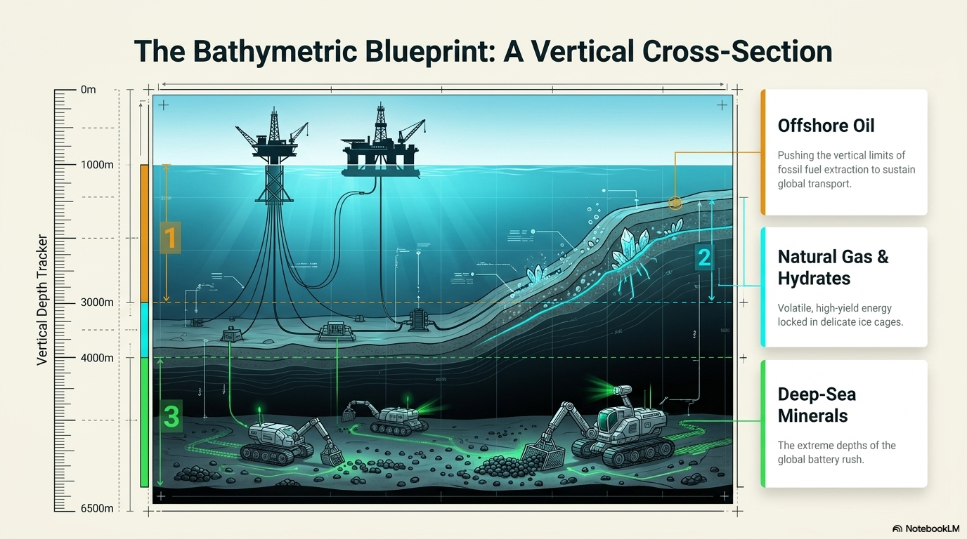

Slide 10
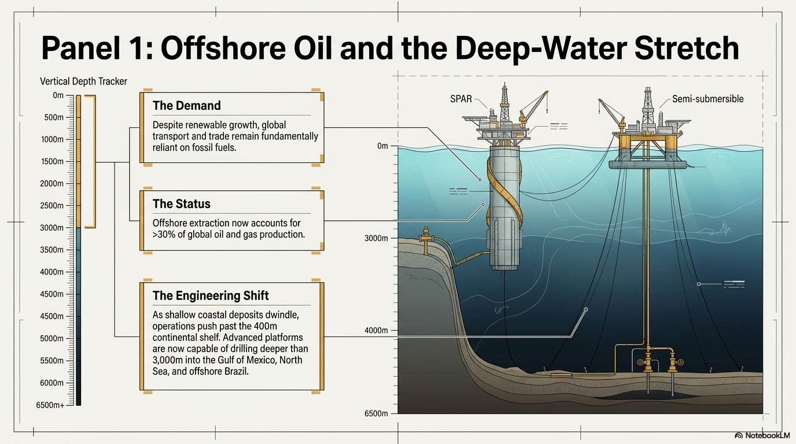

Slide 11
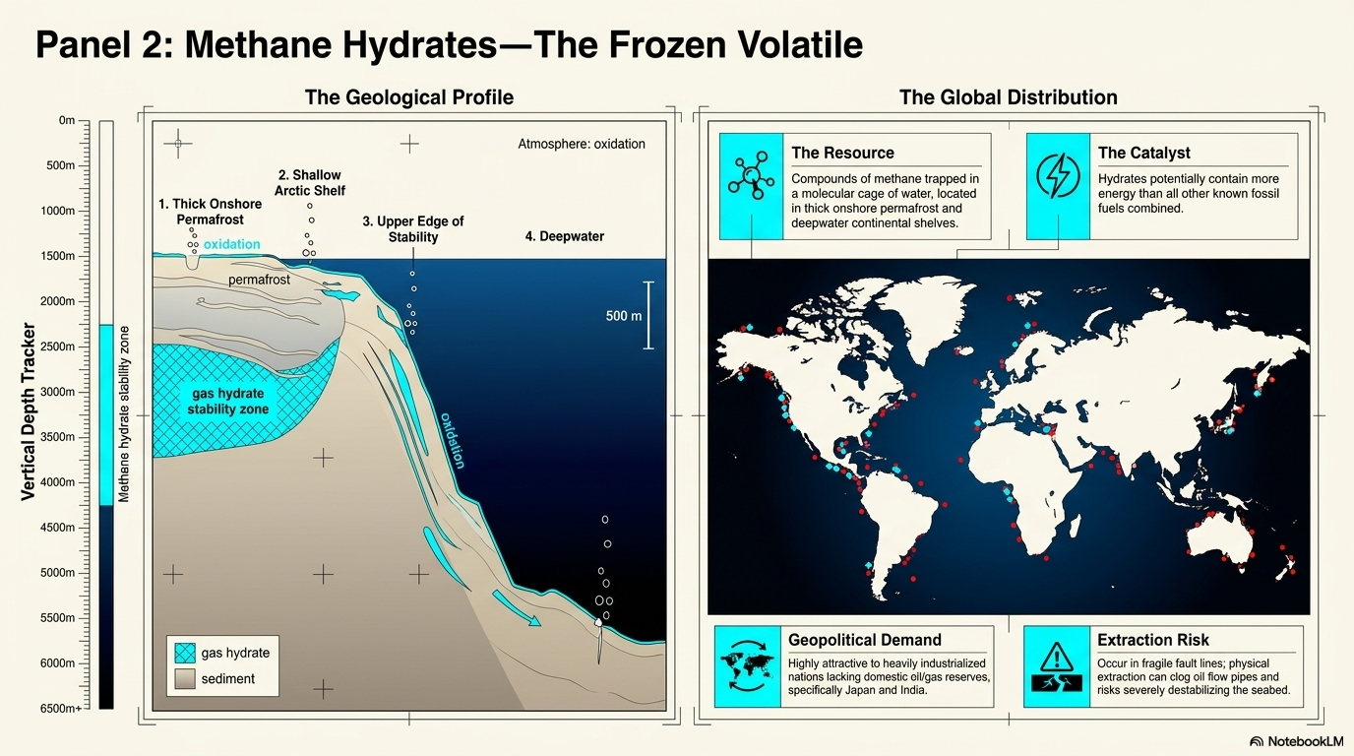

Slide 12
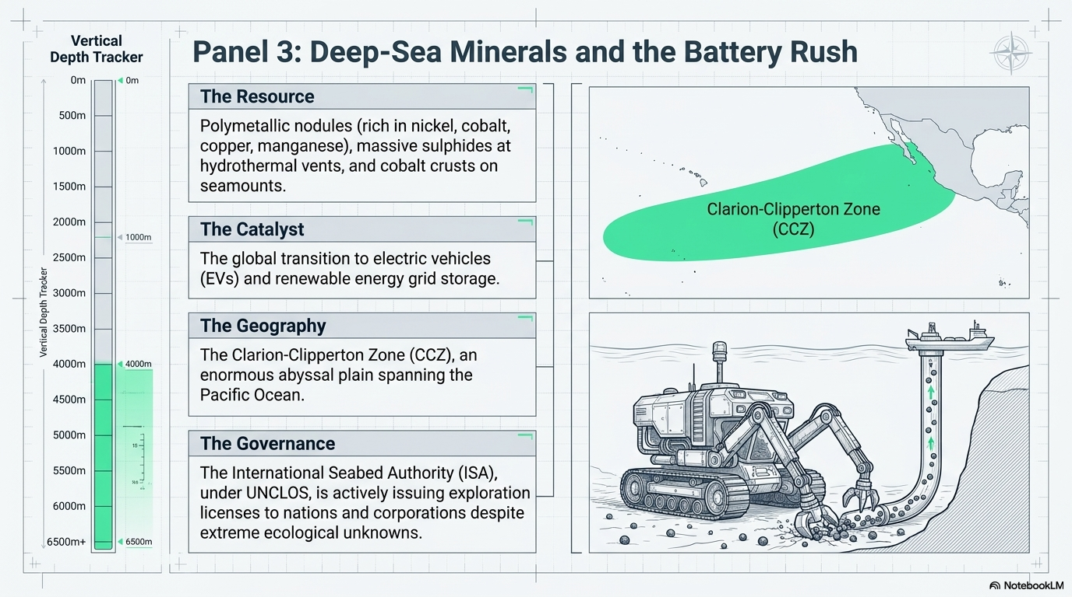

Slide 13
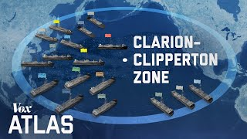
Video: The Race to mine the bottom of the ocean

Slide 14
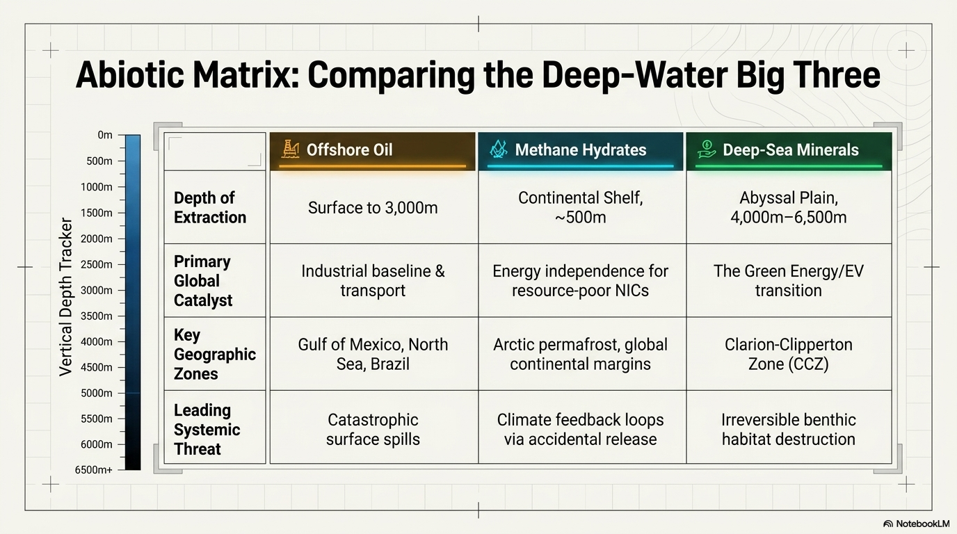

Slide 15
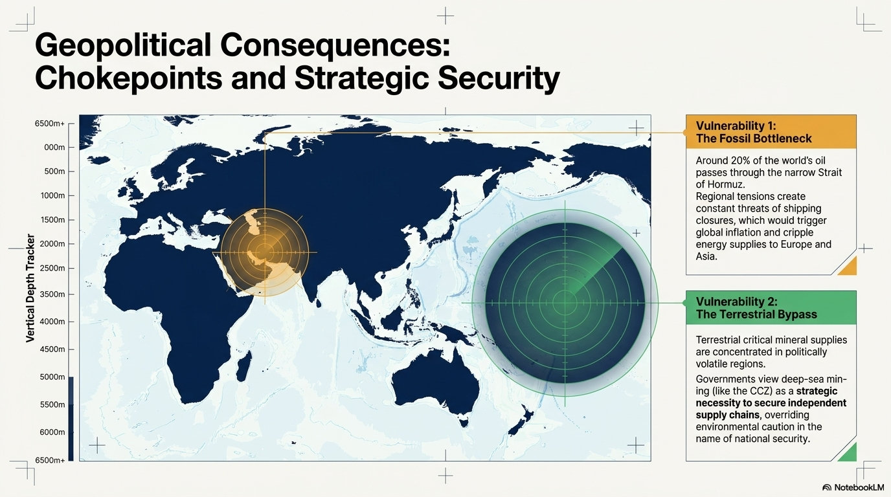

Slide 16
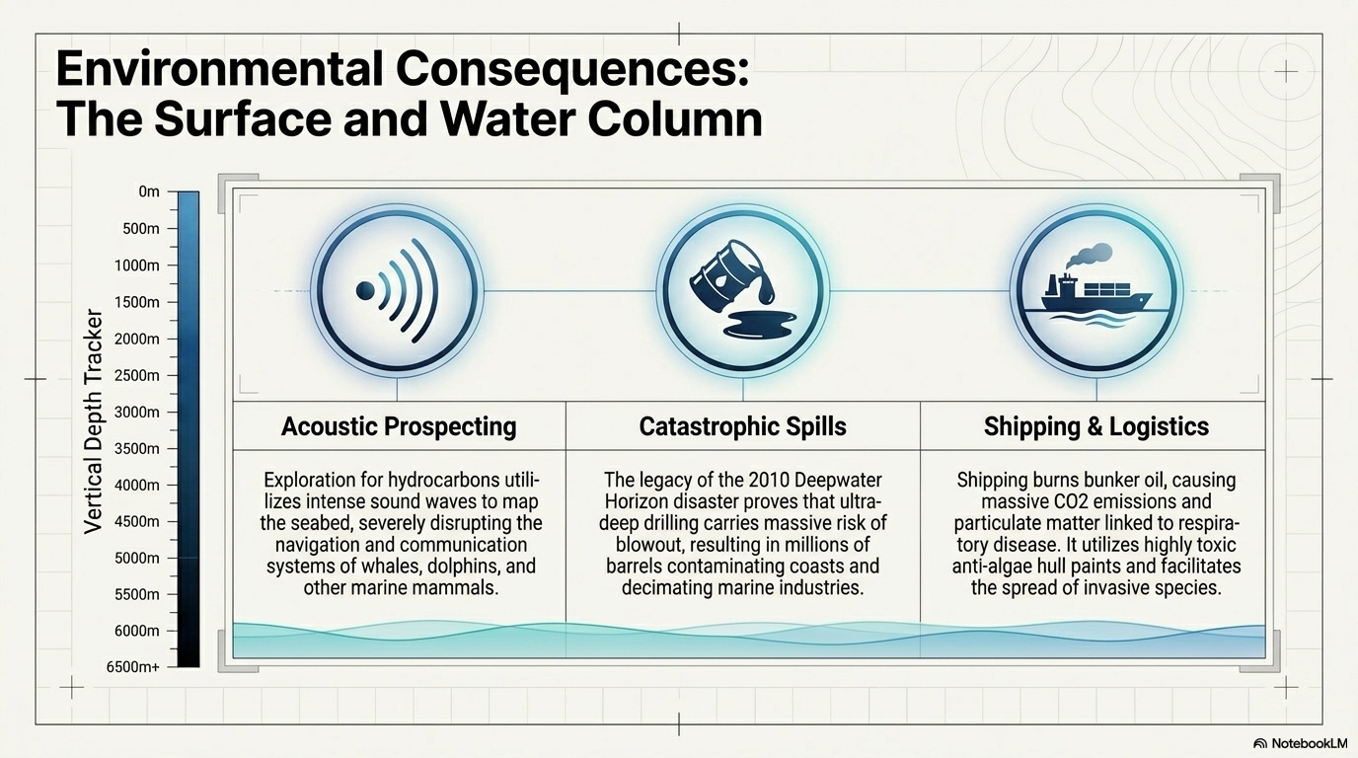

Slide 17
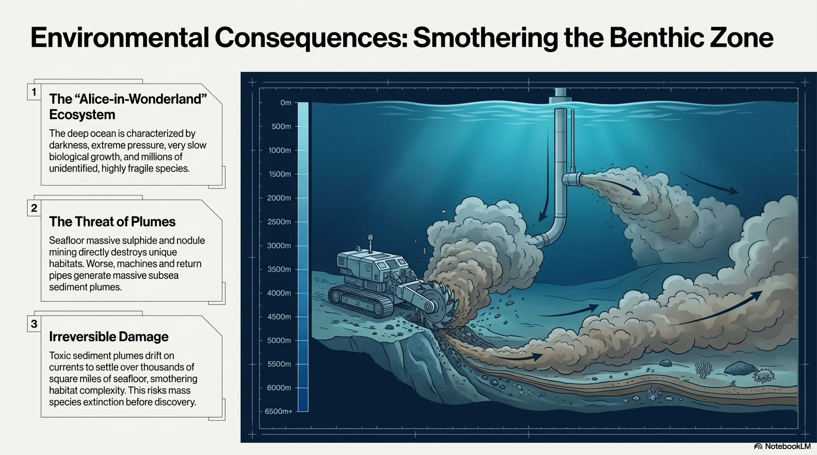

Slide 18
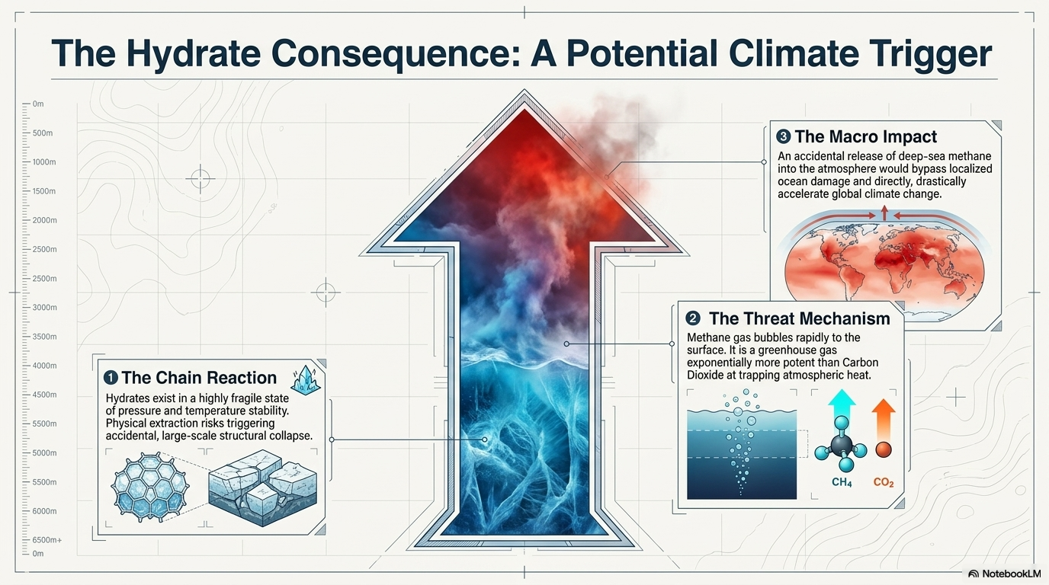

Slide 19
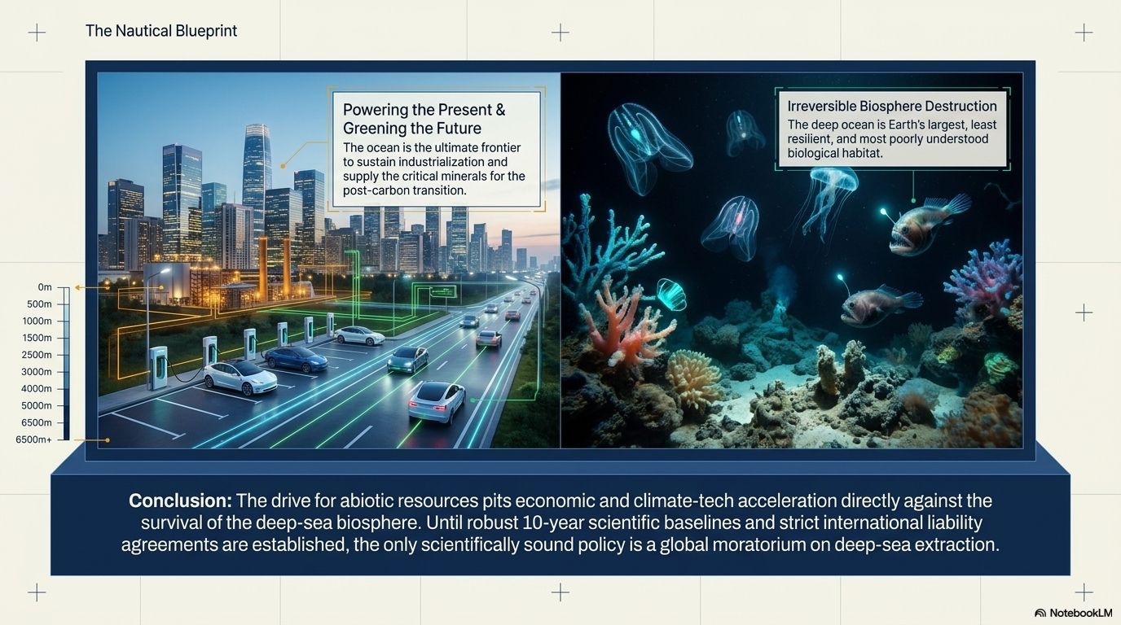

Slide 20
