Slide 1
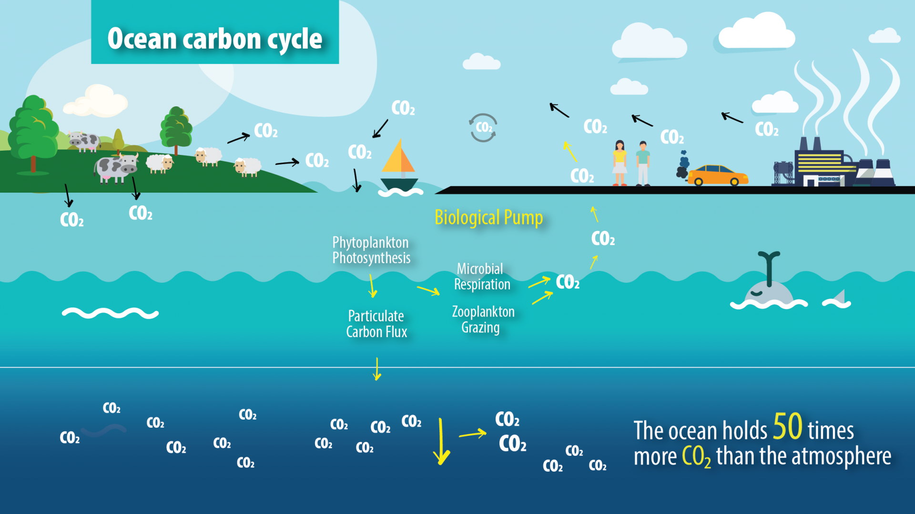
The Oceans and Carbon

Slide 2
Syllabus Link
The changing role of oceans as a store and source of carbon dioxide (CO2)
and
the impacts of ocean acidification on coral reefs

Slide 3

Intro to the Carbon Cycle

Slide 4
Carbon Dioxide and Carbon Sinks
Carbon dioxide (CO2) Carbon dioxide is a gas. It occurs naturally and is also a by-product of human activities such as burning fossil fuels. It is the principal greenhouse gas produced by human activity.
Carbon sink Any process, activity or mechanism that removes carbon from the atmosphere. The biggest carbon sinks are the world's oceans, forests and soils, which absorb large amounts of carbon dioxide from the Earth's atmosphere.

Slide 5
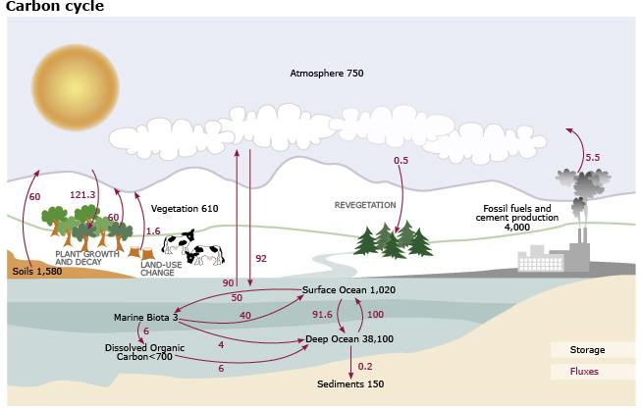

Slide 6
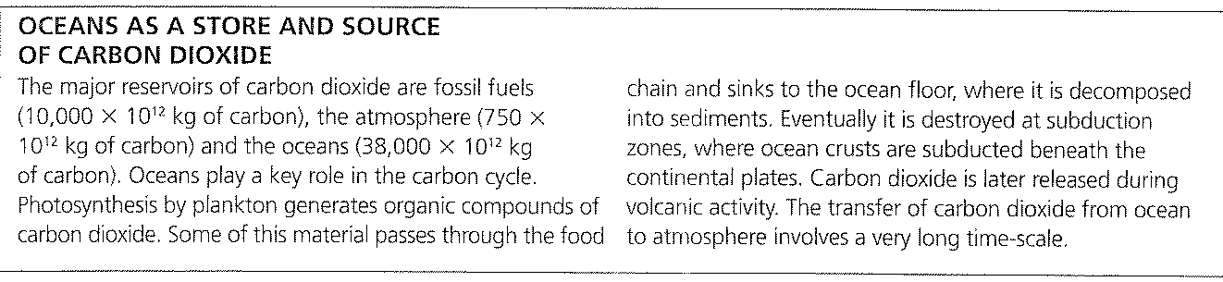
This carbon cycle diagram shows the storage and annual exchange of carbon in gigatons - or billions of tons - of Carbon (GtC). Burning fossil fuels by people adds about 5.5 GtC of carbon per year into the atmosphere.

Slide 7
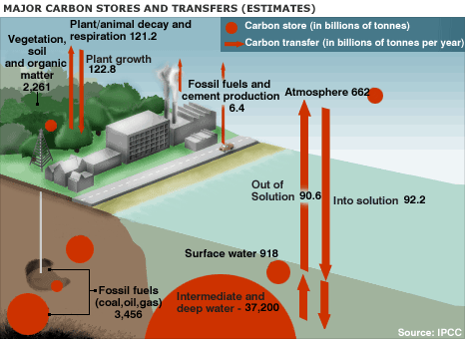

Slide 8
The Distribution of CO2 in the Oceans
The spread of carbon dioxide in the world’s oceans is uneven.
Have a look at the map…
Can you think why there might be more carbon dioxide in some places than others?

Slide 9
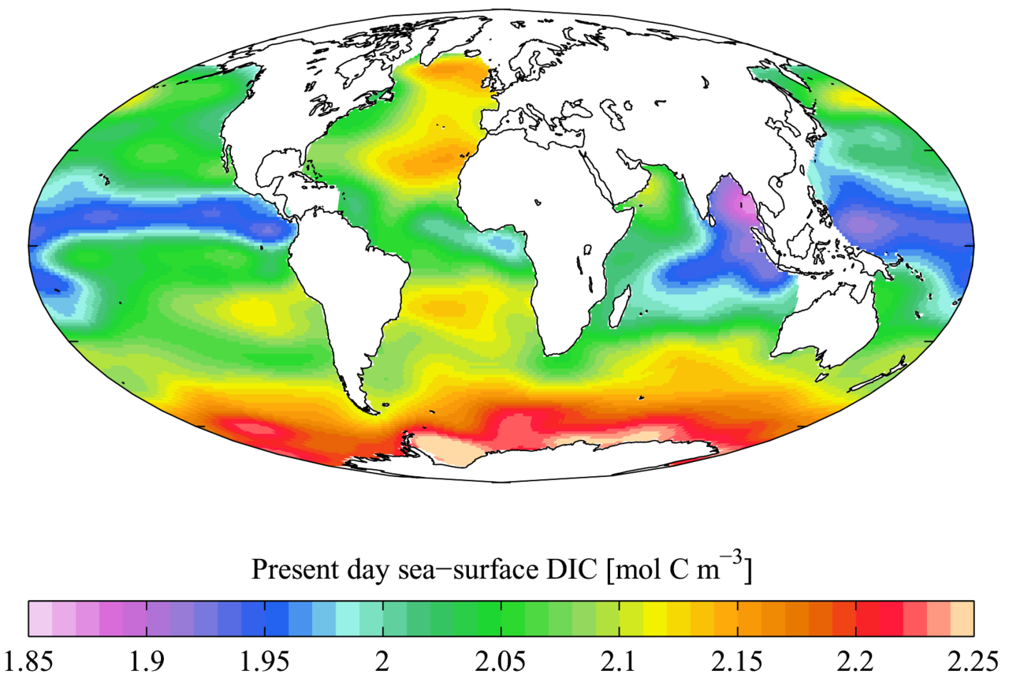
Global CO2 Solubility

Slide 10


Slide 11
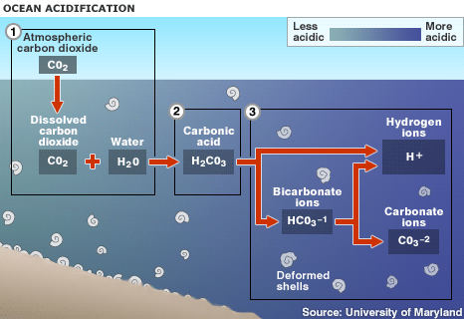

Slide 12
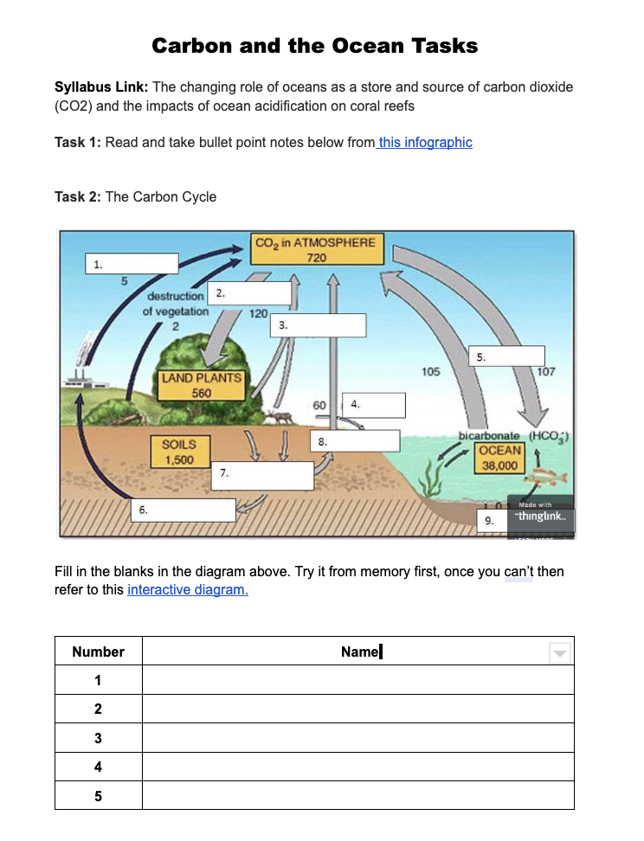
Activities
Complete tasks 1-3 on the task sheet.
Use the reading from Planet Geo and the hyperlinks to help you.

Slide 13
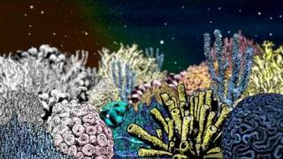
The impacts of ocean acidification on coral reefs

Slide 14
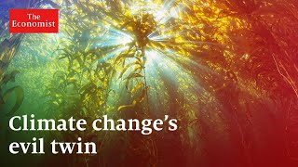
Video Activity: Edpuzzle

Slide 15
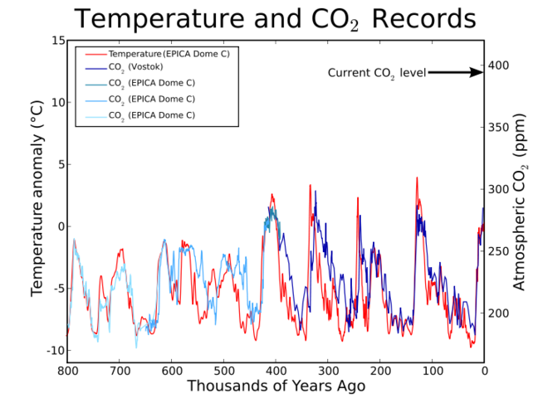
Exam Style Questions
What is the role of the OCB in the carbon cycle?
How is climate change going to affect the carbon cycle?

Slide 16

Exam Style Question
Task: Using the geofile and other articles complete the exam question.
Examine the role of oceans as a store and source of carbon dioxide. (10)
20 minutes

Slide 17
Examine the role of oceans as a store and source of carbon dioxide.[10]
The oceans account for an important share of the world’s carbon dioxide (fossil fuels 10000 × 1012 kg, atmosphere 750 × 1012 kg, and oceans 38 000 × 1012 kg). They also play an important role in the carbon cycle. Photosynthesis by phytoplankton forms organic compounds of carbon dioxide. Some of this passes through the food chain and sinks to the ocean floor where it accumulates in sediment. Eventually it is destroyed at subduction zones and later released during volcanic activity. It is a very long time-scale. Oceans also absorb and then store in solution carbon dioxide derived from the air. Candidates may look at spatial variations in oceans as a source (more in warmer, nutrient rich water) and stores.
To access band D candidates must explain both store and source (balance not necessary). At bands E and F, a structured examination of both store and source begins to address the role/importance of the oceans.
Marks should be allocated according to the mark bands.

