Slide 1
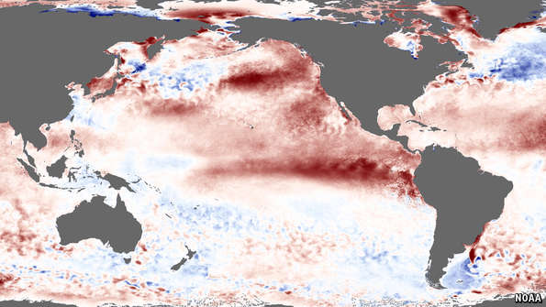
ENSO Cycles -
El Nino & La Nina

Slide 2
Syllabus Link
Atmosphere–oceanic interactions associated with El Niño–Southern Oscillation (ENSO) and La Niña cycles and their climatic, environmental and economic effects
Case Studies: Detailed examples of the geographic impacts of El Niño and La Niña

Slide 3
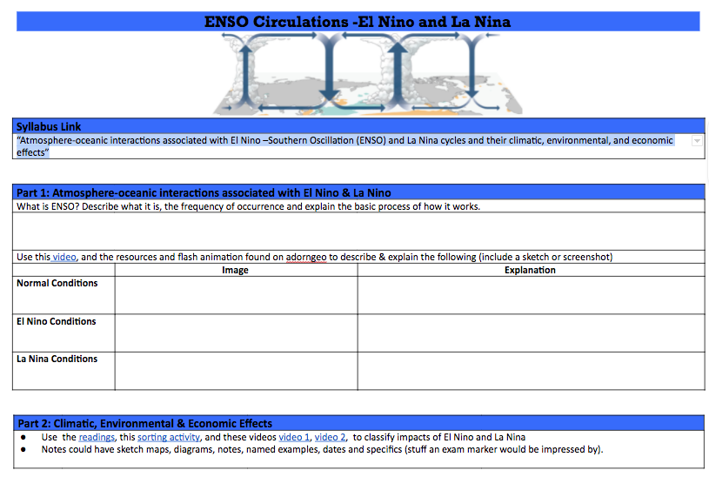
Note Sheet: Take notes on the sheet or digitally

Slide 4
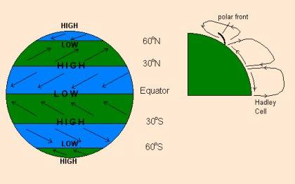
Atmosphere–Oceanic Interactions
General circulation and wind belts
Air moves from areas of high to low pressure

Slide 5
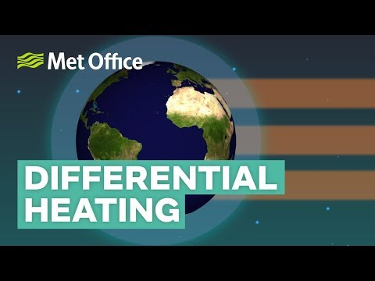
General circulation and wind belts
Air moves from areas of high to low pressure

Slide 6
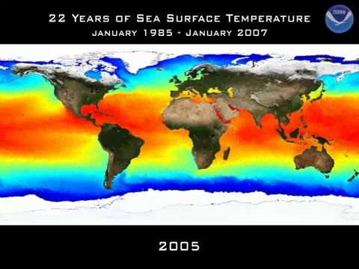

Slide 7
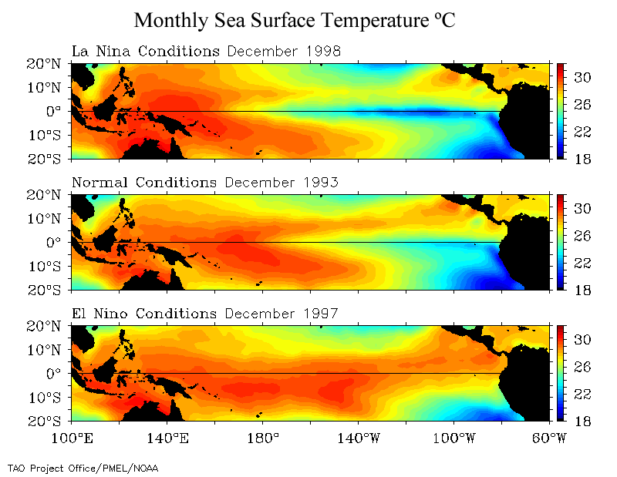
General circulation and wind belts
Air moves from areas of high to low pressure

Slide 8
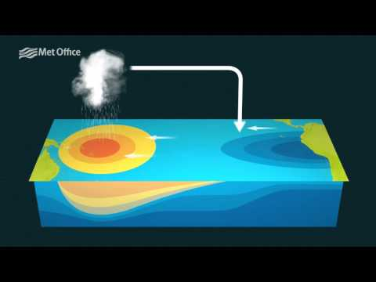

Slide 9
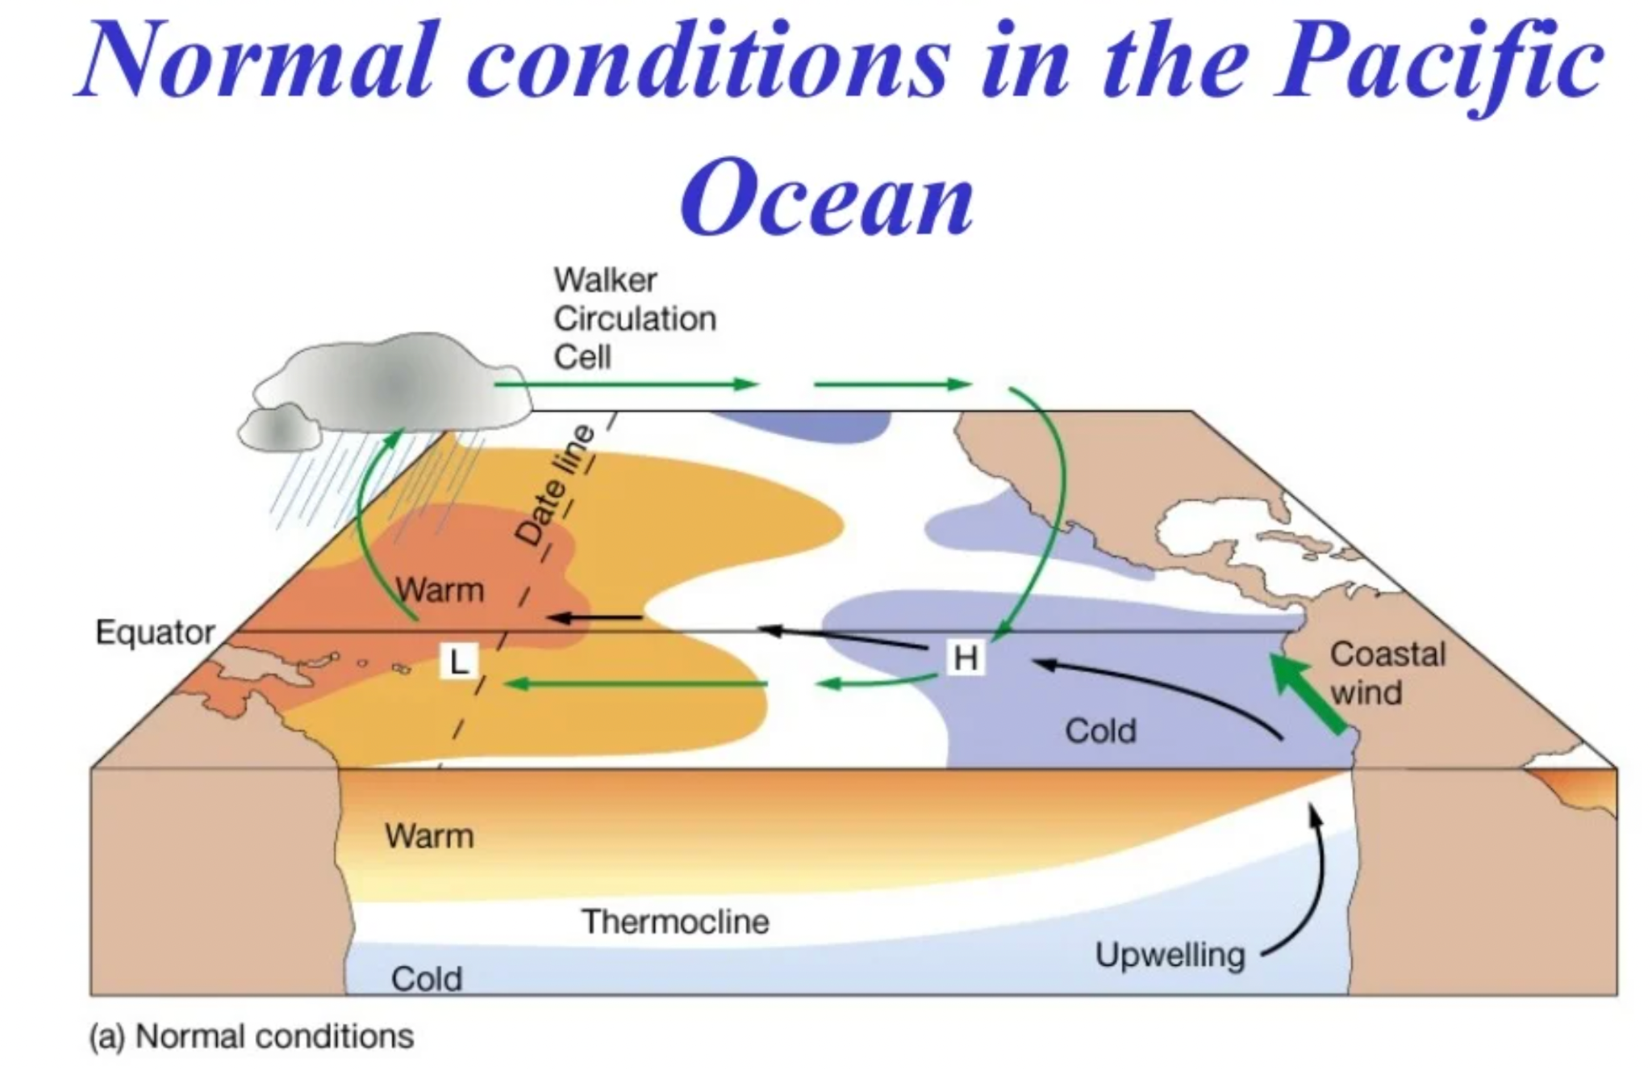

Slide 10
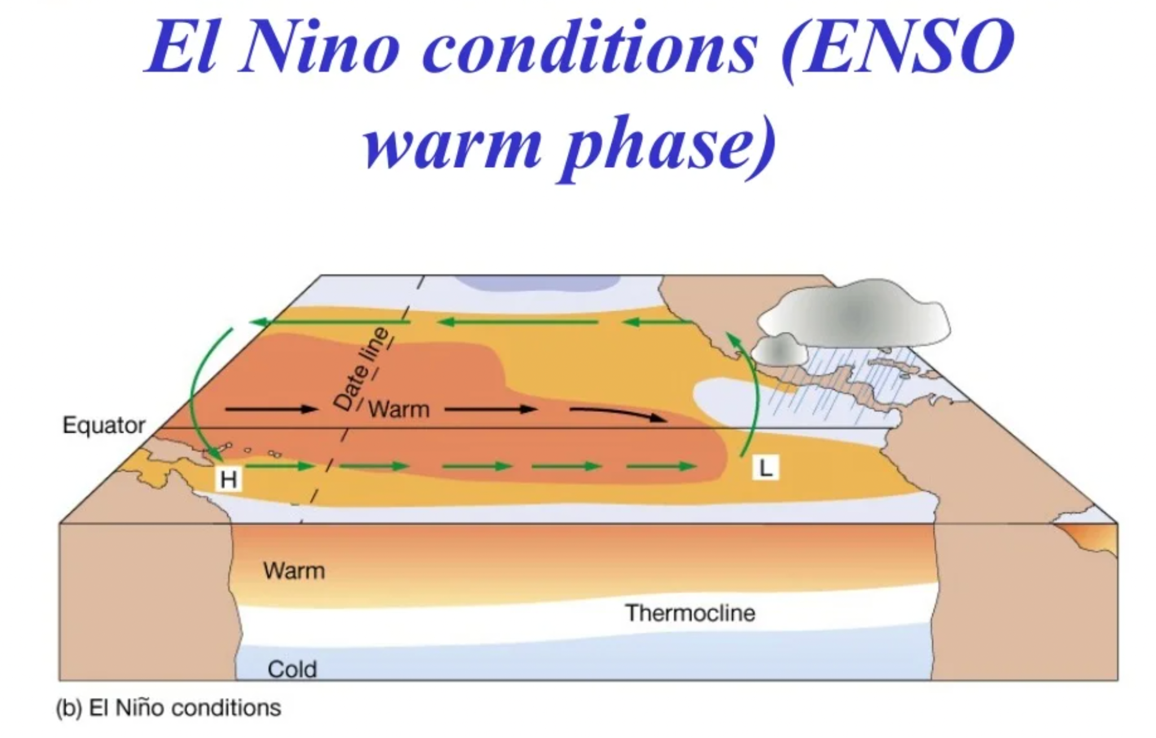

Slide 11
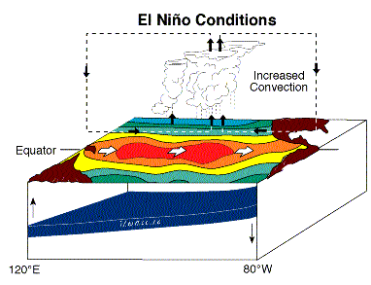
El Nino Event – Pacific Ocean
During an El Nino event the pressure systems and weather change
The trade winds weaken in the central and western Pacific and this causes the warm water in the west to travel eastwards
The thermocline deepens in the east and this reduces the efficiency of cold water upwelling
This affects the primary productivity

Slide 12
El Nino Event - Weather
In the west (Australia/Indonesia) the absence of warm water to heat the atmosphere will lead to dry stable weather conditions (drought/wildfires)
In the east (Ecuador/Peru) the warmer water will heat the atmosphere and lead to convectional uplift and unstable wet weather conditions (floods)

Slide 13
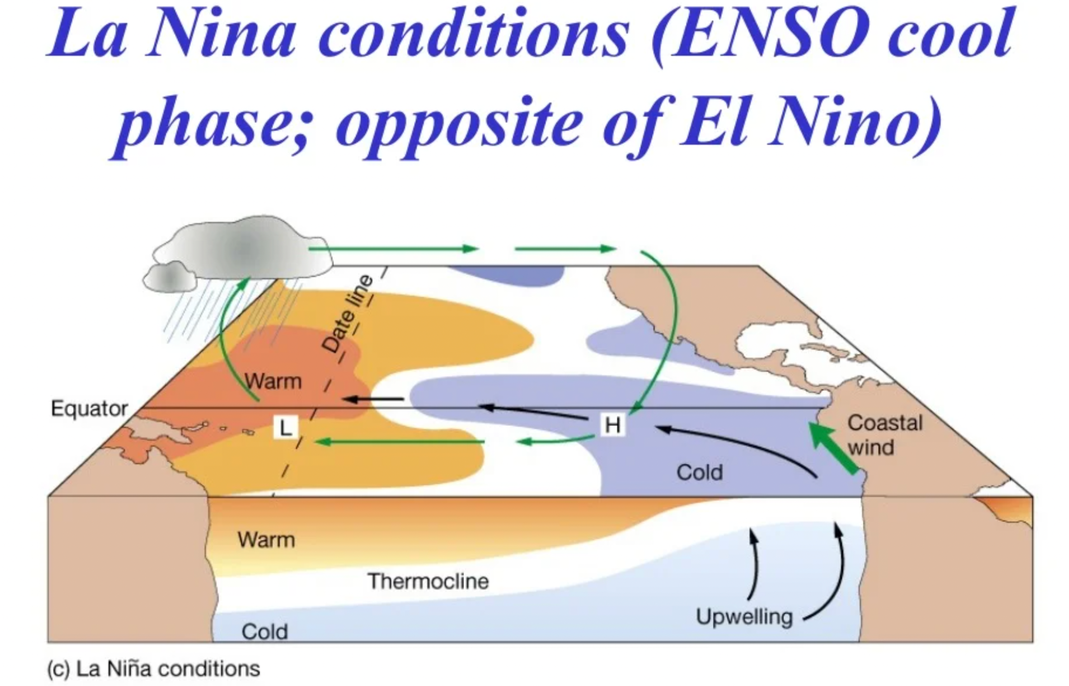

Slide 14
La Nina Event
As the influence of an El Nino event decreases and conditions return to normal occasionally a third weather condition develops – La Nina
This is an exaggerated version of the normal conditions where so much warm water has traveled west that intensive rainfall creates flooding in Australia/Indonesia and intensive droughts occur in Ecuador/Peru

Slide 15
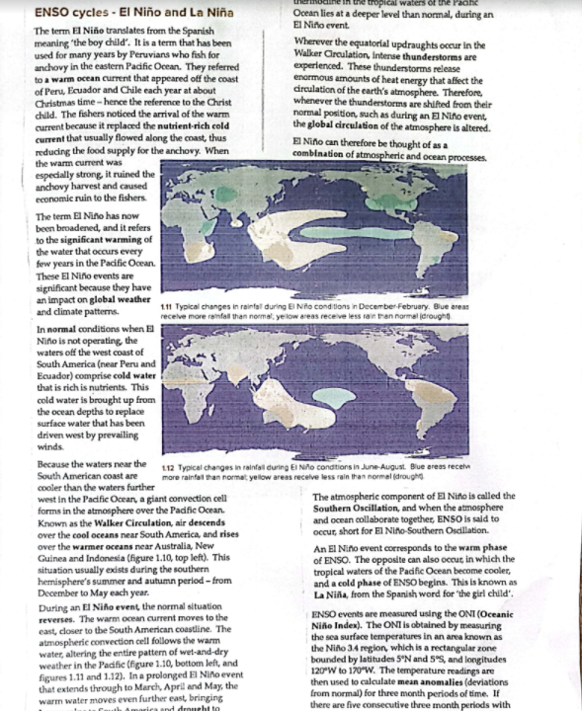
Reading on the Physical Processes
Read and take notes on the ENSO cycle and it’s different phases

Slide 16
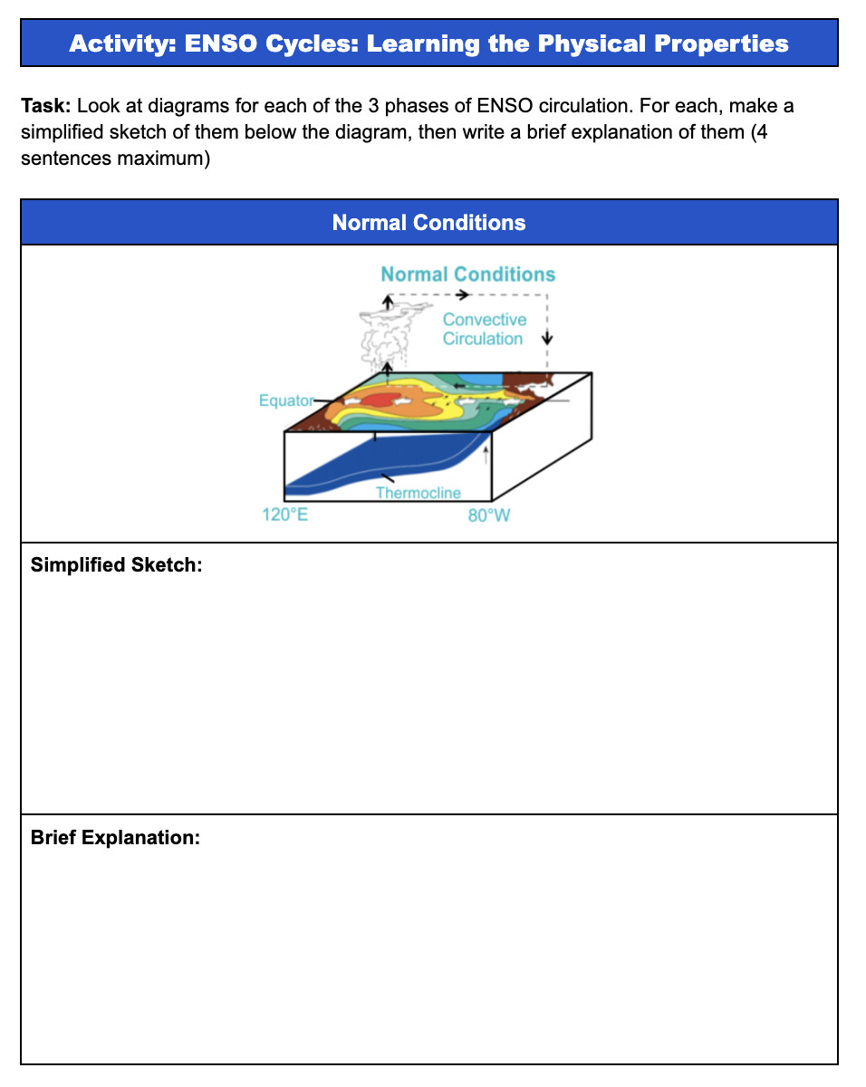
Reading on the Physical Processes
Now complete a simplified sketch and a brief description of each of the 3 phases of ENSO.

Slide 17
Consequences
Atmosphere–oceanic interactions associated with El Niño–Southern Oscillation (ENSO) and La Niña cycles and their climatic, environmental and economic effects
Case Studies: Detailed examples of the geographic impacts of El Niño and La Niña

Slide 18
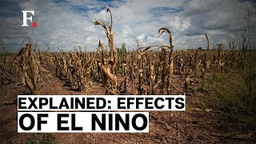
Geographic Impacts

Slide 19
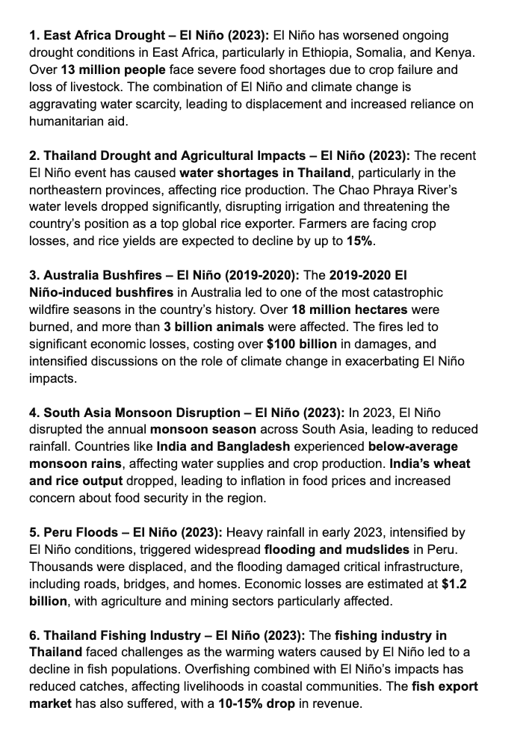
Geographic Impacts
You will be assigned an impacts card. You are going to share your impact class with the rest of the class.
Please take notes on the note taking doc/ map.

Slide 20
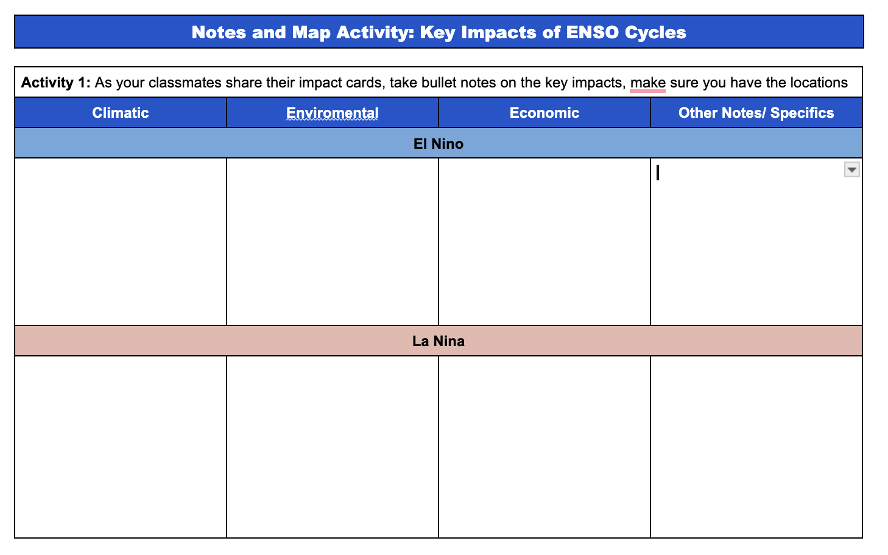
Geographic Impacts
Take notes on the climatic, environmental and economic impacts.
Please take note of the locations and relevant specific details.
Once finished, create a map with annotations to show the spatil impact (colour code for El Nino or La Nina.

Slide 21
Possible Essay Questions:
Could ask any variation of:
The El Niño and La Niña phenomena and their climatic processes.
The environmental and economic effects.

Slide 22
Practice Essay Question:
LAQ:
“Explain the occurrence and consequences of El Nino Southern Oscillation”
10 Marks

