Slide 1
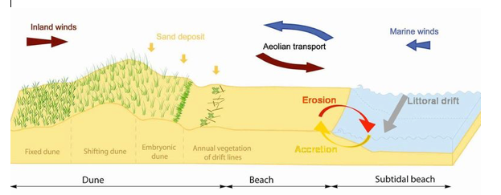
Coastal Processes:
Sand Dune Development

Slide 2
Syllabus Link
The role of coastal processes, wind and vegetation in sand dune development

Slide 3
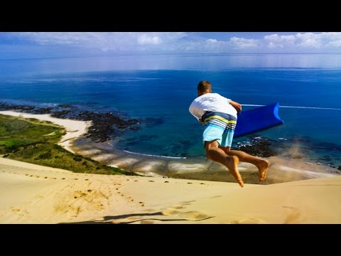

Slide 4
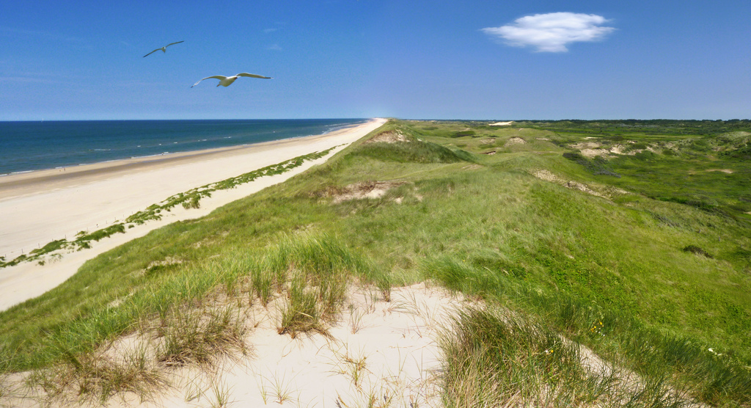
Thinking: How do these factors impact the formation of sand dunes?
Wind
Waves
Beach
Sediment supply
Relief

Slide 5
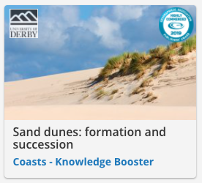
Sand Dune Formation
Watch this video from Timeforgeography.
Take notes as you watch.

Slide 6
Dunes form typically on large flat beach profiles with a large sediment supply to the backshore. Dunes develop in a different way to other depositional features because they are the result of the interaction between marine processes and the atmosphere. In brief, dunes begin to form beyond the strandline of the beach where dry sediment is transported by wind through saltation and suspension. Beach litter and debris that collects on the storm beach acts as an obstacle to saltation and sediment begins to build up. Over time, an embryo dune develops, which may become vegetated by marram grasses. Vegetation stabilizes the dunes in two ways. Firstly, the roots bind the sand together, and secondly the above ground vegetation traps particles of sand as they are blown over the surface. When dunes are less vegetated they remain unstable and so they migrate

Slide 7
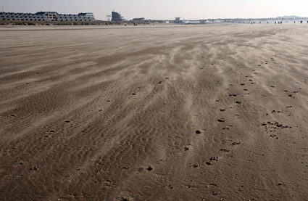
Sand Dune Formation Role Play
In groups you need to come up with a role play to show the main processes in the formation of a sand dune.
Use the resources on adorngeo to assist you.

Slide 8
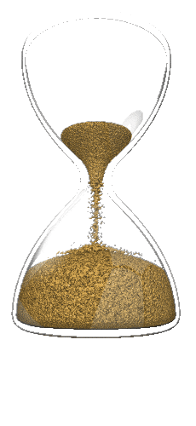
Sand Dune Formation Role Play
You have 15 minutes to create your role play.

Slide 9
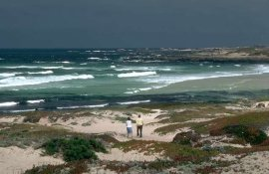
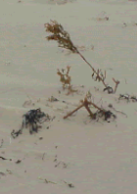
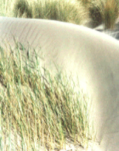
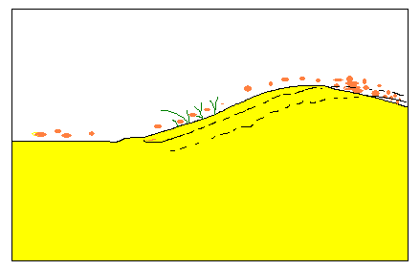
Sand Dunes
https://drive.google.com/file/d/1OC56oHG7kJXbXsrTVx4pE-dNnWQaOh9j/view?usp=sharing
Strong winds can blow sand further up the beach to form sand dunes …
1 Particles are blown off the beach by the onshore breeze.
2 Some particles become trapped in Marram or Spinifex grass and the dune grows in height.
3 Sand is blown off the seaward face of the dune and cascades down the landward face and so the dune advances landward with time.
1
Onshore breeze
3
Beach/Foreshore
Dune
2
Dunes migrate this way

Slide 10
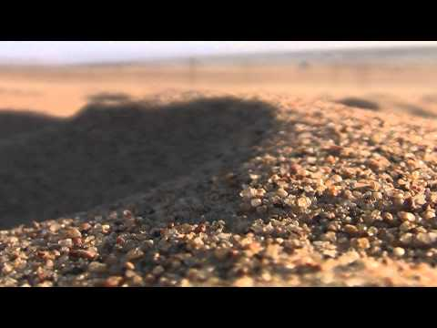
The Process of Saltation

Slide 12
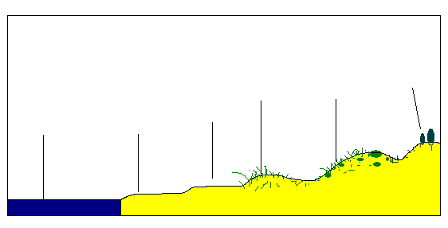
The Dune System
Colonisation of the dunes by invader species like Marram grass changes the dune through the process of succession. Over time the change in the dune allows other species to colonise.
Fixed dune
Fore dune
Mobile dune
Embryonic dune
Sea
Foreshore

Slide 13
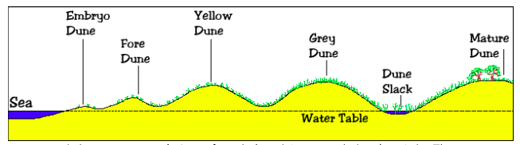
The Dune System
Colonisation of the dunes by invader species like Marram grass changes the dune through the process of succession. Over time the change in the dune allows other species to colonise.
Fixed dune
Fore dune
Mobile dune
Embryonic dune
Sea
Foreshore

Slide 14
Why are sand dunes important?
A natural barrier to the destructive forces of wind and waves, sand dunes are our first line of defense against coastal storms and beach erosion. They absorb the impact of storm surge and high waves, preventing or delaying flooding of inland areas and damage to inland structures.

Slide 15
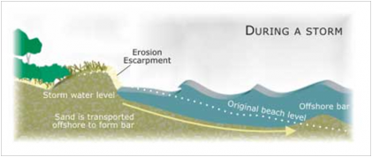
Why are sand dunes important?
During storms sand dunes get eroded away. This sand is carried off shore to form sand bars.
What will a sand bar cause waves to do?

Slide 16
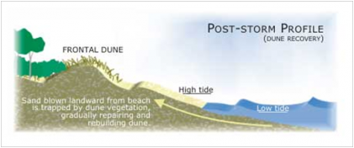
Why are sand dunes important?
In the calm period between storms the sans is carried back onto the beach and used to rebuild the sand dunes.

Slide 17
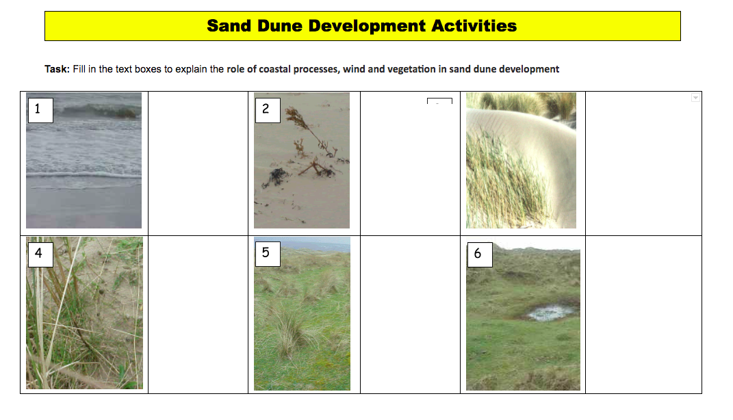
Activities
Complete the activity sheet on google classroom.
There is also a reading to help you do this.

Slide 18
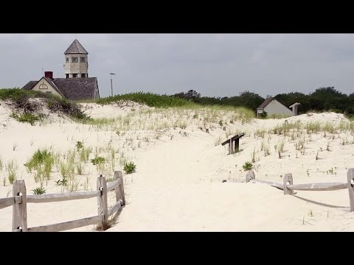
Recap

Slide 19

Practice Question

