Slide 1
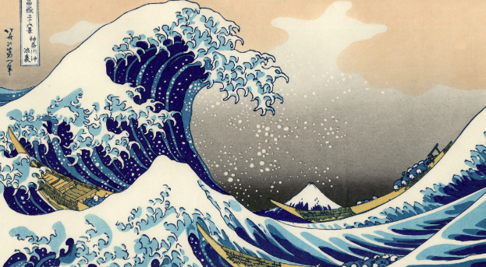
Physical Influences on Coastal Landscapes #1

Slide 2
Geographic Inquiry Theme
How coastal places are shaped by their interactions with oceans

Slide 3
Syllabus Link
Physical influences on coastal landscapes, including waves, tides, sediment supply, lithology, vegetation, subaerial processes and wave processes (littoral drift, hydraulic action and abrasion)

Slide 4
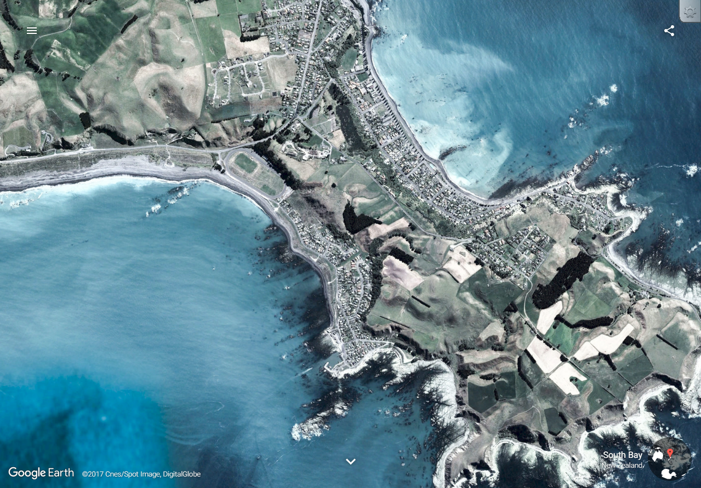
Energy from the sun produces waves and currents
Material that has fallen down slopes because of gravity (“mass movement”)
Position of the moon to create changes in the tides
Sediment from rivers and/or the sea (shells, coral)
What shapes a coastline??
Rock type
Tsunamis
Action of plants and animals
Sea spray (salt)
Temperature changes that break up the rock (“weathering”)
People!
Ports
Energy production
Tourist resorts
Land reclamation
Sea level changes:
Eustatic: Worldwide sea-level changes compared to land
Isostatic: Localised sea-level changes compared to land

Slide 5
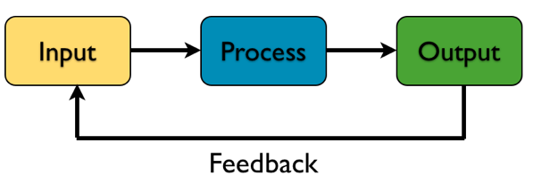
Recap - What is a system?
A system is a group of interacting or interrelated entities that form a unified whole.

Slide 6
What is a system?
A system is a group of interacting or interrelated entities that form a unified whole. There are natural and human-made (designed) systems.
Natural systems: There are many natural systems that occur at a variety of scales.
Human-made systems: Are systems created by humans. Some of these systems are by design but others are more inadvertent. These systems produce outputs that sometimes can have unintended negative consequences.

Slide 7
Key Systems Concepts
Systems are Complex:
They have a number of components, a variety of inputs and outputs, and they interact with other systems
Systems Operate at Different Scales:
Scale is important. Some systems impact the whole globe and all life forms, whereas others have only aminimal local influence.
Systems are vulnerable:
They can be influenced by many interacting factors.

Slide 8
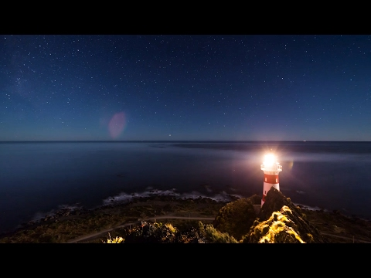

Slide 9
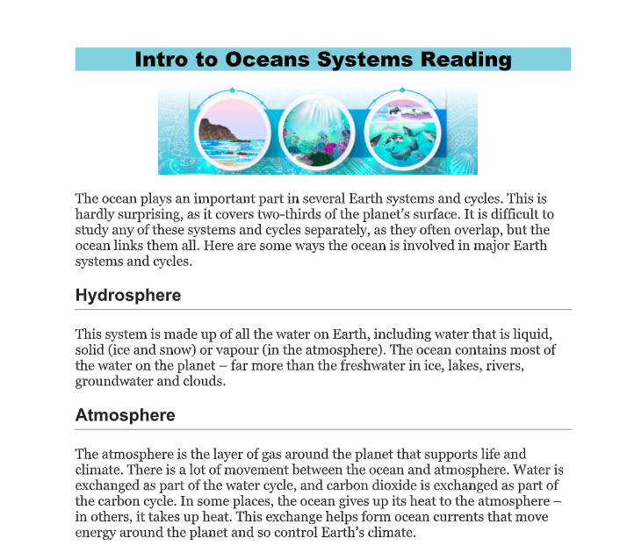
What Systems Impact Coastlines?
Read the handout on components of ocean systems.
As you read take a one sentence summary note from each heading.

Slide 10
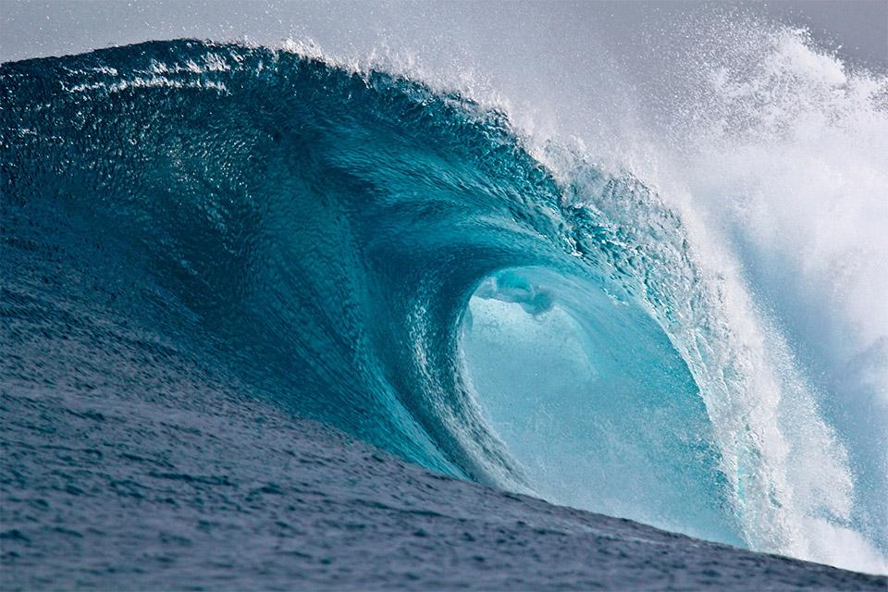
Part 1: Motion in the Ocean
Physical influences on coastal landscapes, including
Waves,
Tides
Littoral drift (local currents)

Slide 11
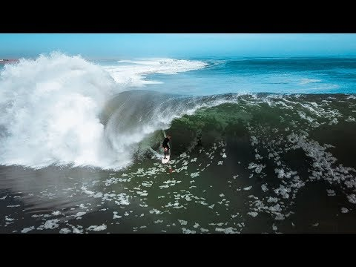
Ocean Waves
1.What caused that wave?
2. Why did it break for so long?

Slide 12
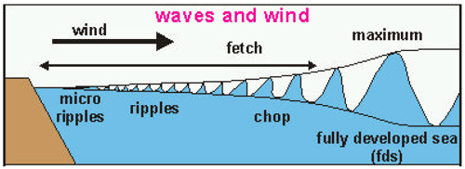
The most important agent shaping coastal landforms is wave action
Waves are energy transmitted through matter.
A wave is formed by the frictional transfer of energy from the wind

Slide 13
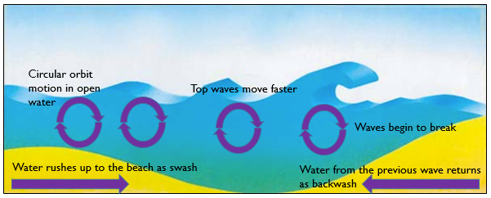
The water does not actually travel as the energy passes through it, but its particles oscillate as the energy passes through them.

Slide 14
Wave energy/size
The size a wave can grow is impacted by 3 factors:
Velocity: The strength of the wind blowing over the water.
Fetch: The distance the wind is blowing over the water.
Duration: How long a time period the wind is transferring energy to the water.

Slide 15
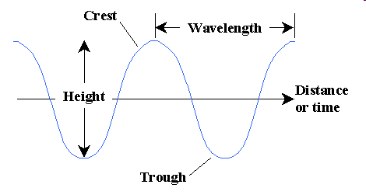
Important Wave Terms
Crest: Highest point
Trough: Lowest point
Height (H): Vertical distance between the crest & trough
Wavelength (L): Horizontal distance between any points on successive waves
Wave Period: Time, in seconds, that elapses during the passing of one wave, or wavelength

Slide 16
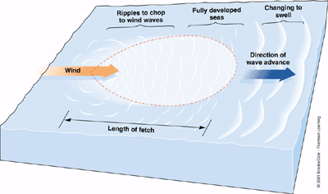
Progress of Wave Formation

Slide 17
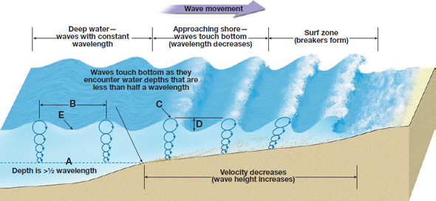
Why do waves break?
As a wave approaches a beach it slows.
The bottom of the wave touches the sand and slows down due to increased friction.
The top of the wave becomes higher and steeper until it topples over. This causes a wave to break.

Slide 18
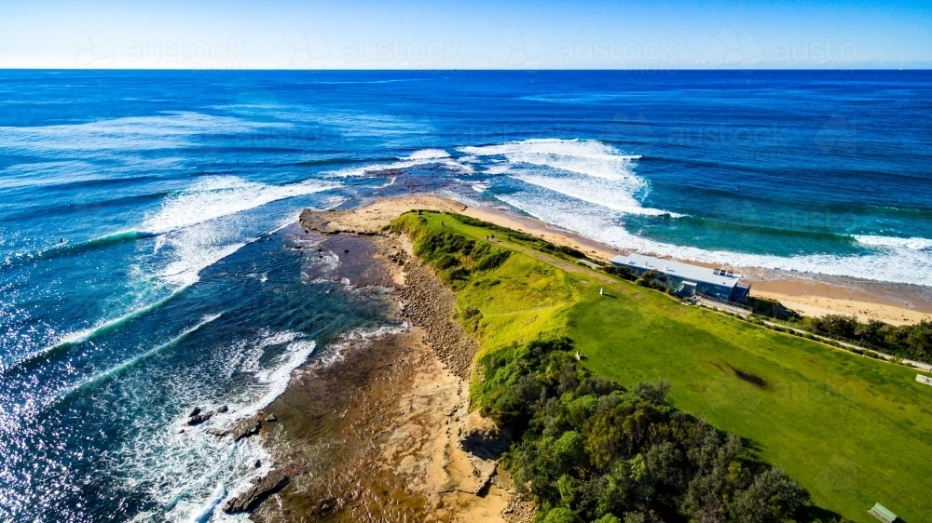
Why is this wave not breaking in a straight line?

Slide 19
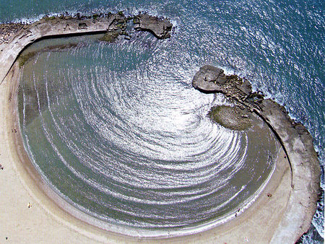
Wave Refraction
Wave refraction is the bending of waves as they approach the shoreline.
The part of the wave crest closer to shore is in shallower water and slows due to friction with the bottom.
The wave crest in deeper water catches up so that the wave crest tends to become parallel to the shore.

Slide 20
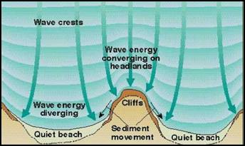
Wave refraction influences the concentration of energy on the coast.

Slide 21
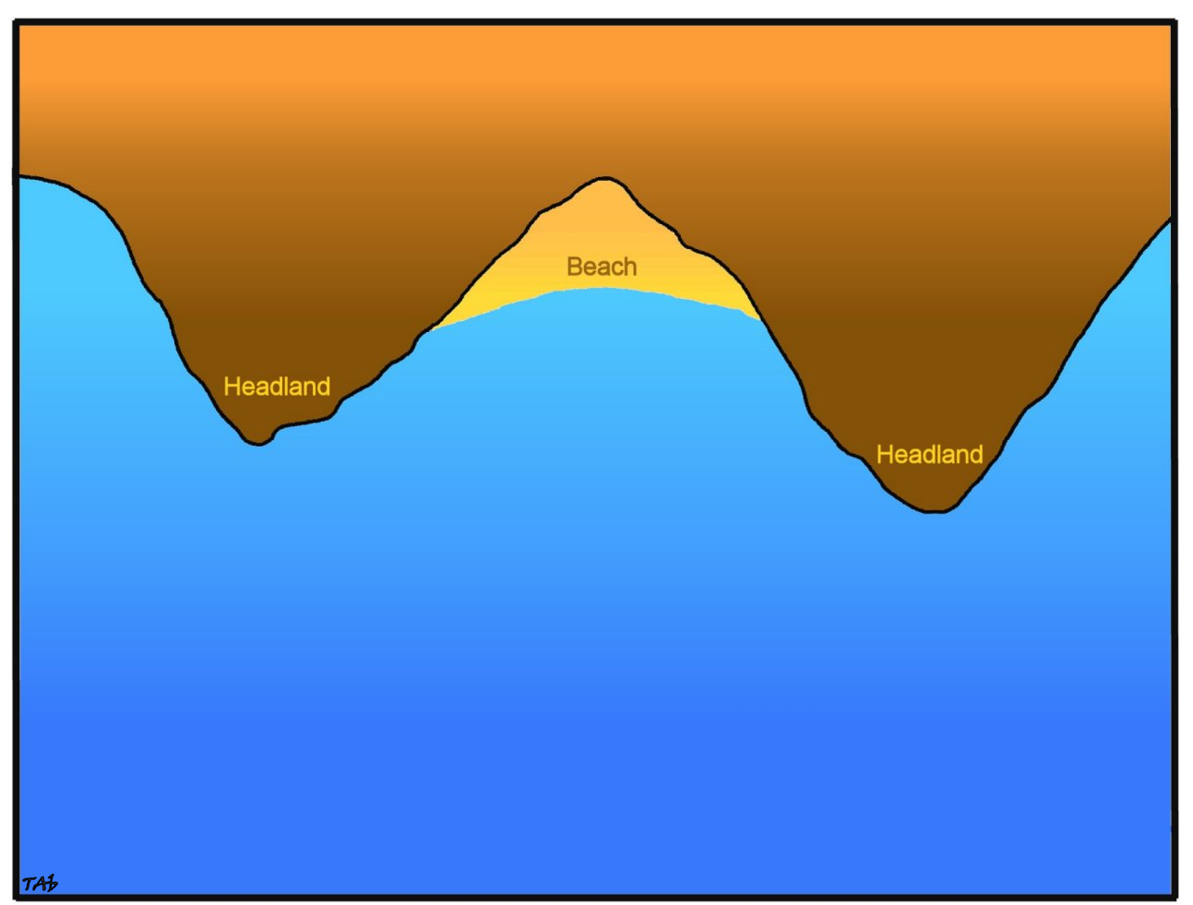
Shallow
water
Shallow
water
wave

Slide 22
Shallow
water
Shallow
water
wave

Slide 23
Shallow
water
Shallow
water
wave

Slide 24
Shallow
water
Shallow
water
wave

Slide 25
Shallow
water
Shallow
water
wave

Slide 26
Shallow
water
Shallow
water
wave

Slide 27
Shallow
water
Shallow
water
wave

Slide 28
Shallow
water
Shallow
water
wave

Slide 29
Shallow
water
Shallow
water
wave

Slide 30
Shallow
water
Shallow
water
wave

Slide 31
Shallow
water
Shallow
water
wave

Slide 32
wave

Slide 34
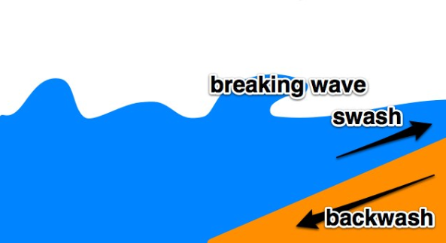
Swash & Backwash
When a wave reaches the shore, the water that rushes up the beach is known as the swash.
The water that flows back towards the sea is known as the backwash.

Slide 35
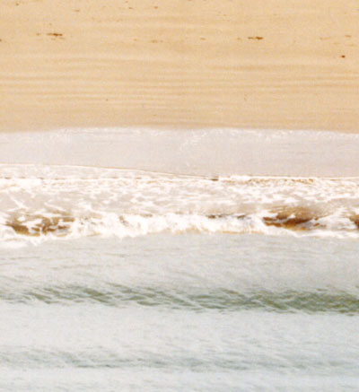
Swash & Backwash
Backwash
Swash
Note: Backwash is always at right angles to the beach

Slide 36
Wave Types
There are two types of waves, each has a different impact on the beach:
Destructive waves: They erode (wear down) the beach.
Constructive waves: They build up (or acrete) the beach.

Slide 37
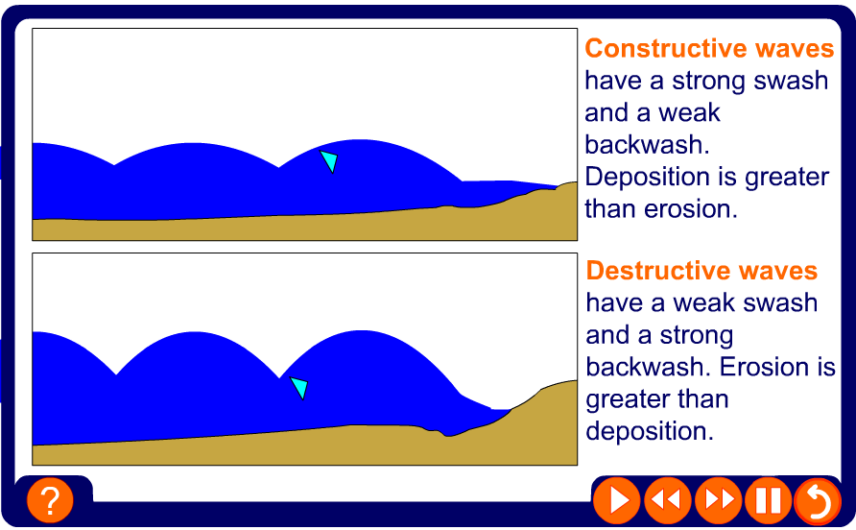
Types of waves

Slide 38
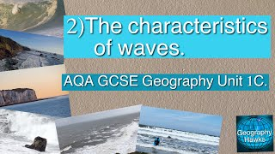

Slide 39
Speed Writing: Explain what happens as a wave approaches the coast?
FETCH | WATER PARTICLES | SEA BED | WAVE HEIGHT | FRICTION
UNSTABLE | BACKWASH | SWASH | CIRCULAR ORBIT | WIND
ENERGY | SHALLOW WATER | WATER DEPTH | SEA SURFACE | SHORE
Notes:
As waves approach the coastline the base of the wave slows due to friction on the seabed. The wavelength decreases but wave height increases and the wave topples forward. The upper part of the wave moves faster than the base so the wave falls forward and breaks.

Slide 40
Practice Question: What is the difference between constructive and destructive waves?
(4 marks)
Notes:
Summarise that they have looked at how waves move material up and down the beach face (Constructive waves move material up the beach whilst destructive waves scour the beach moving it downwards). How else do waves affect the movement of sediment at the coast? Play longshore drift movie to recap concept. Handout diagram worksheet and using diagram on flipchart page 4 discuss longshore drift and its implications on the coast – erosion, groynes and development of landforms such as spits and how to use this idea in exam questions.

Slide 41
What is the difference between constructive and destructive waves?
(4 marks)
L1 (1-2 marks) – Only described either constructive/destructive. Description is vague, little use of key terms.
L2 (2-4 Marks) – Detailed description. Balance between 2 waves types. Mentions and explains how key terms relate to wave type including, fetch, length, frequency, height.
Notes:
Summarise that they have looked at how waves move material up and down the beach face (Constructive waves move material up the beach whilst destructive waves scour the beach moving it downwards). How else do waves affect the movement of sediment at the coast? Play longshore drift movie to recap concept. Handout diagram worksheet and using diagram on flipchart page 4 discuss longshore drift and its implications on the coast – erosion, groynes and development of landforms such as spits and how to use this idea in exam questions.

Slide 42
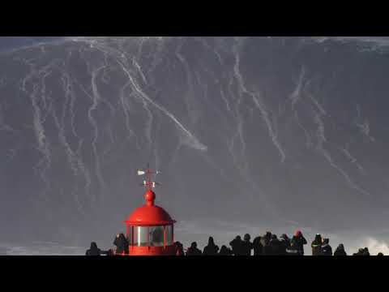

Slide 43
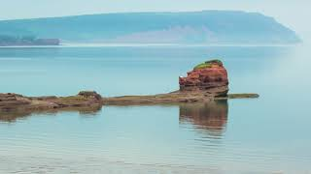
Tides
Bay of Fundy Timelapse

Slide 44
Tides are another major phenomenon that influences coasts.
Definition: Tides are the rise and fall of sea levels caused by the combined effects of the gravitational forces exerted by the Moon and the Sun, and the rotation of Earth.
Depending on location, they can even have a greater significance than waves

Slide 45
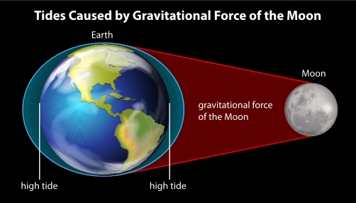
Tides are NOT Waves!

Slide 46
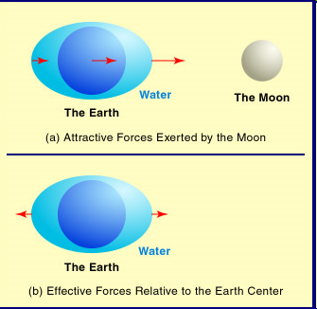
Tides are waves with very long wavelengths which stretch halfway around the globe. These create tidal bulge and tidal trough.
Tides are diurnal (2 high tides and 2 low tides a day)
Air pressure also affects tide (high pressure = lower, low pressure =higher)

Slide 47
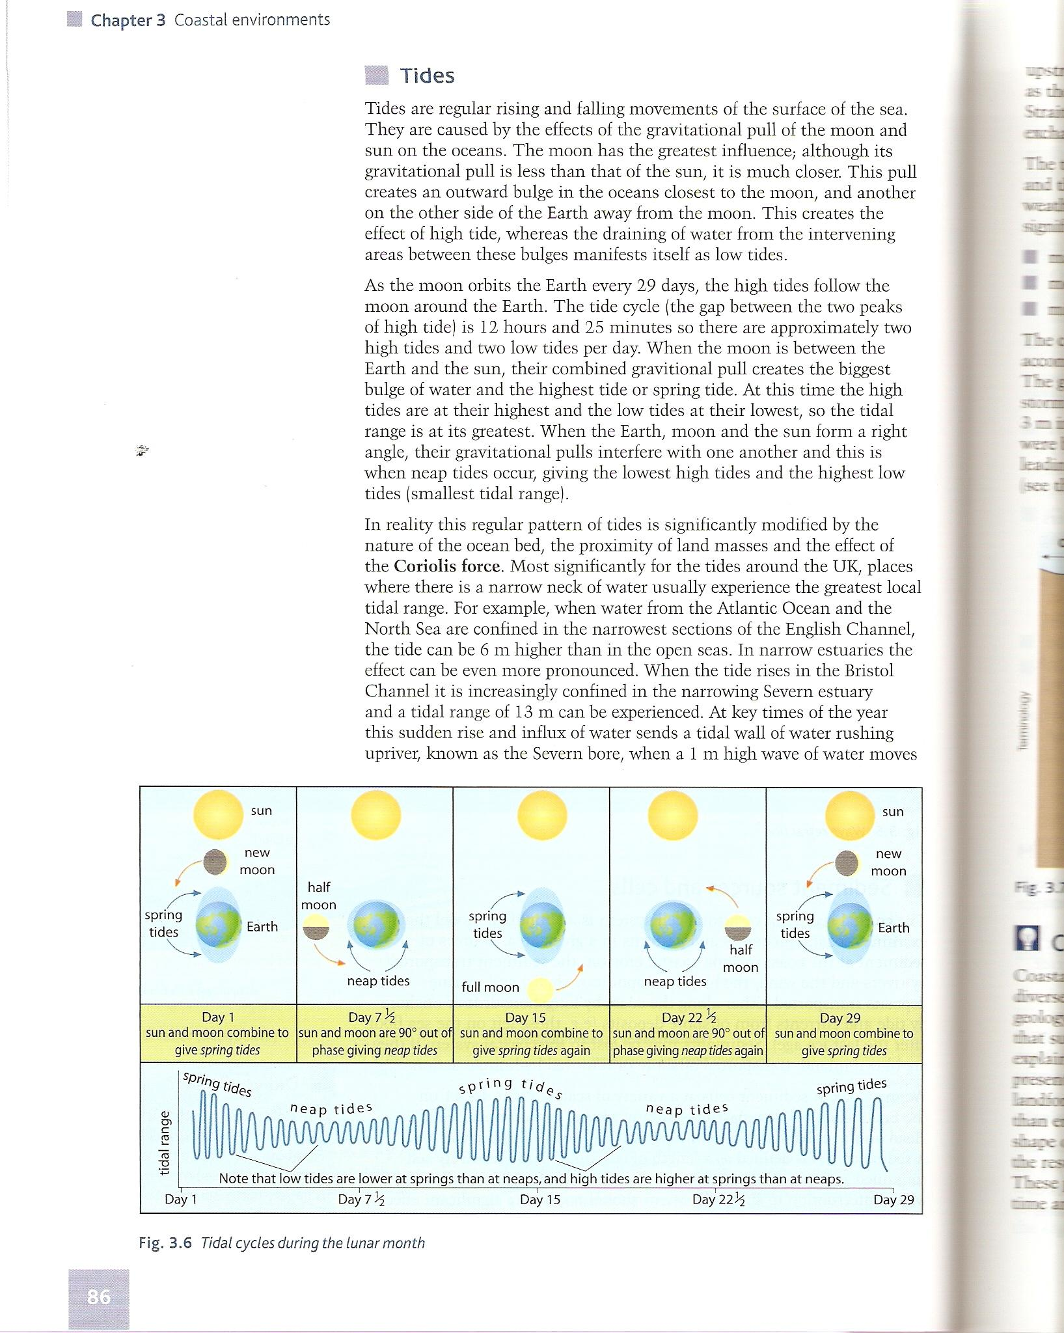
The magnitude depends on the relative positions of the sun and moon
  Together = Spring tides
  45 degrees = Neap tides

Slide 48
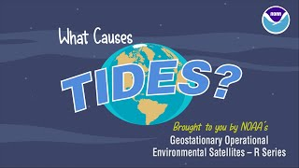

Slide 49
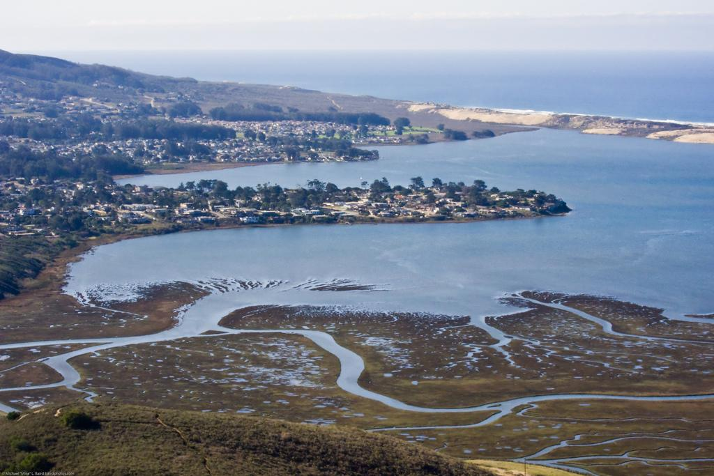
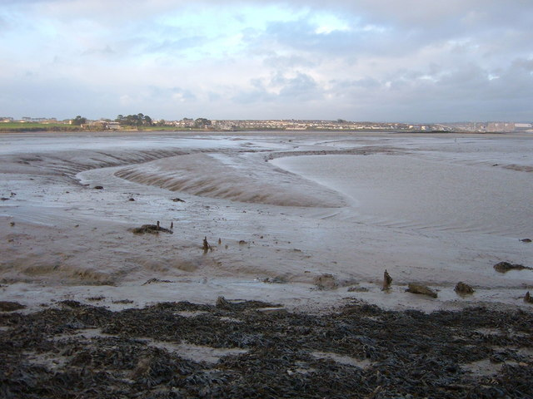
Tides vary the level at which waves and other forces can impact the coast. Some coastal environments are highly influenced by tides such as:
  estuaries: Where the mouth of a river meets the tides
  mudflats: The muddy land left uncovered at low tide

Slide 50
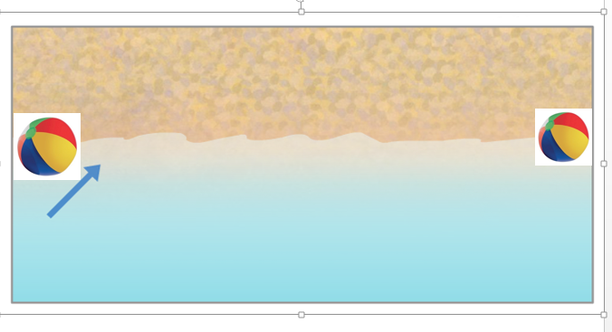
Littoral/ Longshore Currents
Explain this: How did the beach ball end up at the other end of the beach?!?!

Slide 51
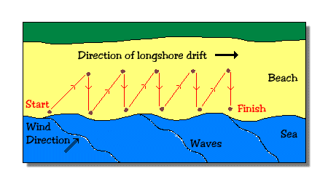
Littoral/ Longshore Currents
Littoral or longshore currents are affected by the velocity and angle of a wave.
The water in a longshore current flows up onto the beach, and back into the ocean. This can lead to a current that moves along the shore

Slide 52
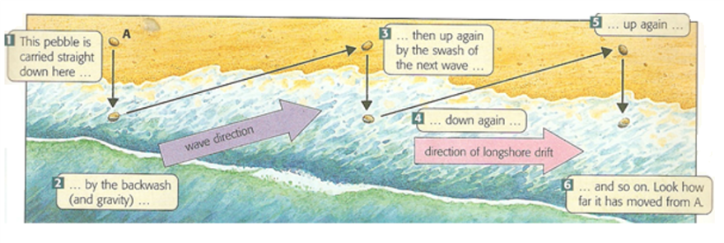
Littoral/ Longshore Currents

Slide 53
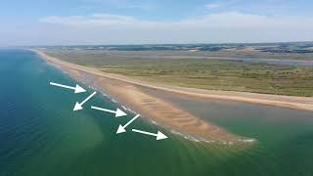

Slide 54
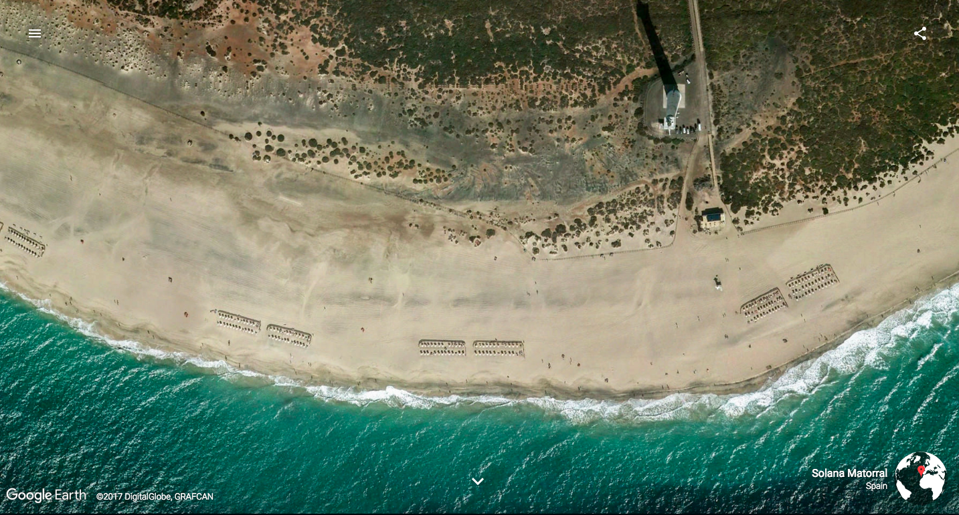
Littoral/ Longshore Currents
Littoral drift: Littoral transport is the term used for the transport of non-cohesive sediments, i.e. mainly sand, along the foreshore and the shoreface due to the action of the breaking waves and the longshore current.

Slide 55
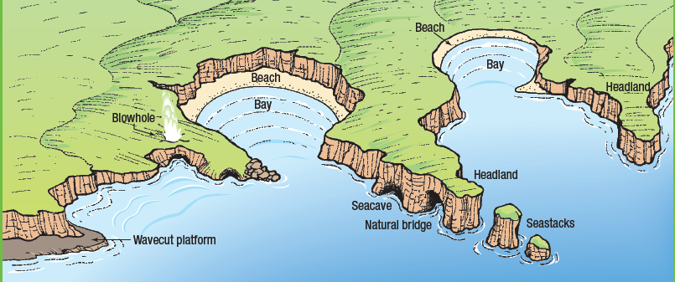
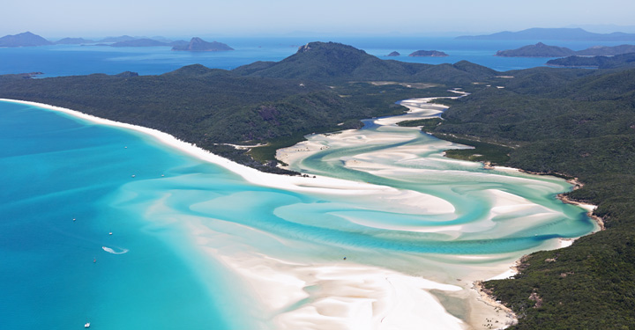
Geographic Inquiry Theme
These ocean forces interact with the coastal places and shape the coast

