Slide 1
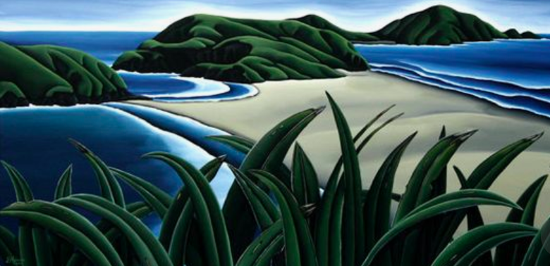
Coastal Landforms
Formation & Characteristics

Slide 2
Syllabus Link
The characteristics and formation of coastal landforms of erosion and deposition, including
  wave cut platform
  cliff,
  stack,
  spit
  beaches

Slide 3
Coastal Processes Recap
Erosion
The wearing away of the land/ cliff by the action of the sea
Transportation
The movement of eroded beach material by the wave e.g. Longshore Drift (LSD)
Deposition
When waves lose their energy they drop material

Slide 4
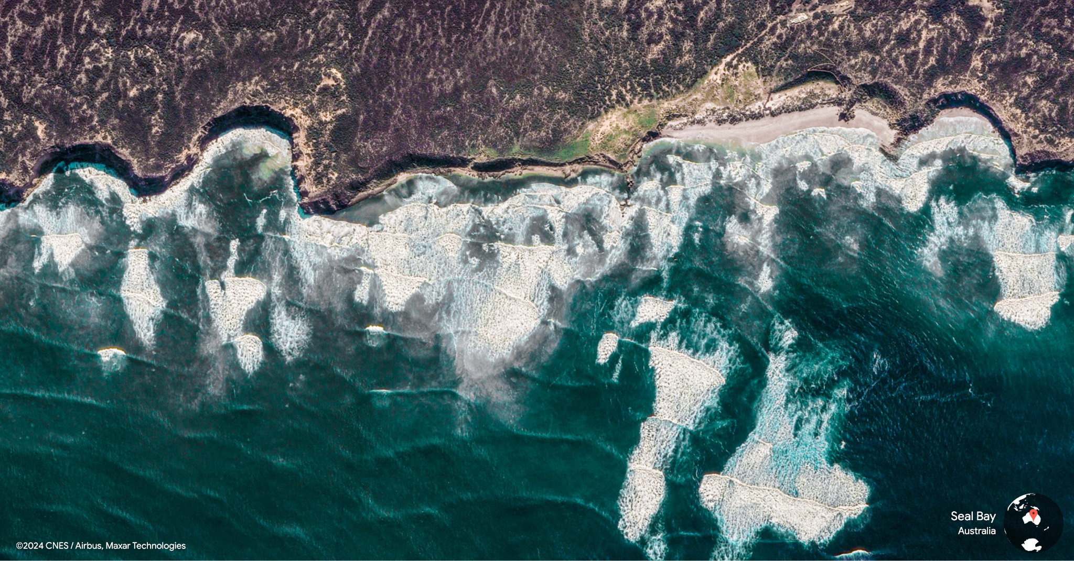
What processes and landforms can you see in this picture?

Slide 5
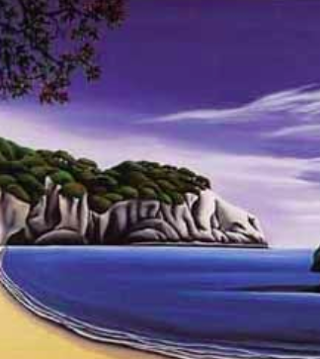
Features of erosion
Bays may be eroded into beds of weaker rock. The harder rocks form headlands and the weaker rocks are eroded to form bays.
Wave energy and refraction are focused on headlands. Rapid erosion can occur in rocks with structural weakness.

Slide 6
Additional Term
Retreating Coasts:
Coasts along which the dominant processes are erosional, resulting in the coastline moving inland. Retreating coasts may also be caused by a positive change in sea level (sea level rise or a fall in land level).

Slide 7
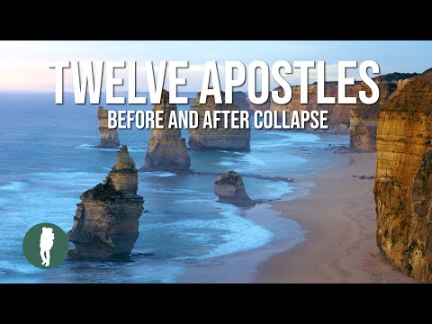

Slide 8
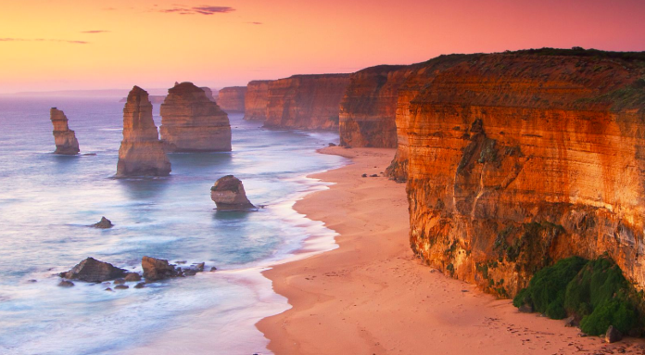
An erosional coastline

Slide 9

Features of deposition
Deposition creates a number of features including beaches and spits. Essential requirements include:
A large supply of sediment
Longshore drift
Low energy coastline
An irregular coastline
Some features need vegetation to bind them

Slide 10
Additional Term
Advancing coasts:
Depositional coasts that are growing as a consequence of sediment deposit and/or the infill of coastal marshes. Advancing coasts may also arise from a negative change in sea level (sea level fall or uplift of land)

Slide 11
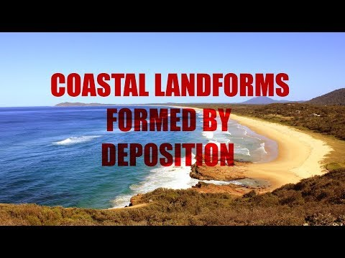

Slide 12
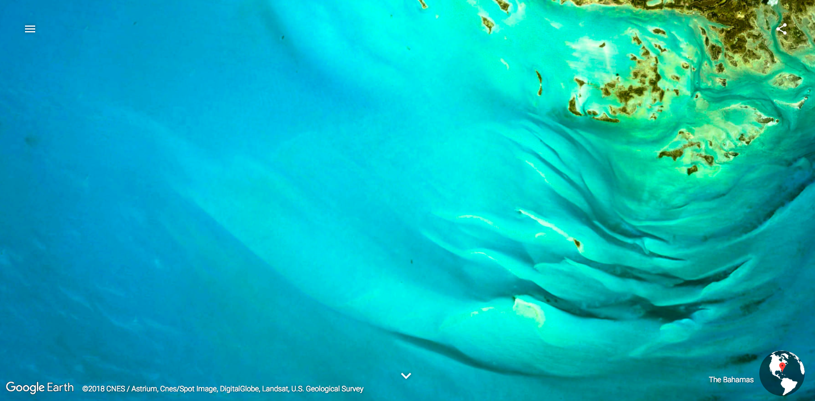
A depositional coast

Slide 13

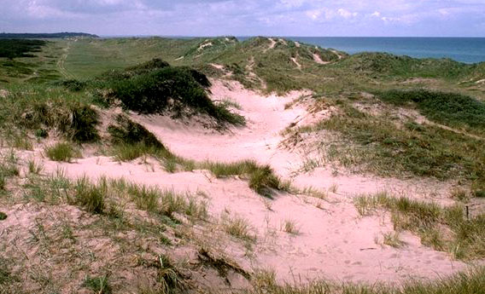
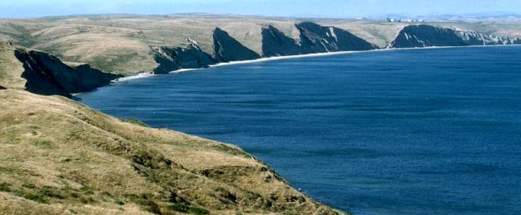

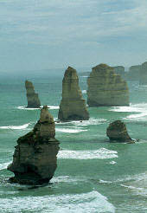
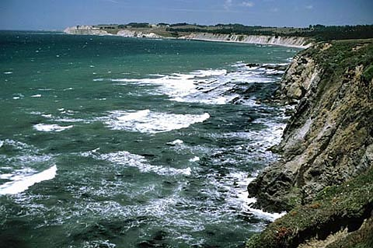
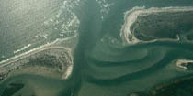

Which of these
are erosional ord depositional
coastal landforms?

Slide 14
Coastal landforms
A variety of landforms are found along the coast, all have been created by either erosion or deposition.
Erosion | Deposition
Cave Arch Stack Stump Cliff Wave cut notch Wave cut platform Headland and bay | Spit Bar Tombolo Saltmarsh Beach

Slide 15
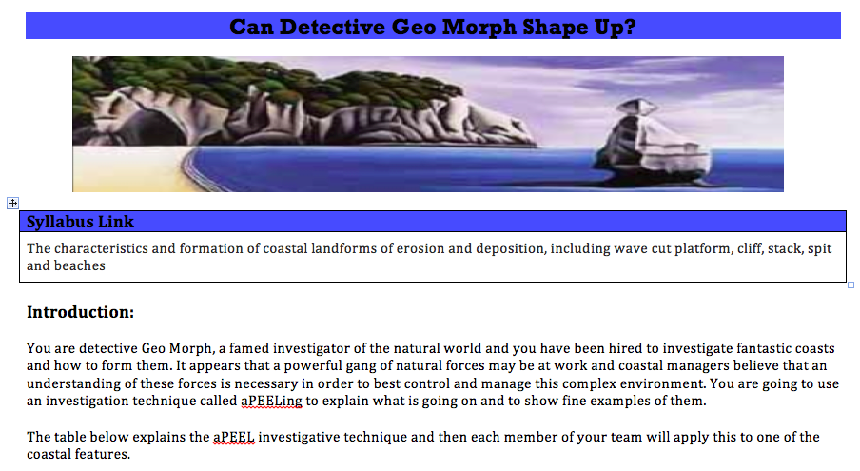

Slide 16
Practice Time
Exam Style Question: Use an annotated diagram to explain the formation of one coastal landform.
Take a piece of scrap A4
Sketch a diagram of a depositional landform (that you haven’t investigated)
Use annotations to explain it’s formation
You have 9 minutes

Slide 17
Practice Time
Take a piece of scrap A4
Sketch a diagram of a erosional landform (that you haven’t investigated)
Use annotations to explain it’s formation
You have 8 minutes

Slide 18
Practice Question # 1
Explain how a beach is formed (4)

Slide 19
Practice Question # 1
Explain how a beach is formed (4)
https://timeforgeography.co.uk/videos_list/coasts/Explain-how-a-beach-is-formed/

Slide 20
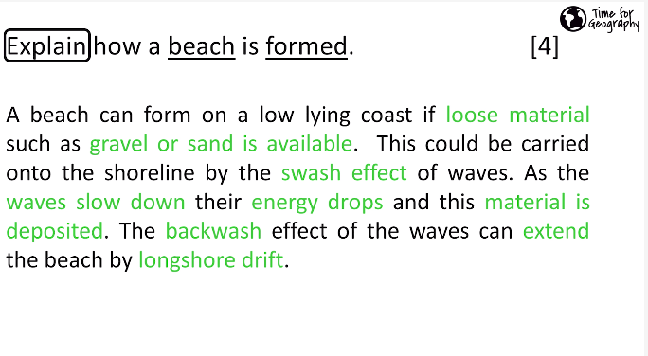
Practice Question # 1
Explain how a beach is formed (4)
https://timeforgeography.co.uk/videos_list/coasts/Explain-how-a-beach-is-formed/

Slide 21
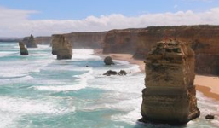
Practice Question #2
Explain with the use of a diagram how the landform shown was formed
(6 marks)

Slide 22
Practice Question #2
Explain with the use of a diagram how the landform shown was formed
(6 marks)
https://timeforgeography.co.uk/videos_list/coasts/Explain-with-the-use-of-a-diagram-how-the-landform-shown-was-formed/

Slide 23
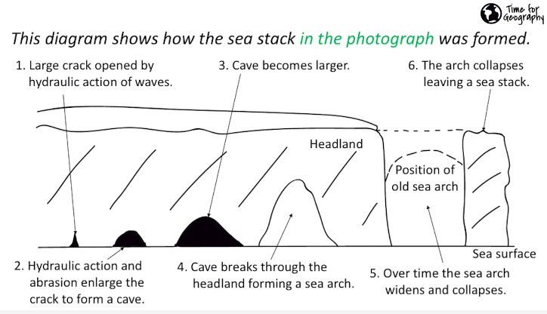
Practice Question #2
Explain with the use of a diagram how the landform shown was formed
(6 marks)
https://timeforgeography.co.uk/videos_list/coasts/Explain-with-the-use-of-a-diagram-how-the-landform-shown-was-formed/

Slide 24
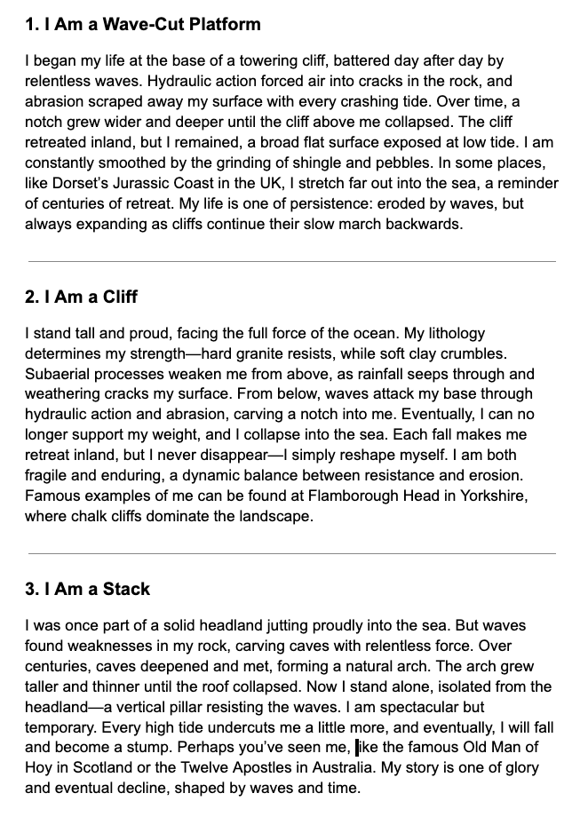
Life Stories of Coastal Landforms
You are all assigned to a coastal landform.
annotate the life story to highlight the key forces and processes that shape that landform.

Slide 25
Life Stories of Coastal Landforms
You are all assigned to a coastal landform.
Now rotate around it another landform
Draw a sketch to illustrate how this landform was created (no words)

Slide 26
Life Stories of Coastal Landforms
You are all assigned to a coastal landform.
Now rotate around it another landform
annotate the sketch to fully explain it’s formation.

Slide 27
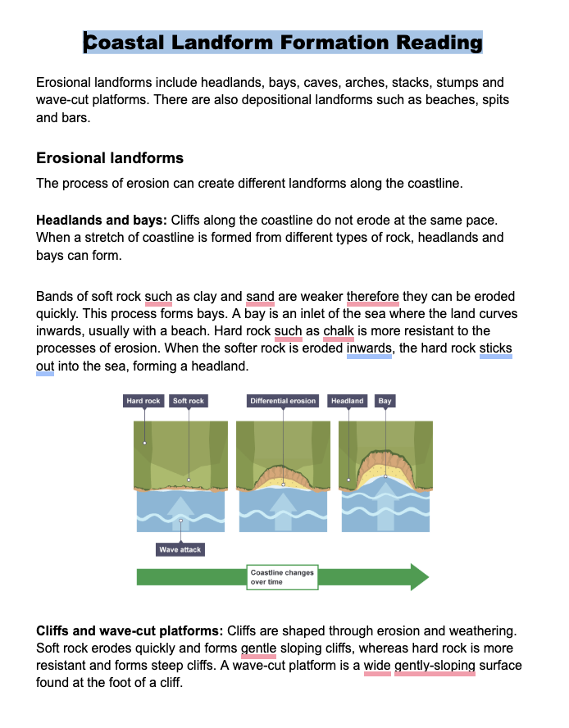
Now Learn More
Now use this document or other sources (textbooks or online) to learn the 5 landforms.
Ideally you can do an annotated sketch and a paragraph explanation for each.

Slide 28

Cake by the Ocean

Slide 29
Stumps by the Ocean
In your groups, use the cake to show the process of the formation of a sea stump:
Create the model out of cake
Annotate it to show the main processes involved
Try and wave lines, including refraction

Slide 30
Sand Spits By the Ocean
In your groups, use crumbled pieces of the cake to show the process of the formation of a sand spit:
Create the model out of cake
Annotate it to show the main processes involved
Include wave and current direction etc

Slide 31
Sand Spits By the Ocean
Now pay attention to the Time for Geography video on Sand spit formation
https://timeforgeography.co.uk/videos-list/coasts/Examine-how-physical-processes-work-together-in-the-formation-of-the-spit-shown/

Slide 32
Landforms By the Ocean
In your groups, use the cake to show the process of the formation of one of the following:
Beach, wave cut platform, cliff, stack, spit, beaches
Steps:
Create the landform out of cake
Make a time lapse video of it
Bonus points for adding a narration voice like David Attenborough

Slide 33
Practice Question
Explain the formation and features of beaches
(10)
As a group:
Write the introduction out in full
Bullet point the key points you would make in your essay

Slide 34
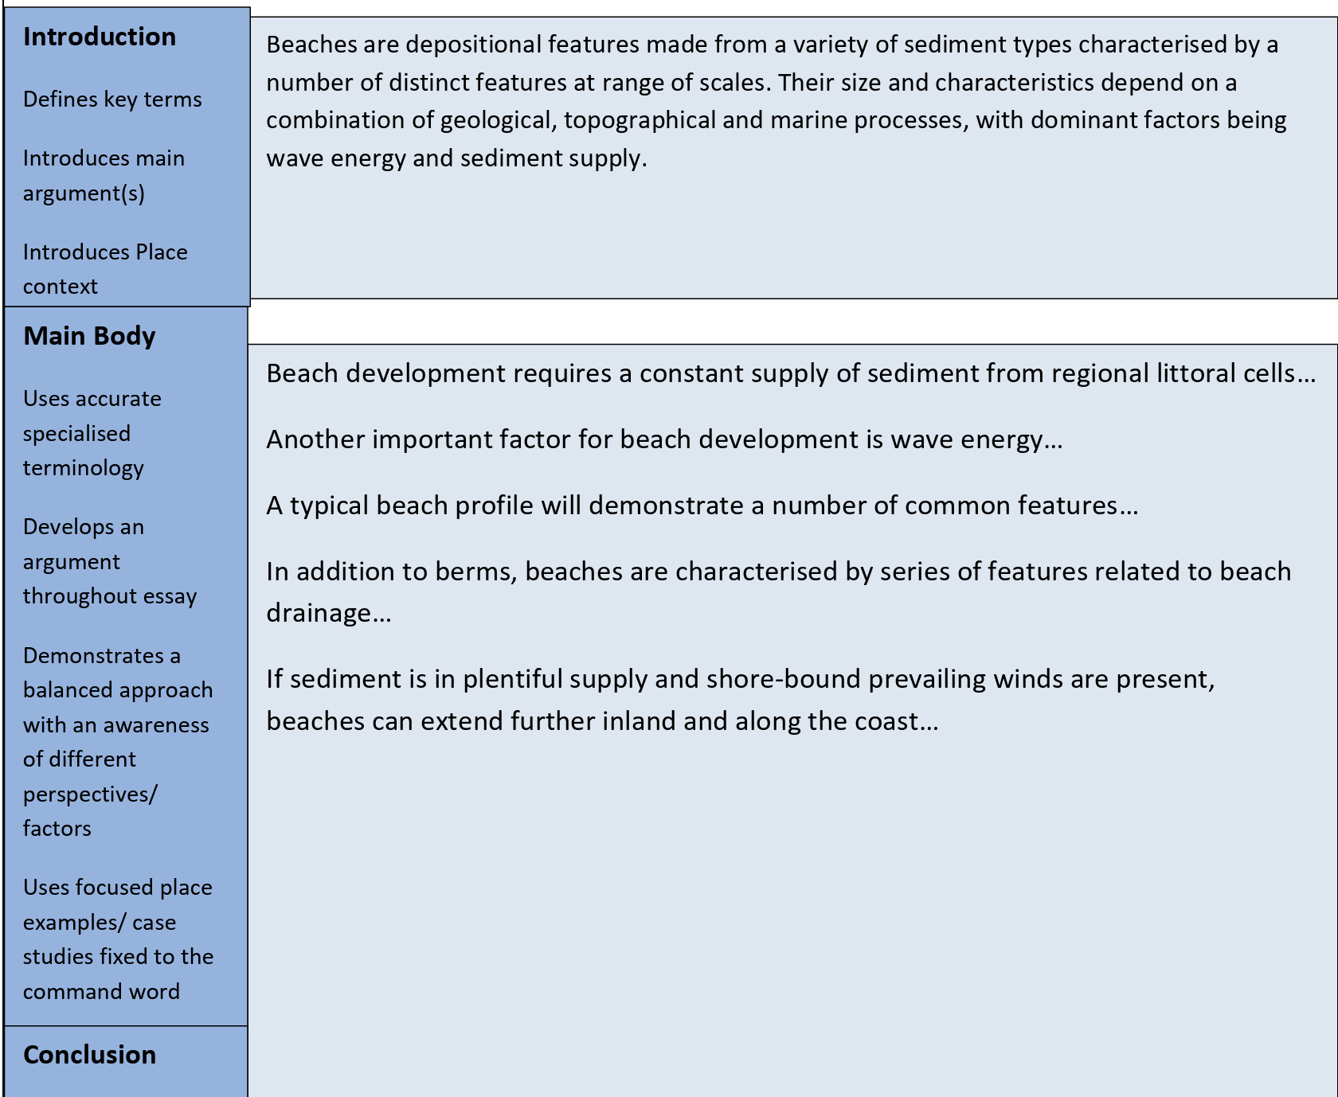
Practice Question

Slide 35
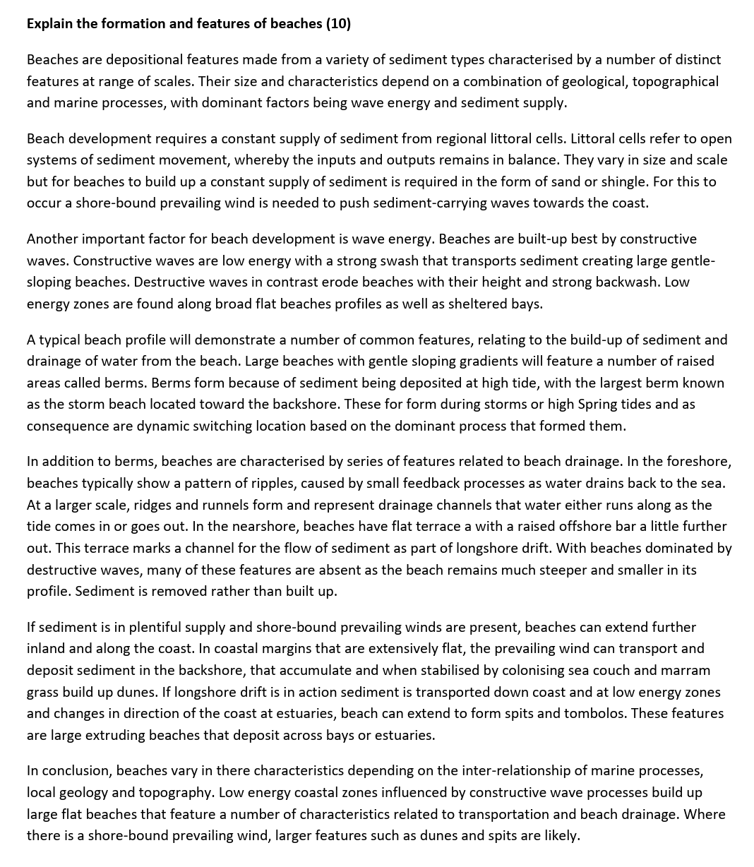
Practice Question

Slide 36

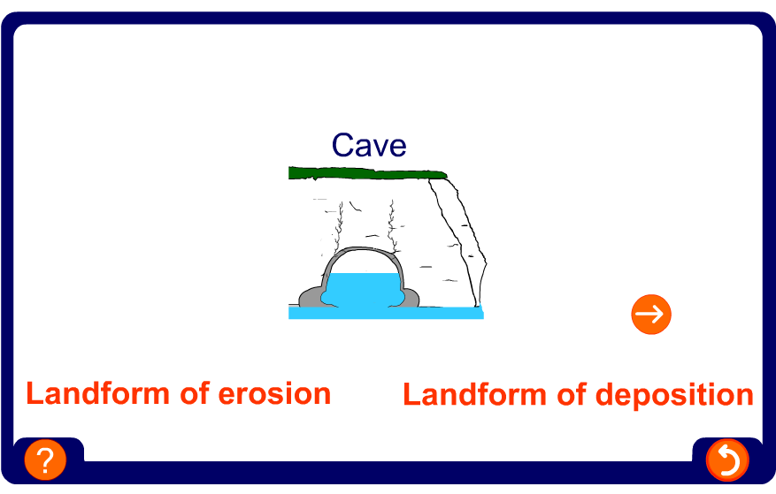
Erosion or deposition?

Slide 37
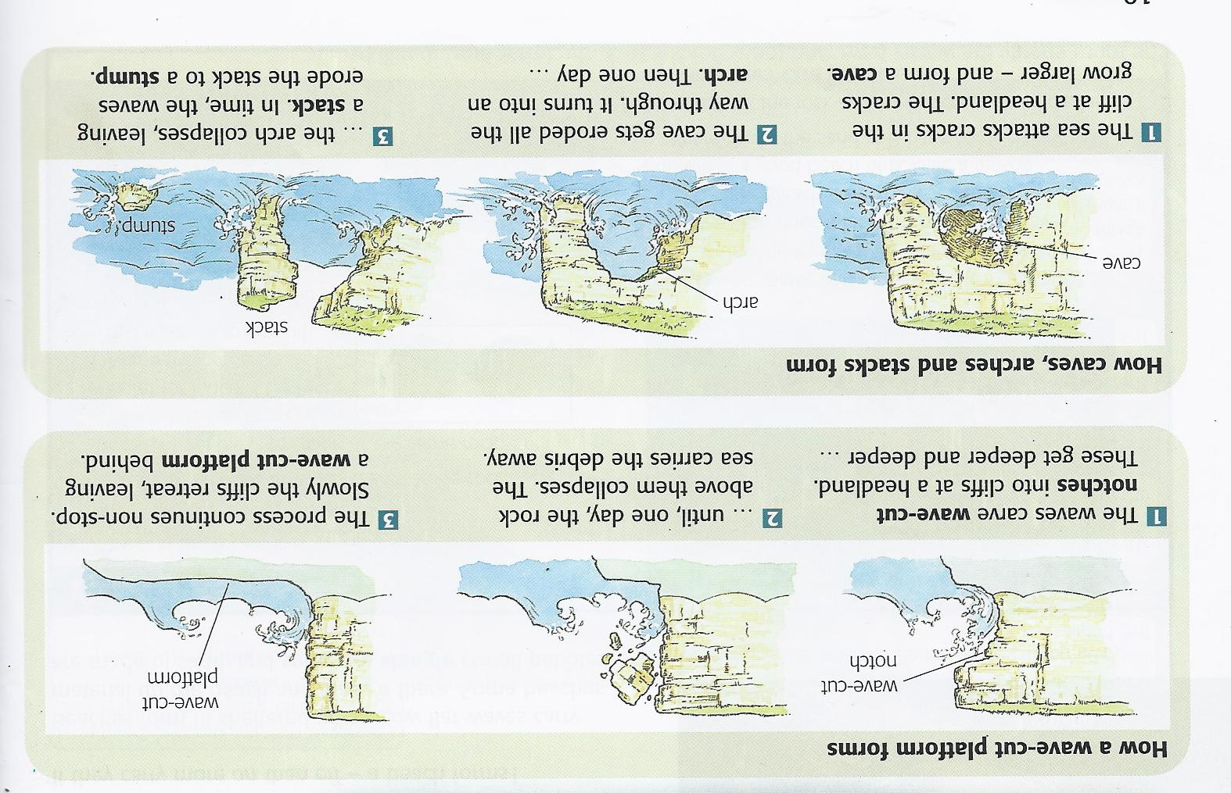
Cave, arch, stack and stump
You may need to include processes of erosion.

Slide 38
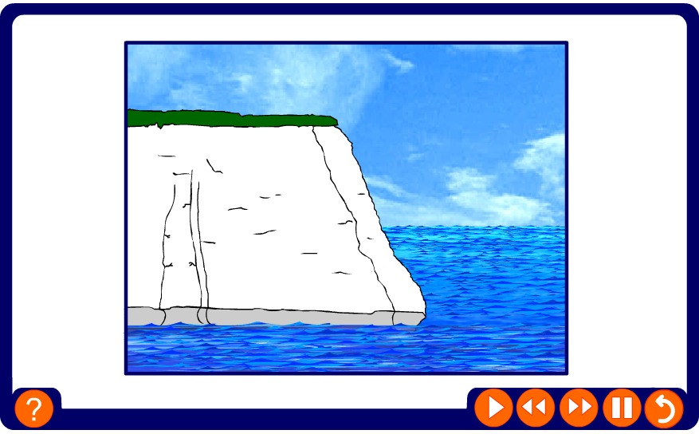
How are caves, arches, stacks and stumps formed?

Slide 39
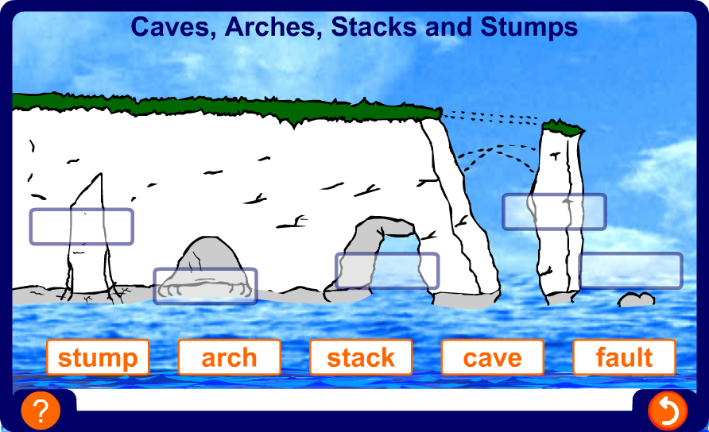
Caves, arches, stacks and stumps

Slide 40
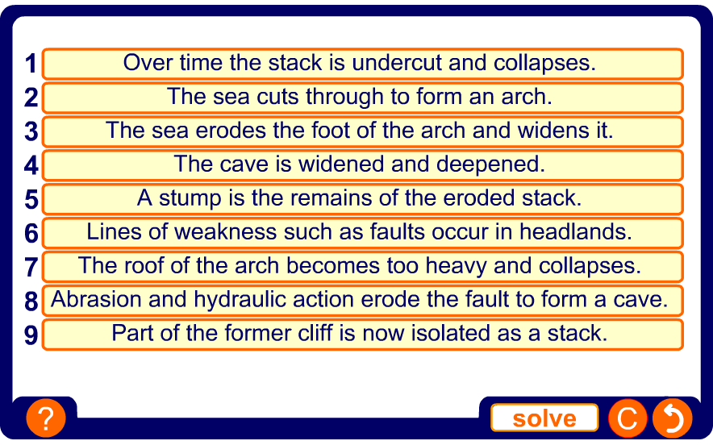
The formation of caves, arches, stacks and stumps

Slide 41
Cliff and cliff retreat
You may need to include processes of erosion.

Slide 42
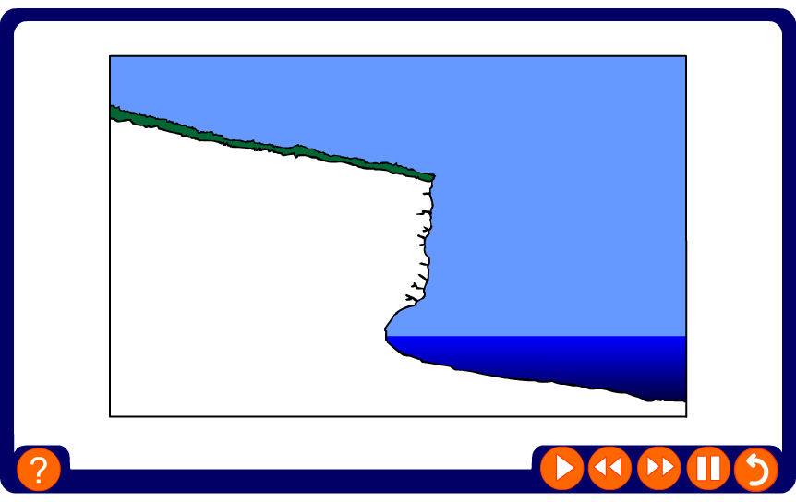
How are cliffs and wave-cut platforms formed?

Slide 43
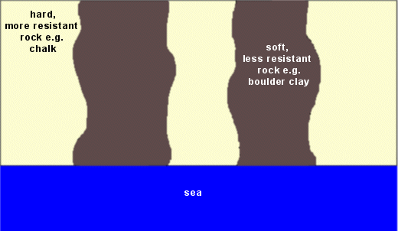
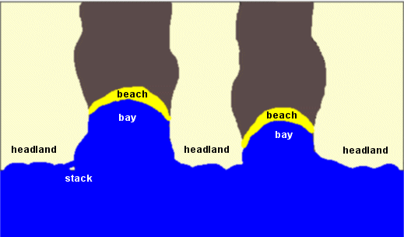
Headlands and bays
Headlands and bays are formed where there are different rock types.
The softer and less resistant rock will eroded away much faster than the harder and more resistant rock.
This will form a headland where the harder rock are found.
And a bay where the softer rocks are found.
Much of the eroded material will be deposited in the sheltered bay forming a beach.

Slide 44
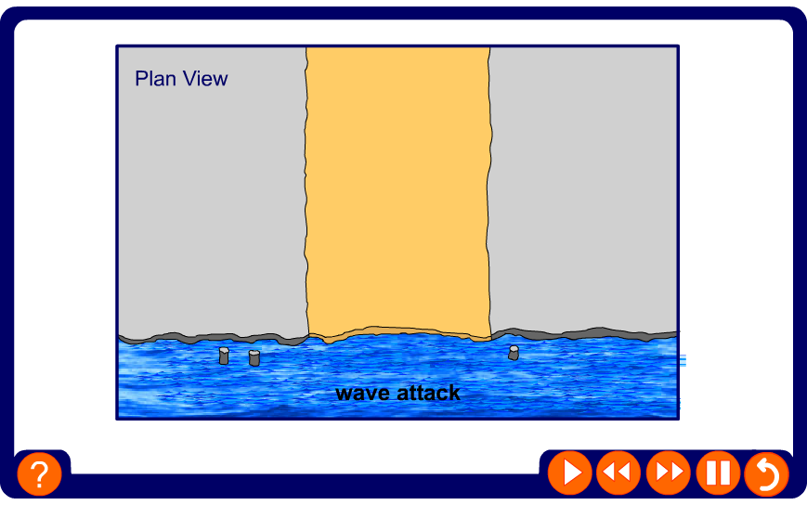
Headlands and bays

Slide 45
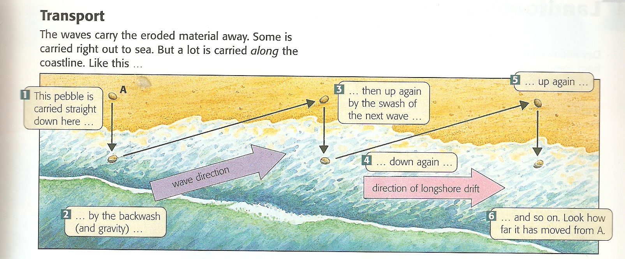
Longshore drift
This is a type of transportation.
Remember that longshore drift is controlled by the direction of the prevailing wind (which affect the angle the waves and swash move up a beach)

Slide 46
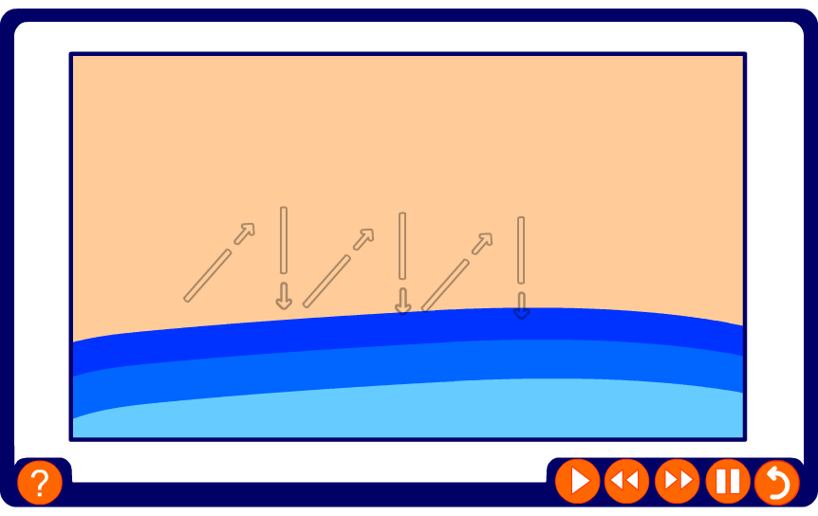
How is sediment transported along the coast?

Slide 47
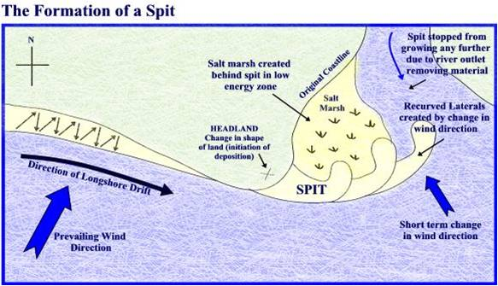
Spit
A spit is a depositional landform, created along coastlines where longshore drift occurs.

Slide 48
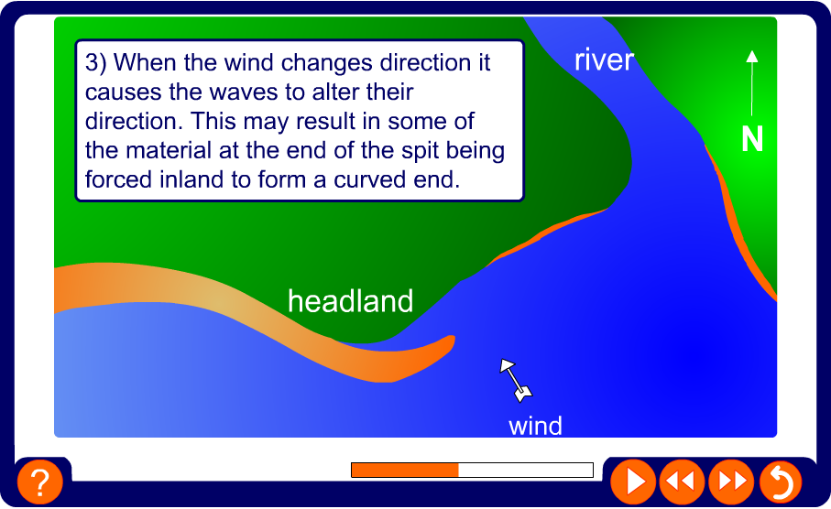
How are spits formed?

Slide 49
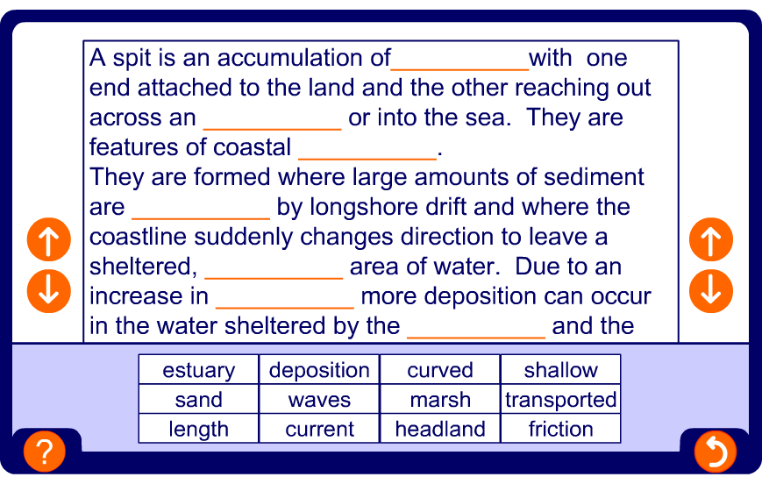
How are spits formed?

