Slide 1
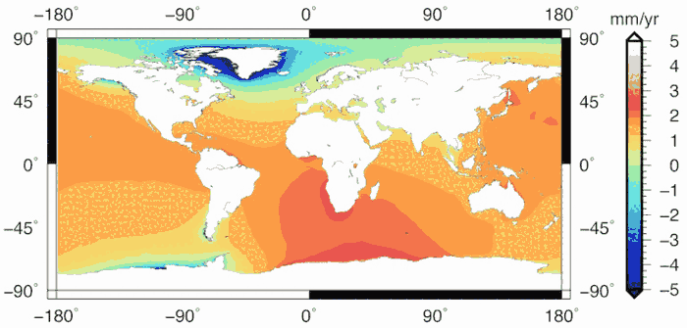
Skills Introduction:
Patterns & Trends

Slide 2
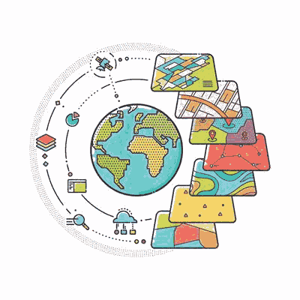
Introduction
Analysis is an increasingly important skill in the workplace.
It is important to learn to analyse data trends & spatial patterns (analysis of patterns over space/ place)

Slide 3
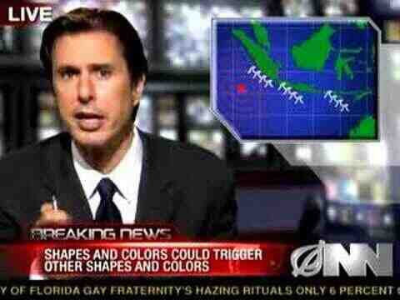
Introduction
You need to be more effective at it than this!

Slide 4
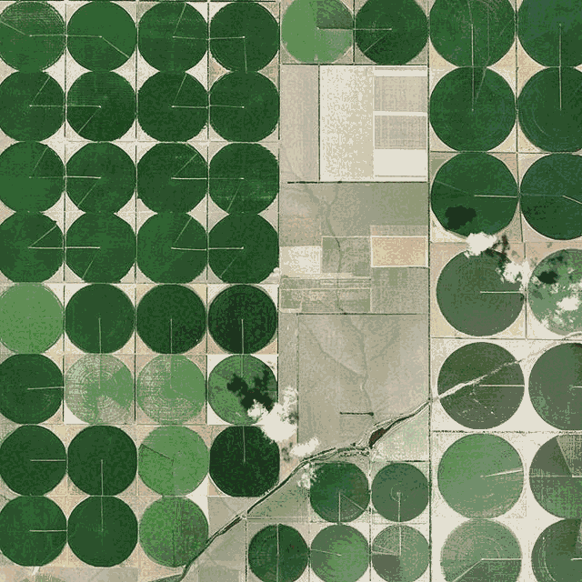
What are Geographical Patterns?
Definition: arrangement of people, places, or things across a specific space.
Patterns have characteristics that are similar and that repeat themselves in a natural or human environment

Slide 5
The Use of Geographical Patterns
Identifying geographic patterns helps in understanding the relationships and interactions between different locations.
Example of use:
The pattern of coral bleaching on coral reefs
The area of ocast impacted by oil spills such as the deepwater horizon

Slide 6
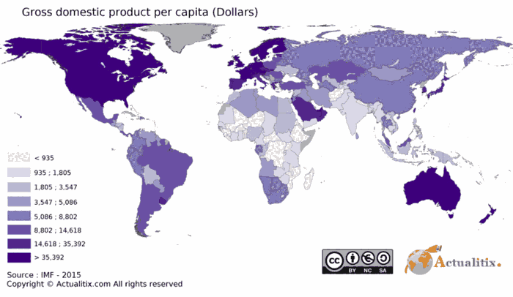
Example: GDP Per Capita

Slide 7
What are Geographical Patterns?
Patterns may be of different sorts: For example the pattern of currents, patterns of fishing
You need to analyse connections between characteristics to determine patterns.
Maps can display patterns as do some types of graphs.

Slide 8
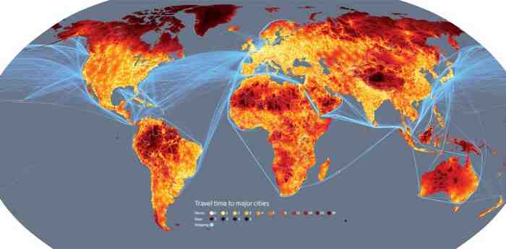
Example: Global Shipping Routes

Slide 9
Tips for Answering on Patterns
Firstly offer a general overview of the pattern, is there even or uneven data
Reference the map where appropriate, places, compass points (use North, East etc, not left or top)
If there is scale - try to use. It can be used for describing the location, situation and size of a place or feature
Quantify! - Always use data if the map shows it
Identify any anomalies/outliers

Slide 10
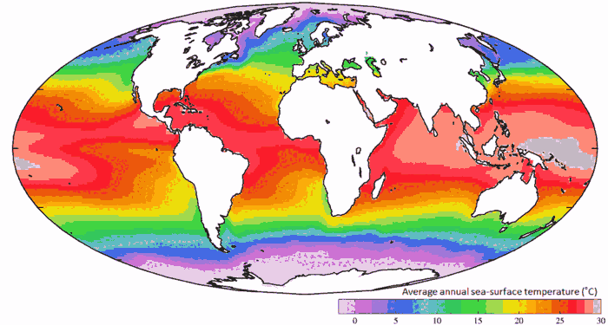
Example: Global Ocean Temperatures

Slide 11
Important Term:
Quantify: Use data or specific content from a map or graph to support the statements that you make.
For example, if a map has years you can use those to help describe a trend, or you can use quantities represented to illustrate the increase or decrease in size etc.

Slide 12
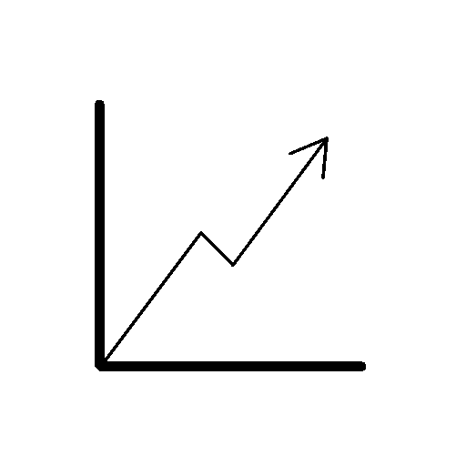
What are Geographical Trends?
Definition:
A trend is a gradual change in data or an average
or a general tendency of a series of data points to move in a certain direction over time

Slide 13
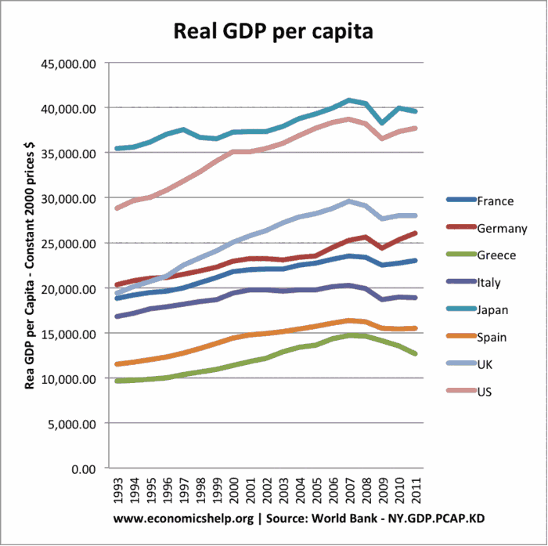
What are Geographical Trends?

Slide 14
What are Geographical Trends?
The data may be spatial, social, economic, physical, or environmental.
Students analyse connections between those characteristics over time to determine trends.
Trends are often displayed in graphs, although a series of maps can also be used.

Slide 15
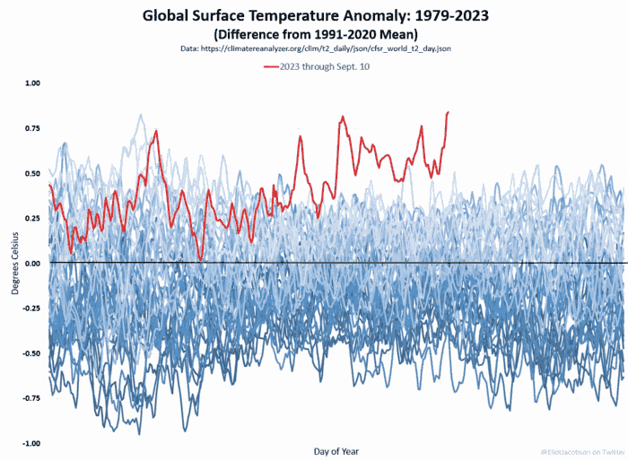
What are Geographical Trends?
What is the trend shown here?
Why is it important to recognise such trends?

Slide 16
Tips for Answering on Trends
Firstly offer a general overview of the trend, it might show a rise or fall or a divide in the pattern of change
Refer to rates of change and time references
Refer to whether the growth/ fall is constant or fluctuating
Quantify! - Always use data, such as high and low, possible range
Identify any anomalies

Slide 17
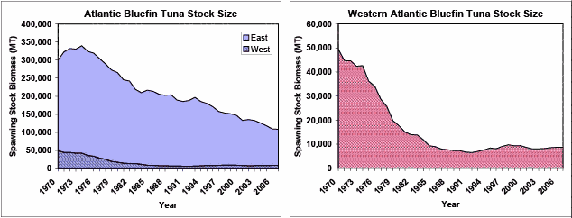
What are Geographical Trends?

Slide 18
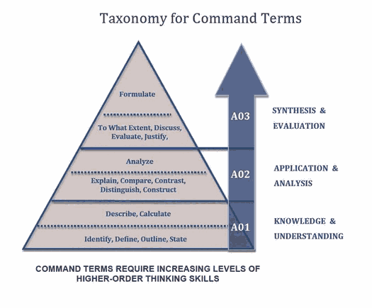
Command Terms
Command terms are used to define the thinking skills that students are expected to demonstrate.

Slide 19
Related Terms: Anomaly
Definition: An anomaly is something that deviates from what is expected or normal.
It is a deviation or irregularity that stands out from the usual pattern or behavior.
You can have anomalies in both patterns and trends.

Slide 20
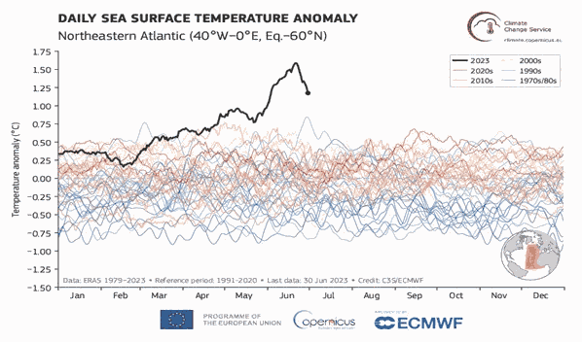
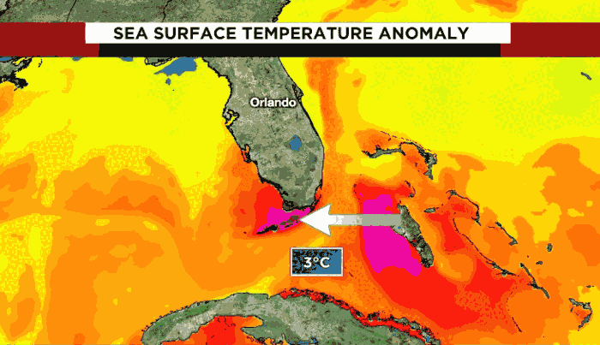
Related Terms: Anomaly
An anomaly in a trend
An anomaly in a pattern

Slide 21
Tips for Answering on Anomaly
Firstly offer a general statement on the anomaly
Highlight the degree of variation between what is normally expected
Quantify! - Always use data, such as high and low, possible range

Slide 22
Related Concept:Command Terms
Command terms tell you what you need to do for each analysis question and the level of thinking required.
Common command terms we will use for patterns and trends include:
State
Describe
Explain

Slide 23

State
Give a specific name, value or other brief answer without explanation or calculation.

Slide 24
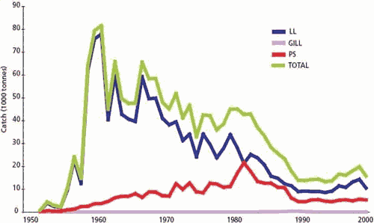
State
State the year that total global tuna catch peaked.

Slide 25

Describe
Give a detailed account or picture of a situation, event, pattern or process.

Slide 26
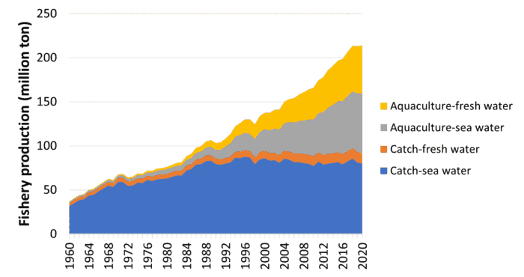
Describe
Describe the trends in sea water catch and sea water aquaculture.

Slide 27

Explain
Give a detailed account including reasons or causes
@COLINGALLY

Slide 28
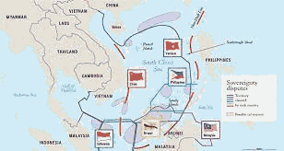
Explain
Explain how China’s 9 dash line leads to geopolitical conflict in the South China Sea
@COLINGALLY

