Slide 1
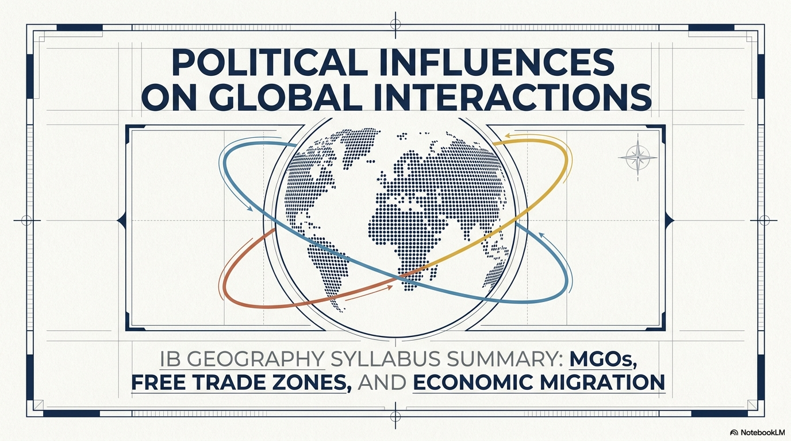

Slide 2
Syllabus Link
Political factors that affect global interactions:
Multi-governmental organizations (MGOs) and free trade zones
Economic migration controls and rules

Slide 3
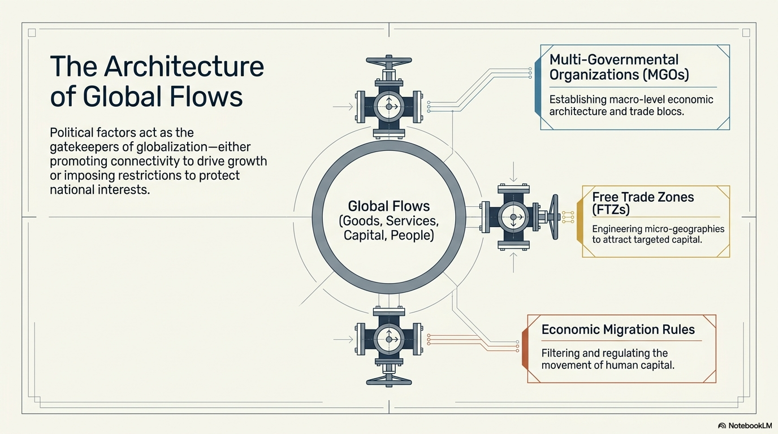

Slide 4
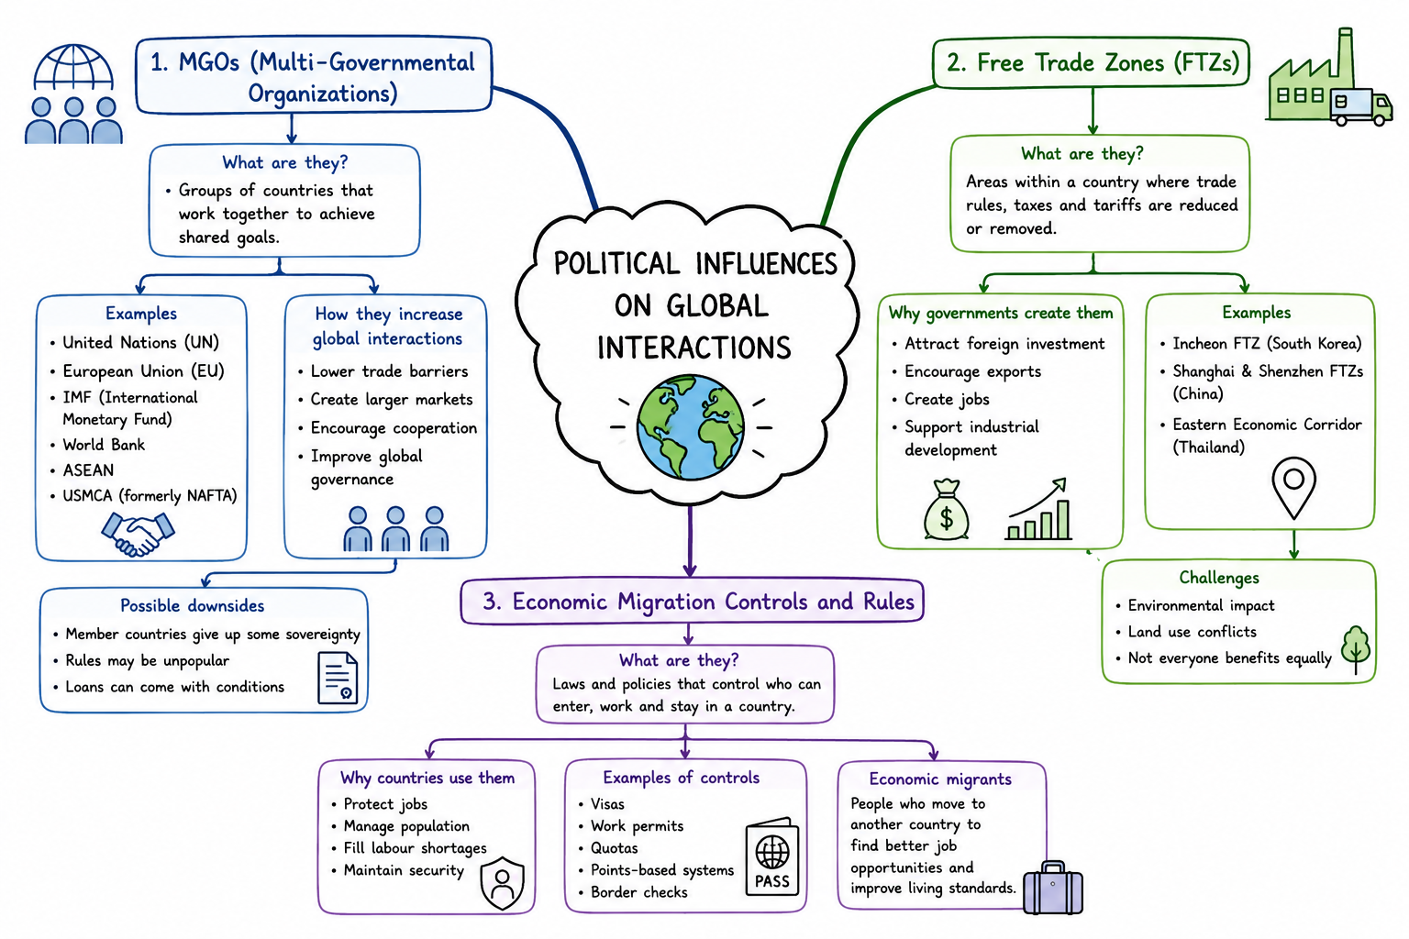
Intro Video
We are going to watch an intro video on this topic.
As you watch the video make a dual coded (a mind map that combines text and visuals) mindmap of important terms and key details.

Slide 5
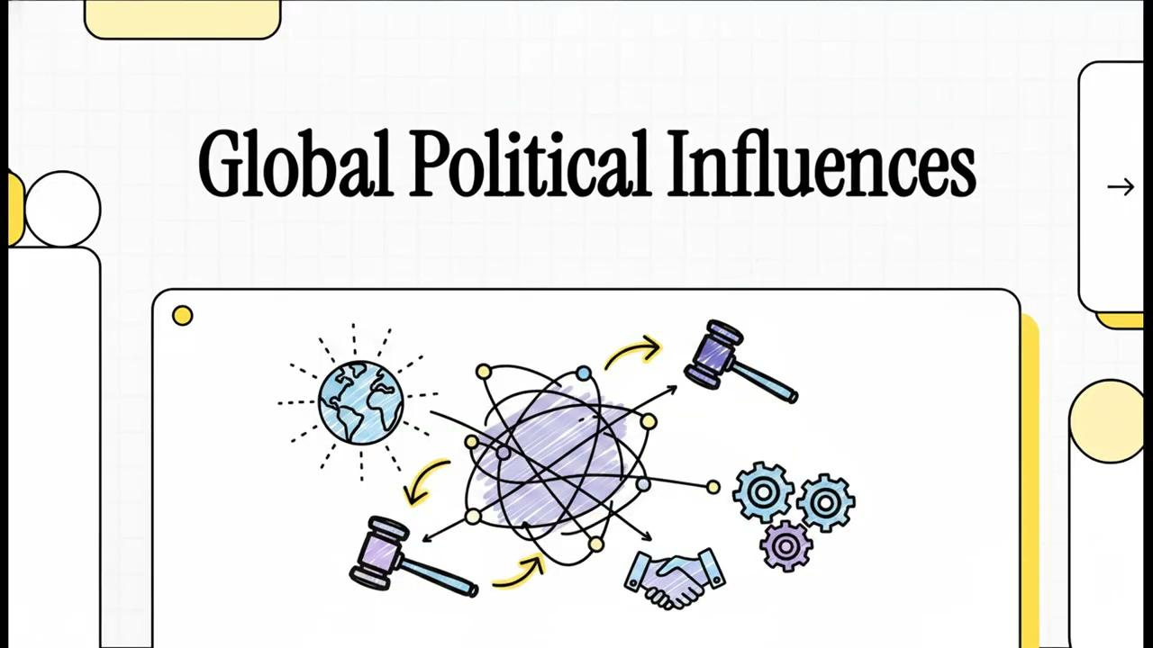

Slide 6
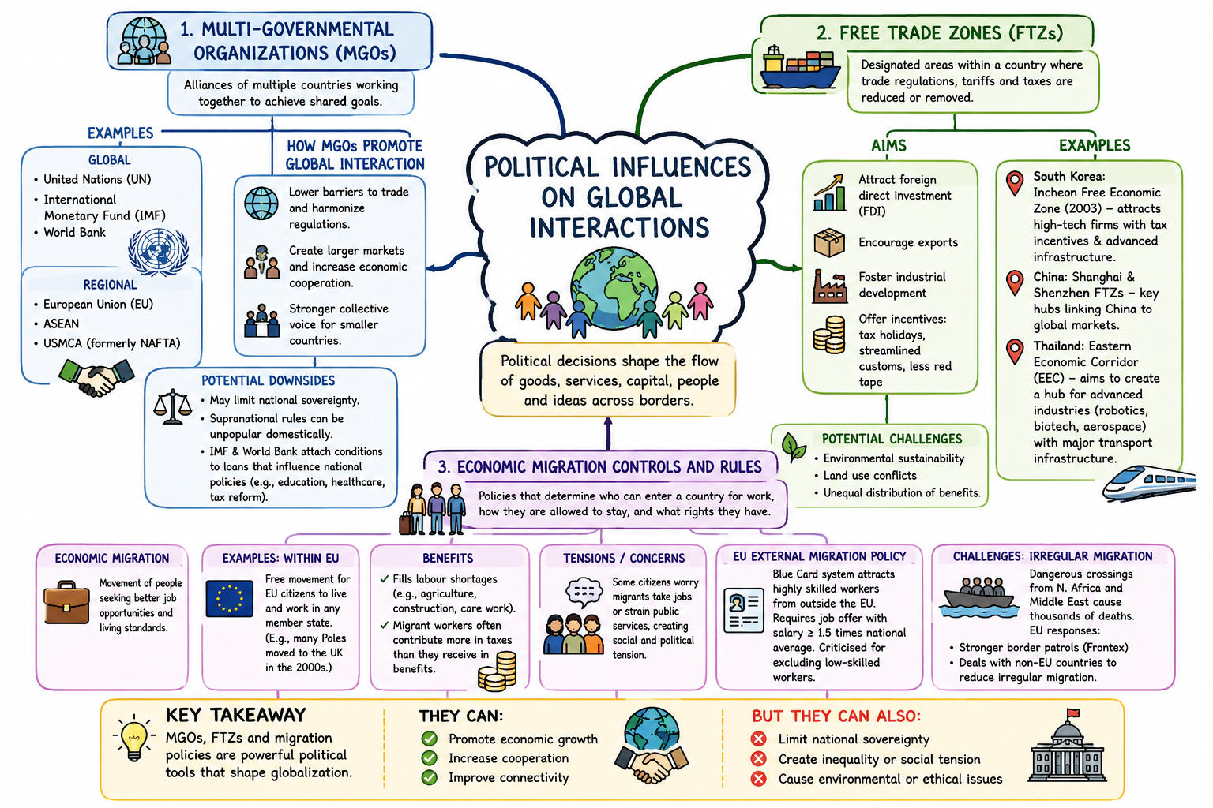

Slide 7
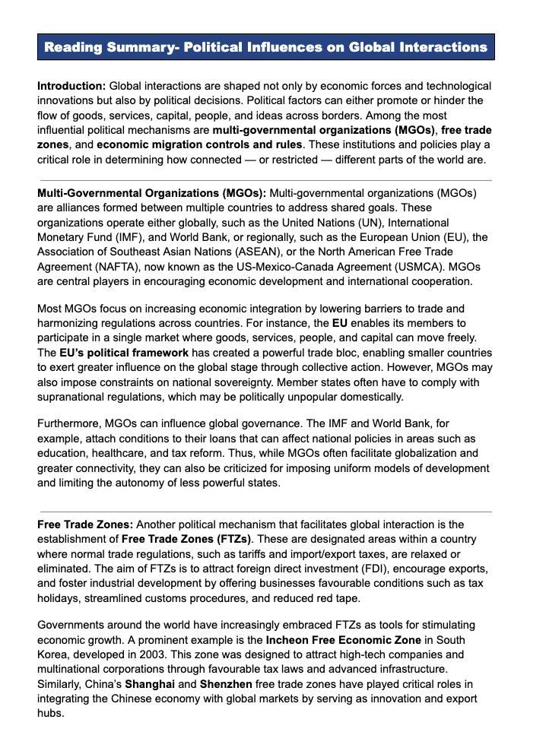
Reading Activity
Read the summary of political influences on global interactions and:
Take notes or add additional points to your mind map
Complete the activities on Google Classroom
Then use the slides to add to your understanding (the videos may help)

Slide 8
What are MGOs?
Multi governmental organizations are those that operate across a number of different states. Some are International, such as the World Bank, the IMF and the UN, whereas others regional such as the North American Free Trade Agreement or the European Union.
Most MGOs focus on economic matters in the attempt to increase trade and interactions, although there maybe some protectionism from external states

Slide 9
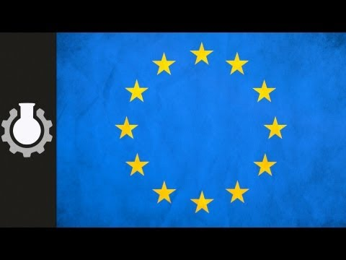
What is the EU?

Slide 10
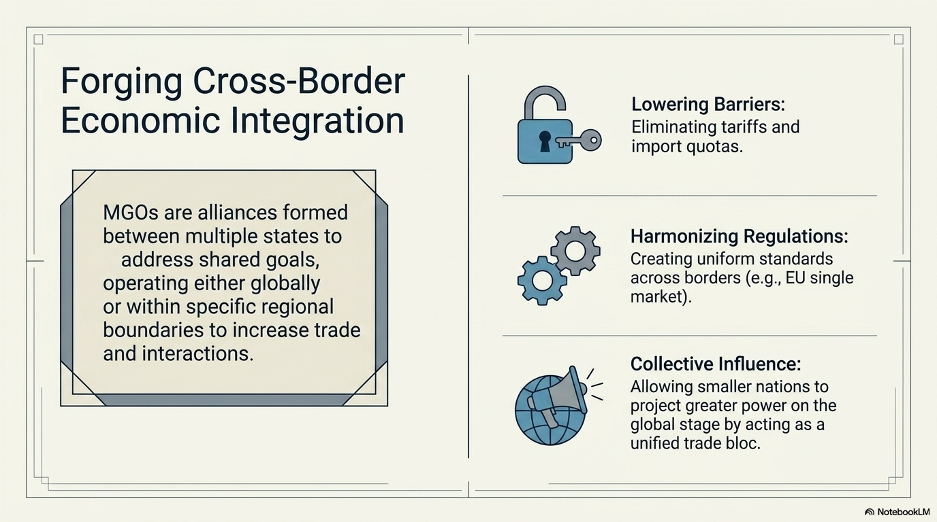

Slide 11
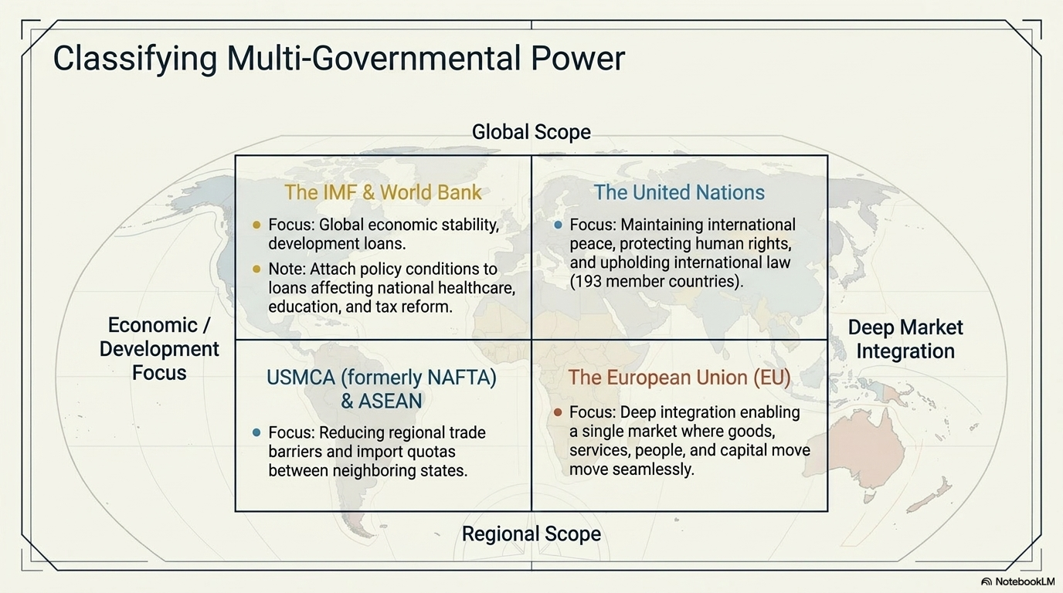

Slide 12
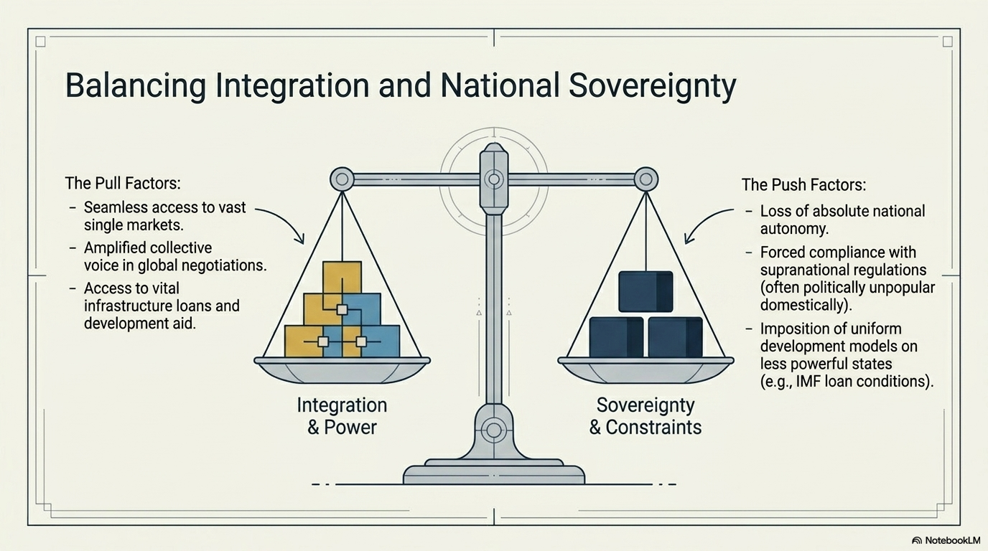

Slide 13
Free Trade Areas
A free-trade area is the region encompassing a trade bloc whose member countries have signed a free trade agreement.
Such agreements involve cooperation between at least two countries to reduce trade barriers, import quotas and tariffs, and to increase trade of goods and services with each other.

Slide 14
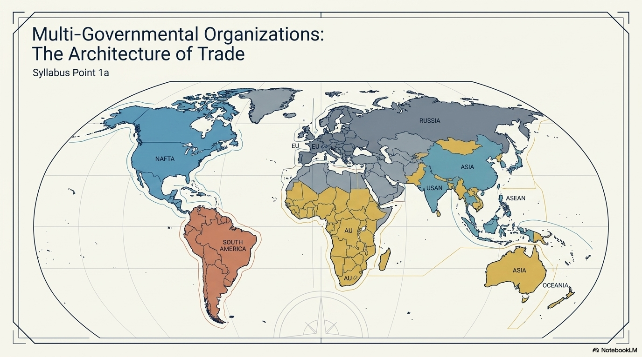

Slide 15
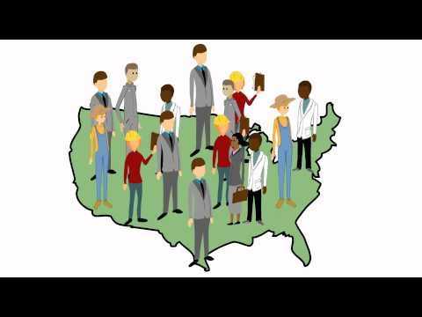

Slide 16
Free Trade Zones
Free trade zones, or free/special economic zones, are geographic areas that have different laws to the rest of the country.
FTZs aim to facilitate trade, attract business and generate economic growth through the removal of taxes and tarrifs, the establishment of streamlined customs procedures and reduced regulation.

Slide 17
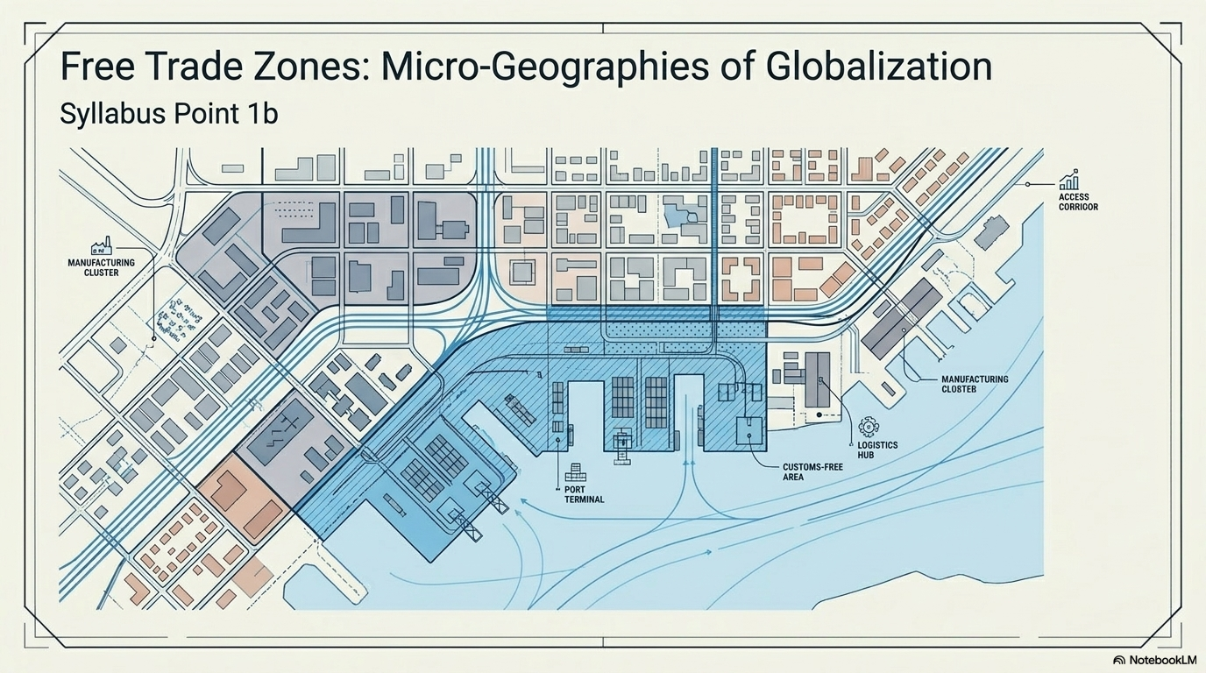

Slide 18
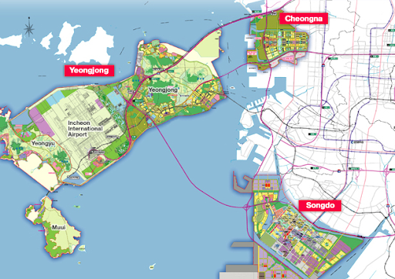
Free Trade Zones
FEZs facilitate global flows in goods and contribute to hubs of innovation by attracting companies to locate together. The government of South Korea agreed on an ambitious plan to develop the Incheon FEZ in 2003.

Slide 19
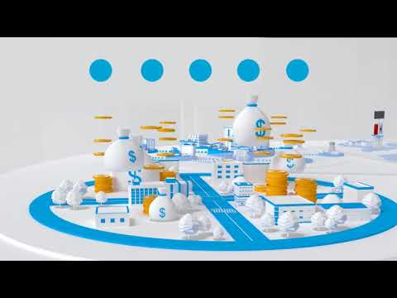

Slide 20
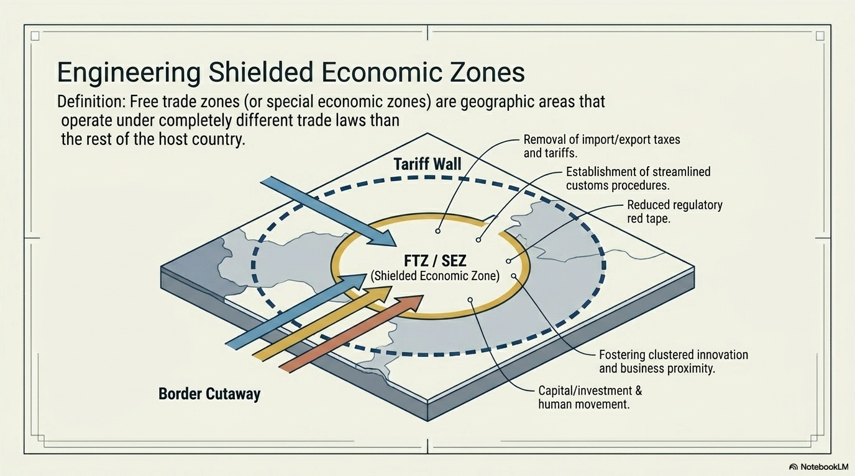

Slide 21
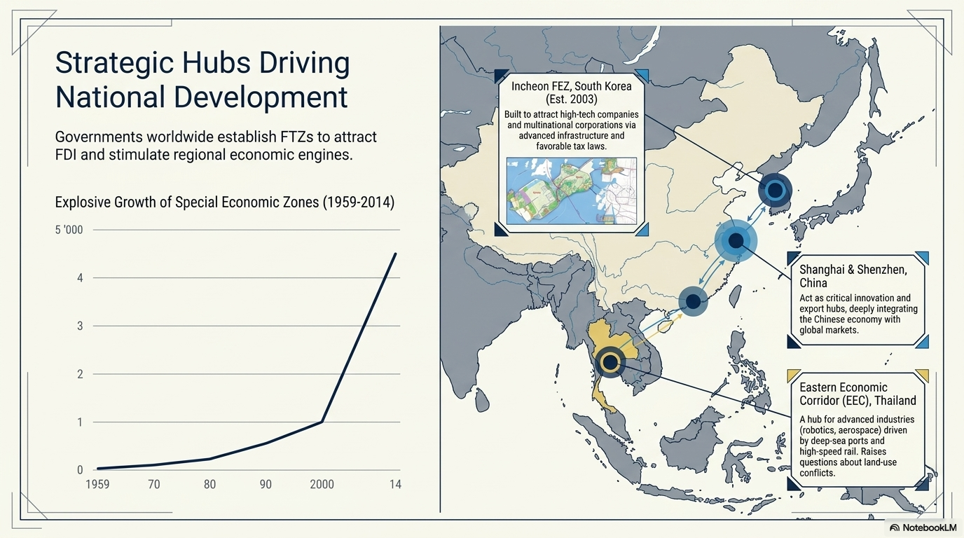

Slide 22
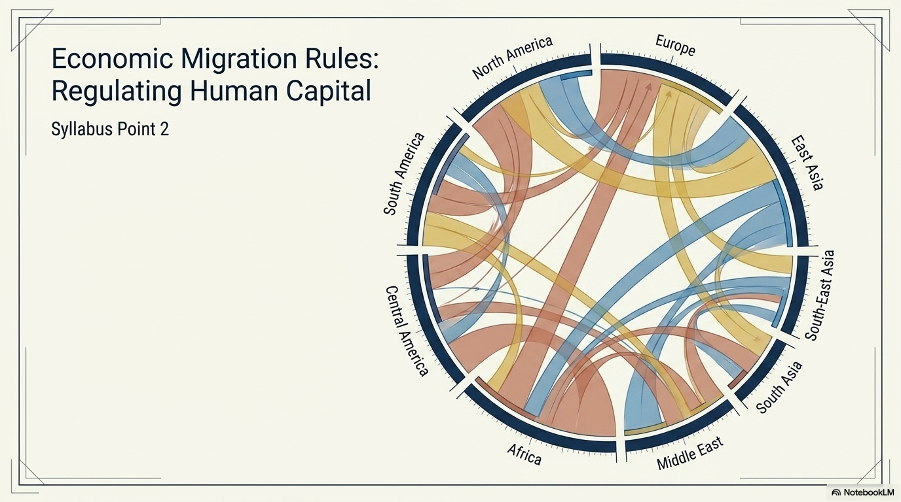

Slide 23
Economic Migration
What is it?
An economic migrant is someone who emigrates from one region to another, including crossing international borders, seeking an improved standard of living, because the conditions or job opportunities in the migrant's own region are insufficient.
The United Nations uses the term migrant worker.

Slide 24
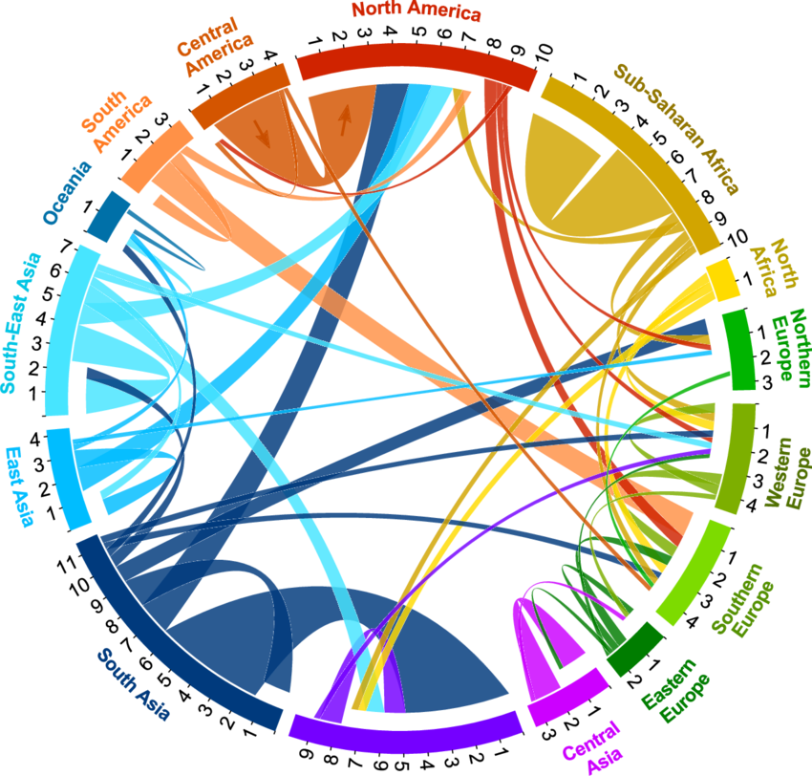
Economic Migration

Slide 25
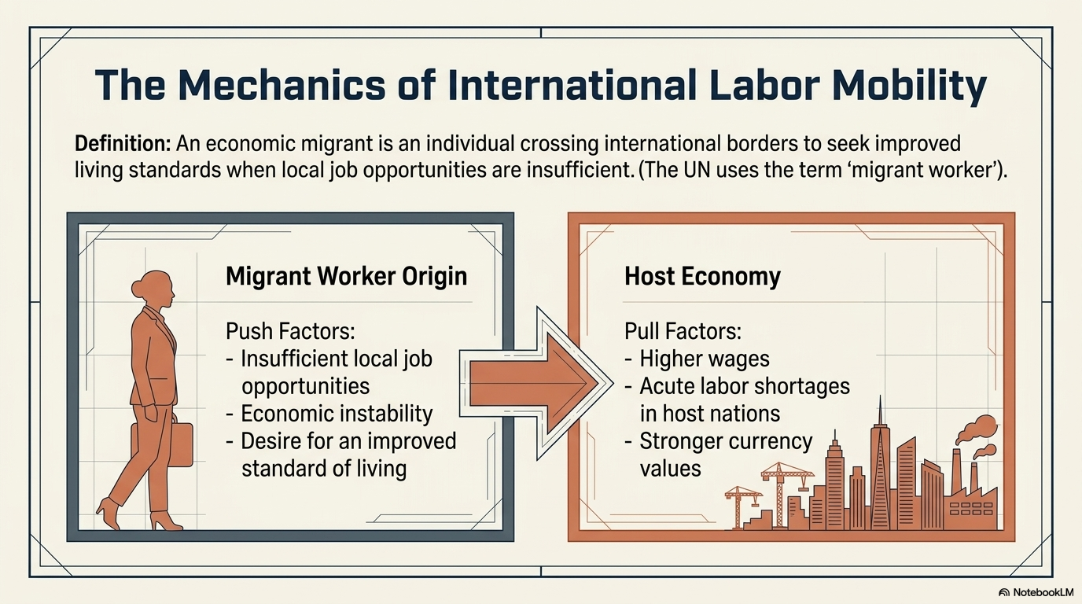

Slide 26
Economic Migration Rules
Economic migration controls and rules are the laws, policies, and regulations governments use to manage the movement of people entering a country for work or economic opportunities.
These controls may include:
Visas & Work permits
Quotas & Points-based immigration systems
Border checks
Restrictions on certain jobs or industries

Slide 27
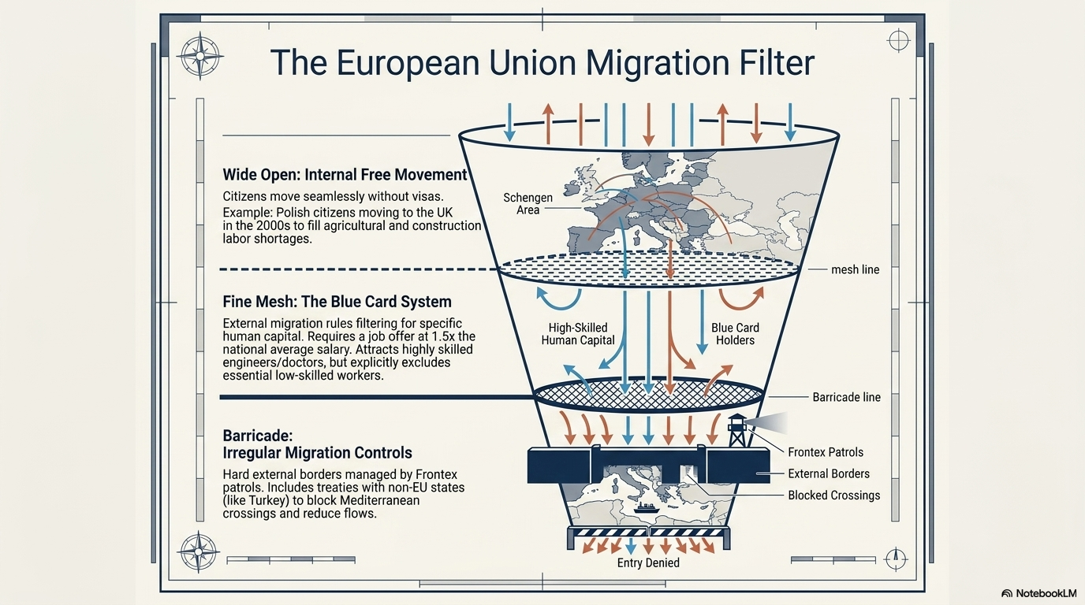

Slide 28
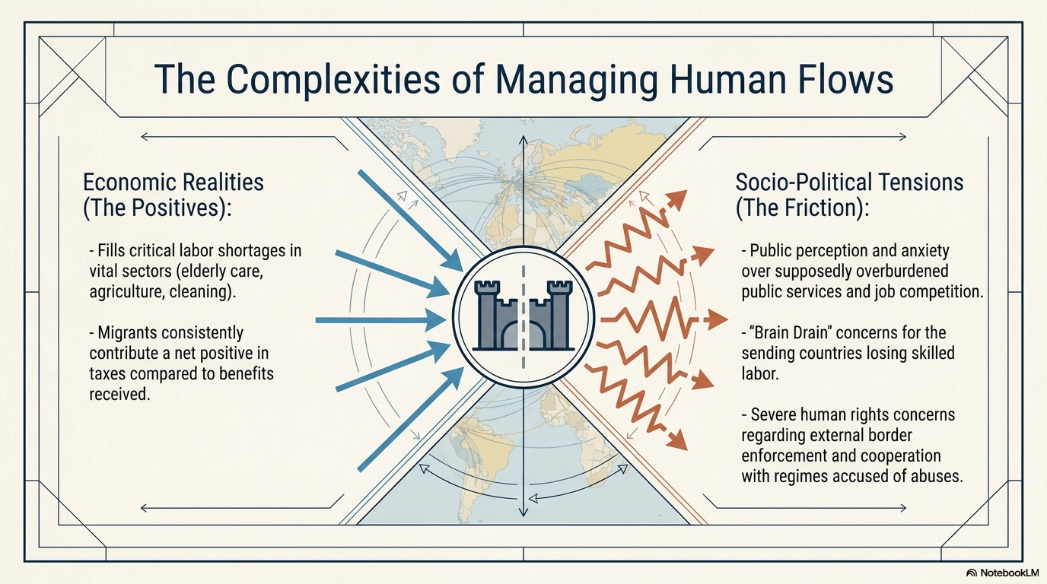

Slide 29
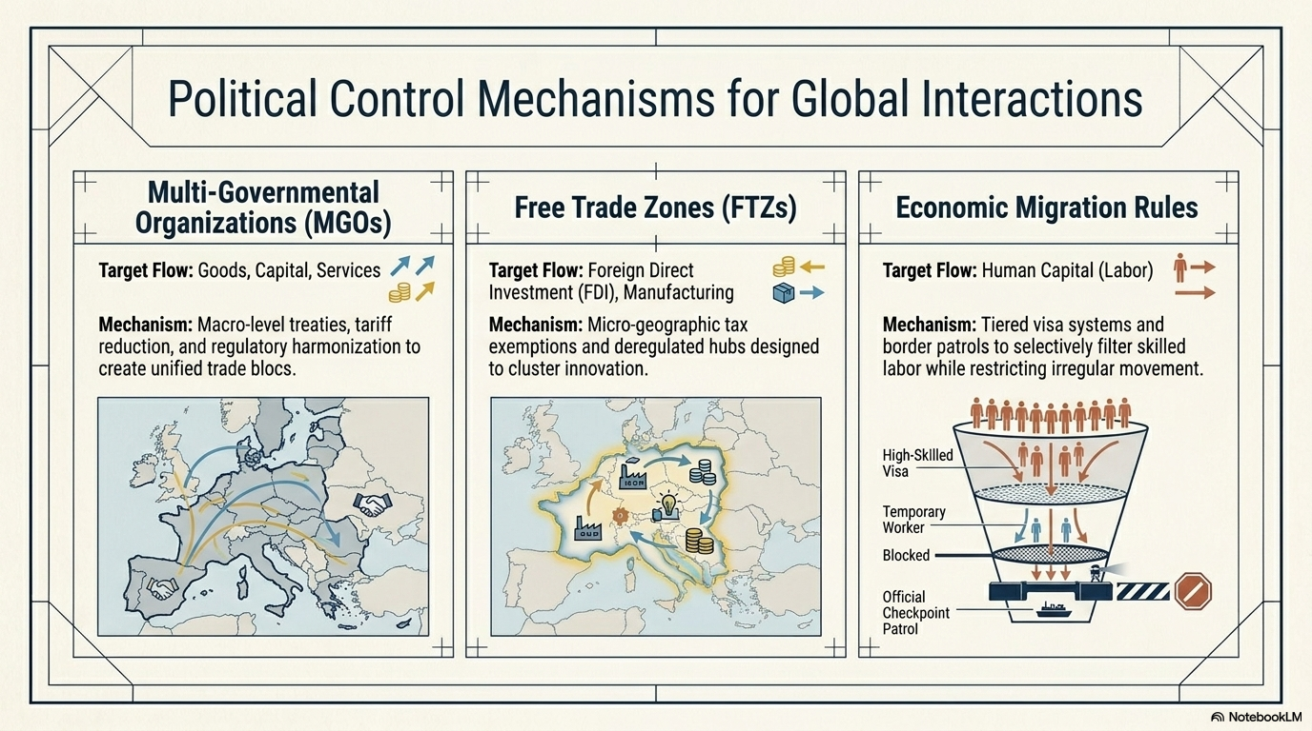

Slide 30
